Slide 1



Overview of Echo State Networks using Different Reservoirs and Activation Functions
Dan - Andrei MARGIN
Virgil DOBROTA
andrei.margin@gmail.ro
Virgil.Dobrota@com.utcluj.ro

Slide 2
Agenda
Introduction
Reservoir Computing and Echo State Networks
  Predictive Analysis
  Recurrent Neural Networks
  Echo State Networks
Echo State Networks configurations
  Reservoirs networks
  Readout models
Experimental Results
Conclusions and Future Work
11/4/2021
2021 RoEduNet Conference: Networking in Education and Research
2
Notes:
This is the agenda of this presentation.
First a short Introduction. Then Reservoir Computing principles are presented.
We will continue with the configurations used for network traffic predictions will be presented.
In the end, the experimental results and conclusions.

Slide 3

Introduction
Data are the most valuable resources of nowadays businesses
How do we manage all this data?
  Data Analysis
    Security
    Quality of Experience (QoE)
  Network Traffic Prediction
    Neural Networks
    Machine Learning
    Statistical algorithm
    Data mining
11/4/2021
2021 RoEduNet Conference: Networking in Education and Research
3
Notes:
Data are the most valuable resource of nowadays. This is the premise from which we start. Thinking about this, we need to put the next question:
How do we manage all this data?
There are 2 aspects that I want to emphasis here, one is Data Analysis and the other one is Traffic Prediction.
Data analysis is the process of cleaning and modeling data in such way to get useful information from it. Further, it can be used to improve:
1. Network security
2. User`s Quality of Experience
According to [1], Traffic Prediction is a form of advanced data analytics which can be used to forecast events based on historical data. Most used techniques are:
1. Neural Networks
2. Machine Learning
3. Statistical algorithms
4. Data mining
The present paper focuses on network traffic prediction concept, using neural networks architectures.

Slide 4
Introduction
Motivation:
  Online and offline network traffic prediction
  Security actions
  QoS and QoE
Notes:
Why do we need Traffic prediction?
The motivation of this paper is that we can use network traffic prediction algorithms for:
security actions (mitigation)
adjusting network parameters to maintain user expectances

Slide 5
Introduction
Solution:
  Echo State Networks
  Traffic prediction algorithm
  One dimension temporal data vector
  Low RMSE
  Low training and prediction time
  References: CNN, SARIMA, LSTM
Notes:
The solution for the problems presented previously are based on the following concepts:
ESN as neural network architecture.
Starting from here, a traffic prediction algorithm can be used to predict temporal data. Different configurations will be tested, having in mind 2 goals:
1. Maintain RMSE as low as possible
2. Decrease the training and prediction time values.
The results are compared with traditional prediction models: CNN, SARIMA and LSTM

Slide 6
Reservoir Computing
Type of Recurrent Neural Networks (RNN)
IBM definition = “RNNs are a type of artificial neural networks which use sequential data or time series data”
RNN vs FFNN
Notes:
Reservoir Computing is a type of RNN, which according to IBM are “ An artificial neural network which use sequential data or time series.
The main difference between RNN and FFNN is that the classical FFNN network has independent input and output values, while in RNN the output at a certain step is dependent on the previous values. In this way, RNN networks are also called “networks with memory”

Slide 7

Reservoir Computing
Neural networks characteristics:
  Input signal
  Internal network
  Readout layer
  Activation function
Notes:
General characteristics of a neural network are the followings:
Input signal
Internal network (or hidden layers)
Readout layer (or output layer)
Activation function
We will insist a little bit more on the activation functions

Slide 8
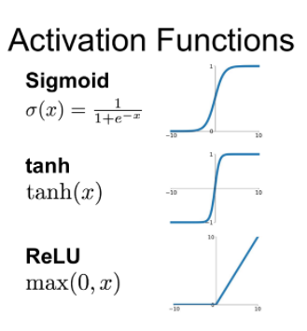
Reservoir Computing
Notes:
Within a neural network, the activation functions will determine whether a neuron should be active or not at a certain state of the process.
In this paper, three different activation functions were considered while trying to improve the performances of the system:
Sigmoid
Hyperbolic tangent
Rectified Linear Unit (ReLU)

Slide 9
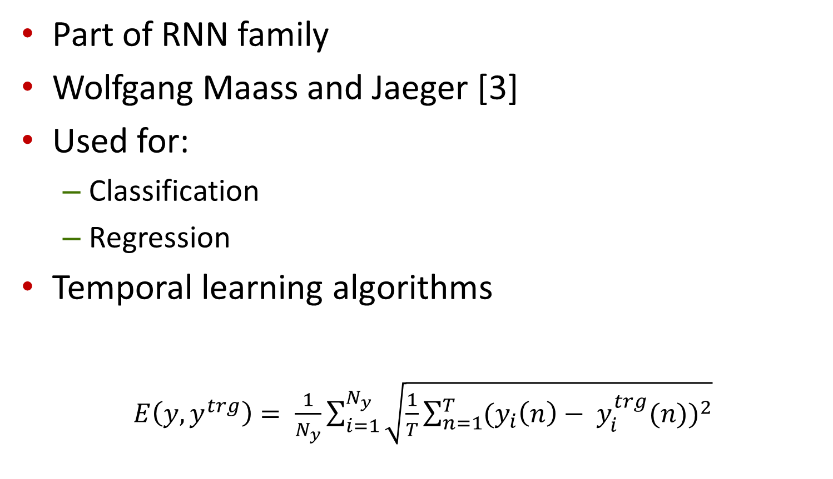
Echo State Networks (ESN)
Part of RNN family
Wolfgang Maass and Jaeger [3]
Used for:
  Classification
  Regression
Temporal learning algorithms
$E\left(y,y^{trg}\right)= \frac{1}{N_{y}}\sum_{i=1}^{N_{y}}{\sqrt{\frac{1}{T}\sum_{n=1}^{T}{{(y_{i}\left(n\right)− y_{i}^{trg}(n))}^{2}}}}$
Notes:
Echo State Networks (ESN) are part of RNN family, being the first Reservoir Computing approaches mentioned in research papers.
Firstly, it is mentioned in Maass and Jaeger`s paper, back in 2001 (cred?)
It is used both for classification and regression, and most likely used for temporal learning algorithms.
In a simplified way, the main task of an ESN is to generate an output signal y(t) based on previous learning, which match as close as possible the target signal y_trg(t).
Here, we have the RMSE equation of ESN, where :
Y(y) is the predicted signal
y_trg(t) is the target signal,
T is the number of samples
Ny is the vector dimension

Slide 10

Echo State Networks (ESN)
Neuron activation:
$\tilde{x}\left(n\right)=f\left(W^{in}\left[1;u\left(n\right)\right]+Wx\left(n−1\right)\right)$
$$x\left(n\right)=\left(1−α\right)x\left(n−1\right)+α\tilde{x}(n)$$
$$y\left(n\right)= W^{out}[1;u\left(n\right);x\left(n\right)]$$
Notes:
These are the equations used to determine the state of a neuron at a certain moment.
$\tilde{x}\left(n\right)$ represents the update, or the state at certain step
x(n) the result of the network activation function at a certain step and
Y(n) is the value of the output signal at step n.
We have input weight matrix (W_in) and output weight matrix (W_out), while alpha is the leaking rate ( a = (0,1] )

Slide 11
Echo State Networks
Notes:
This is a general ESN architecture, where multiple components can be identified:
Input signal and input weights
Reservoir and internal weights
Readout and output weights
Output Signal
Target Signal
Just to mention that the feedback only adjusts output weights, while the reservoir remains constant within the process.
From this, we can conclude that this is an advantage of Reservoir Computing networks, because re-initialization time is lower, internal weights being generated only once at startup

Slide 12
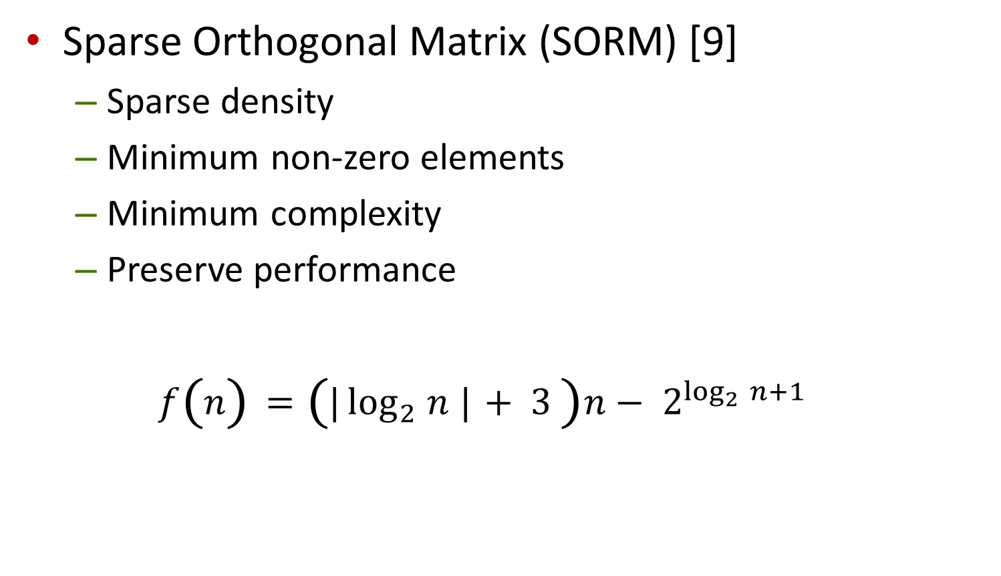
ESN – Reservoir networks
Sparse Orthogonal Matrix (SORM) [9]
  Sparse density
  Minimum non-zero elements
  Minimum complexity
  Preserve performance
  $$f\left(n\right)=\left(|\log_{2}{n}{|}+ 3 \right)n− 2^{\log_{2}{n}+1}$$
Notes:
As a recall from the previous figure, ESN is mainly composed by 2 parts: the reservoir and the readouts. In the following few slides, we will talk about reservoirs and how did we used it within the experiments.
First one is based on SORM model. This model represents a square matrix, where each elements determines the state of an neuron at a given moment.
The key parameter here is the matrix sparsity, which gives us the minimum number of non-zero elements, such that the matrix remains orthogonal. According to [9], this number can be deduced using this formula.

Slide 13
Sparse Orthogonal Matrix
Notes:
Here we have de UML diagram of SORM generation process. First, we define the desired Sparsity threshold, as a float number between (0,1], representing the percentage of non-zero elements
Then, a random orthogonal matrix is generated. After computing its sparsity, we compare this value with our defined threshold.
If the values is greater or equal, the matrix is validated, otherwise the process continues.

Slide 14

ESN – Reservoir networks
Delay Line Reservoir (DLR) [10]
  $\left(\begin{aligned}\begin{aligned}w_{00} \\ w_{10}\end{aligned}\begin{aligned}w_{01} \\ w_{11}\end{aligned}\begin{aligned}w_{02} \\ w_{12}\end{aligned}\begin{aligned}w_{03} \\ w_{13}\end{aligned} \\ \begin{aligned}w_{20} \\ w_{30}\end{aligned}\begin{aligned}w_{21} \\ w_{31}\end{aligned}\begin{aligned}w_{22} \\ w_{32}\end{aligned}\begin{aligned}w_{23} \\ w_{33}\end{aligned}\end{aligned}\right)$
Notes:
The second reservoir used is the Delay Line Reservoir.
This one is composed by linear units, as it can be seen from the figure in the left. The main property of this architecture is that its internal matrix has non-zero elements only on the lower sub-diagonal.
We can see here in the right which is the lower sub-diagonal of a square matrix.
In this simple example, we have a 4x4 square matrix. With red, it is the diagonal, and with green we have the lower sub-diagonal elements.

Slide 15
ESN – Reservoir networks
Extended Reservoir (ER)
  Classical network
  Random matrix
Notes:
Extended Reservoir is the last reservoir type used within this paper, and represents the classical reservoir network, where the matrix is randomly generated without any extra conditions

Slide 16
ESN – Readout models
Ridge Regression [11]
  Linear vector
  Multi-collinearity
  Input bias
Notes:
Ridge Regression model represent one of the output models tested. It is represented by a vector of weights applied on the output of the reservoir.
It uses an input bias to deal with possible multi-collinearity problems
[For answers]
What is multi-collinearity? => Existence of linear relationships among independent variables, which can lead to higher standard errors and in our case, decreasing the predictability capabilities of the model

Slide 17

ESN – Readout models
Bayes Regression (BR)
  Bayes rule
  Avoid insufficient data problem
    $$P\left(Y | X\right)= \frac{P(X|Y)P(Y)}{P(X)}$$
Notes:
The second readout model proposed is Bayes Regression model.
The advantage of this one against the classical Ridge Regression model is that it solves the insufficient data problem, by defining priori weights using Bayes rule

Slide 18
Experiments and Results
Public dataset
  Bitrate and packet rate timeseries
Criteria
  Root Mean Square (RMSE)
  Training time
  Prediction time
Notes:
Now, I want to present you the experiments and then to compare the results.
As input data, a public dataset was used, consisting of bitrate and packet rate timeseries values.
There will be two different scenarios tested : short-time prediction (meaning a few seconds ahead), and long-term prediction (a few minutes ahead)
The criteria used to compare the results of each configuration is based on :
RMSE
Training time
Prediction time

Slide 19
Experiments and Results
Configuration model
  Number of input layer neurons: [5,50]
  Number of output layers: 1
  Reservoir network size: [50, 1000]
  Spectral radius: [0.1, 0.9]
  Activation function: Sigmoid, ReLU, tanh
  Reservoir density: [0.1, 0.9] – used for SORM
Notes:
Each ESN architecture evaluated is defined as a multi-parameter configuration. One configuration is composed by:
Number of input layer neurons [5,50]
Number of output layers: 1
Reservoir network size [50,1000]
Spectral radius: [0.1, 0.9]
Activation function: Sigmoid, ReLU, tanh
Reservoir density: [0.1, 0.9] – used for SORM

Slide 20
Experiments and Results
Machine configuration:
  Windows 10 Pro
  Intel® Core™ i7-4710HQ CPU, 2.50GHz
  12 GB RAM
  Python 3.7.5
Relative values to be considered
Notes:
Before discussing the experiments and the results, I want to mention that, because we are going to present prediction results, where some timestamps are included, we need to specify the machine configuration that was used. The following hardware configuration was used:
Windows 10 Pro, ….
Because absolute values of some of the results can be influenced by hardware capacity, the differences between them are to be considered. The final goal is to determine which ESN configuration performs better with respect to the others

Slide 21
Experiments and Results
Network Configuration/Results | Long term
 | Data rate prediction |  |  | Packet rate prediction
 | Training time [s] | Prediction time [s] | RMSE | Training time [s] | Prediction time [s] | RMSE
LSTM | 168.4 | 3.041 | 245.100 | 199.42 | 5.233 | 257.400
CNN | 23.05 | 1.553 | 165.800 | 30.091 | 2.012 | 172.120
SARIMA | 4.112 | 0.821 | 160.100 | 5.2220 | 1.140 | 150.200
ESN-LEAKY | 0.095 | 0.064 | 128.050 | 0.1690 | 0.033 | 127.100
ESN-Sparse_Ridge | 0.108 | 0.023 | 126.900 | 0.0770 | 0.024 | 127.421
ESN-Delay_Ridge | 5.585 | 0.115 | 125.624 | 7.9060 | 0.111 | 124.182
ESN-Delay_Line | 0.190 | 0.046 | 131.921 | 0.0730 | 0.013 | 139.547
ESN-Delay_Bayes | 6.814 | 0.126 | 130.214 | 2.6450 | 0.062 | 125.173
ESN-Ext_Bayes | 0.024 | 0.203 | 122.131 | 0.8810 | 0.054 | 123.149
ESN-SORM_Ridge_Density | 0.405 | 0.031 | 123.264 | 0.3500 | 0.032 | 122.434
Notes:
Ok, first results presented are related to Long Term Prediction. There are 6 different configurations tested, ones highlighted in blue. We need to mention that all 6 configurations performed better in terms of RMSE, training and prediction time, compared with classical ESN and other popular prediction models (LSTM, CNN, SARIMA).
Regarding Data rate prediction, Extended Reservoir with Ridge Regression readout performed better.
On the other hand, SORM network was better in case of packet rate prediction.
We will see each configuration and the results on the next slide.

Slide 22
Experiments and Results
ESN-Ext_Bayes (long term data rate prediction):
  Input layer size: 15
  Matrix size: 50 x 50
  Activation function: Sigmoid
  Spectral Radius: 0.6
Notes:
The configuration that performed the best for long term prediction data rate has the following configuration:
Input layer size: 15
Matrix size: 50 x 50
Spectral radius: 0.6
Activation function: Sigmoid
In the output graphic, the red signal is the predicted one, and follows very close the original signal

Slide 23
Experiments and Results
ESN-SORM_Ridge_Density (long term packet rate prediction):
  Input layer size: 5
  Matrix size: 200 x 200
  Spectral Radius: 0.7
  Sparsity: 80%
Notes:
The configuration that performed the best for long term prediction packet rate has the following configuration:
Input layer size: 5
Matrix size: 200 x 200
Spectral radius: 0.7
Sparsity: 80%
In the output graphic, the red signal is the predicted one and the likeliness with the original signal can be seen.

Slide 24
Experiments and Results
Network Configuration/Results | Short term
 | Data rate prediction |  |  | Packet rate prediction
 | Training time [s] | Prediction time [s] | RMSE | Training time [s] | Prediction time [s] | RMSE
LSTM | 3.101 | 0.105 | 13.80 | 22.21 | 1.120 | 154.200
CNN | 1.652 | 0.074 | 11.92 | 5.100 | 0.450 | 162.023
SARIMA | 0.820 | 0.022 | 5.512 | 0.312 | 0.194 | 106.200
ESN-LEAKY | 0.012 | 0.004 | 9.560 | 0.031 | 0.019 | 113.900
ESN-Sparse_Ridge | 0.016 | 0.005 | 9.238 | 0.011 | 0.002 | 126.261
ESN-Delay_Ridge | 0.020 | 0.003 | 9.362 | 0.161 | 0.004 | 112.636
ESN-Delay_Line | 0.011 | 0.002 | 9.357 | 0.016 | 0.003 | 122.091
ESN-Delay_Bayes | 0.396 | 0.005 | 8.768 | 0.471 | 0.008 | 111.358
ESN-Ext_Bayes | 0.203 | 0.006 | 8.477 | 0.098 | 0.004 | 103.715
ESN-SORM_Ridge_Density | 0.059 | 0.002 | 8.553 | 0.001 | 0.036 | 105.718
Notes:
In terms of short term prediction, the same two models performed the best.
For data rate prediction, Extended Reservoir performed better, while at packet rate, the results are similar in terms of RMSE (103 vs 105).
As an observation here, SORM matrix obtained a much lower training time (0.001 vs 0.098), which makes it the winner here.
As a comparison with classical models, SARIMA has a close RMSE values of 106.2, but training and prediction time values are much higher than SORM

Slide 25
Experiments and Results
ESN-Ext_Bayes (short term data rate prediction):
  Input layer size: 15
  Matrix size: 50 x 50
  Activation function: Sigmoid
  Spectral Radius: 0.5
Notes:
The configuration that performed the best for short term prediction data rate has the following configuration:
Input layer size: 15
Matrix size: 50 x 50
Spectral radius: 0.5
Activation function: Sigmoid
In the output graphic, the red signal is the predicted one, and follows very close the original signal

Slide 26
Experiments and Results
ESN-SORM_Ridge_Density (short term packet rate prediction):
  Input layer size: 5
  Matrix size: 50 x 50
  Spectral Radius: 0.1
  Sparsity: 70%
Notes:
The configuration that performed the best for short term prediction packet rate has the following configuration:
Input layer size: 5
Matrix size: 50 x 50
Spectral radius: 0.1
Sparsity: 70%
In the output graphic, the red signal is the predicted one and the likeliness with the original signal can be seen.

Slide 27
Conclusions on Results
ESN configuration parameter`s weight differ
Sigmoid activation function for RMSE
ReLU for time indicators
Notes:
Now a few remarks related to overall experiments and other results.
All ESN configuration parameters can influence the results, but from the experiments, we can say that activation function has a higher influence, along with sparsity coefficient for SORM model
Regarding activation functions, Sigmoid provided better results in terms of RMSE, while training and prediction time was similar also in case of Hyperbolic tangent one.
The third activation function, ReLU, offer better time indicators in some cases (training time and prediction time), but significantly lower RMSE, and that is why Sigmoid was the winner

Slide 28
Conclusions and Future Work
What was accomplished
  Different ESN configurations
  Prediction capabilities review
  Comparison with classical algorithms
What we want to do next
  Test SORM matrix reservoir ESN on real networks
  Integrate the model with Quantum Computing to speed up training and prediction time
Notes:
What was accomplished?
We tested prediction capabilities for different ESN configurations. Three reservoir models and two readouts were used
The output results were compared with other classical algorithms like CNN, LSTM or SARIMA, in terms of RMSE, training and prediction time.
What we want to do next?
The next goal here is to test the SORM matrix reservoir using real data from a network
And then, to try and integrate the model with QC, to speed up the training and the prediction time
[For answers]
Why QC => because it is good for high order computing equations => in this case, all matrix calculus can be done on quantum computers to speed up the initialization and re-configuration of weights

Slide 29
References
Prediction Analysis Steps, [Online], Available: https://www.proschoolonline.com/blog/predictive-analytics-meaning-important-algorithms-learn
IBM Cloud Education, “Recurrent Neural Networks”, 2020, [Online], Available: https://www.ibm.com/cloud/learn/recurrent-neural-networks
H. Jaeger, “Echo State Network”, Scholarpedia, 2007, doi: 10.4249/scholarpedia.2330
M. Lukoševičius, “A Practical Guide to Applying Echo State Networks”, Neural Networks: Tricks of the Trade. Lecture Notes in Computer Science, vol 7700. Springer, Berlin, Heidelberg, 2012, doi: 10.1007/978-3-642-35289-8_36
W. Ponghiran, G. Srinivasan, K. Roy, “Reinforcement Learning With Low-Complexity Liquid State Machines”, Front. Neurosci. 13:883, 2019, doi: 10.3389/fnins.2019.00883
O. A. Adeleke, “Echo-State Networks for Network Traffic Prediction”, Annual Information Technology, Electronics and Mobile Communication Conference, 2019, doi: 10.1109/IEMCON.2019.8936255
2021 RoEduNet Conference: Networking in Education and Research

Slide 30
References
K. Bush. C. Anderson, "Modeling reward functions for incomplete state representations via echo state networks," Proceedings. 2005 IEEE International Joint Conference on Neural Networks, 2005, pp. 2995-3000 vol. 5, doi: 10.1109/IJCNN.2005.1556402.
J. Schneider, “Bayesian Locally Weighted Regression” [Online], Available: https://www.cs.cmu.edu/~schneide/tut5/node37.html
S. Tobias, W. Welf, L. Roger, “Design Strategies for Weight Matrices of Echo State Networks. Neural computation”, 2012, doi: 10.1162/NECO_a_00374
R. Ali, T.Peter, “Minimum complexity echo state network.”, 2010, doi: 10.1109/TNN.2010.2089641.
NCSS, "Ridge Regression", [Online], Available: https://ncss-wpengine.netdna-ssl.com/wp-content/themes/ncss/pdf/Procedures/NCSS/Ridge_Regression.pdf
2021 RoEduNet Conference: Networking in Education and Research

