Slide 1
viztop - Intuitive Visualization of Remote Real-Time Monitoring of Linux Processes
Zoran Constantinescu, Monica Vladoiu
UPG University of Ploiesti

Slide 2
vizualization
is important in instruction and education;
CS education, in particular, can benefit incredibly for incorporating visualization tools in day to day teaching and learning;
  algorithm animations, theoretical CS, security, key concepts in learning programming, computer archit. & organization.

Slide 3
viztop
allows intuitive visualization of remote monitoring of the dynamic of processes in a running Linux OS, in real-time;
using a graph of interconnected nodes (both processes and threads);
visual cues represent different info;
strong correlation <the visual elements – processes’ characteristics>.

Slide 4
viztop - architecture

Slide 5
viztop - backend
information about processes
  scanning the “/proc” filesystem;
  for each process:
    pid, ppid, state, memory, cpu;
    info files, pipes, sockets;
  keeps a list of this information;
  creates a differential update information.

Slide 6
viztop – frontend (GUI)
web based user interface;
single web page application -> Javascript
  gets data and updates from the backend;
  display process information graphically:
    processes, relationships;
    states, memory, cpu;
    files, pipes, sockets.

Slide 7
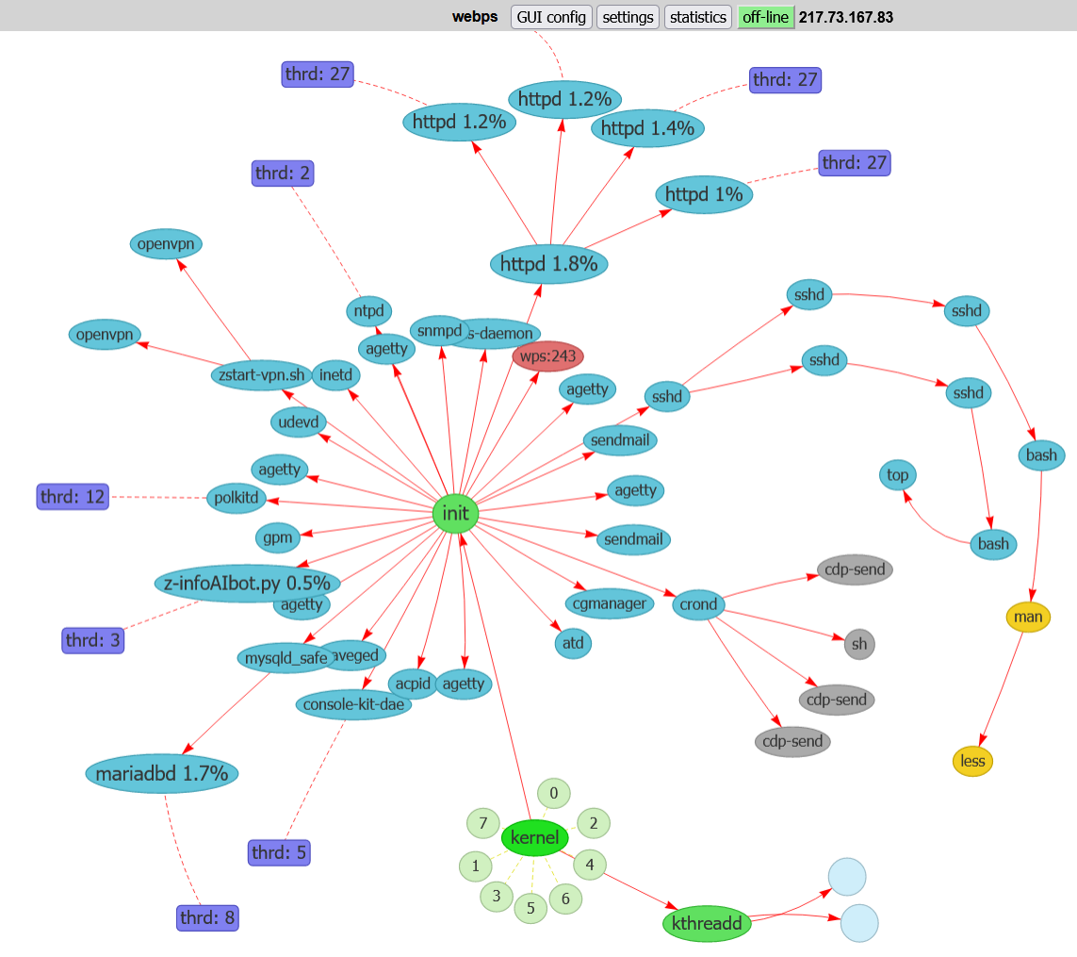
GUI for process visualization

Slide 8
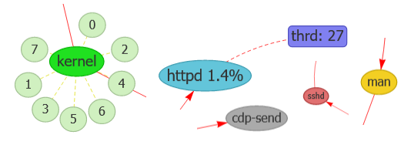
Processes in different states

Slide 9
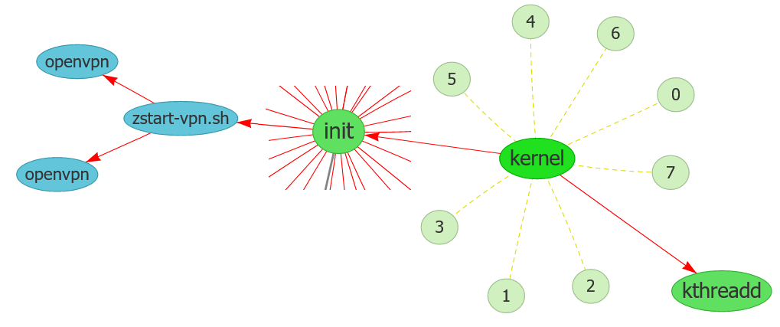
Child and parent processes

Slide 10
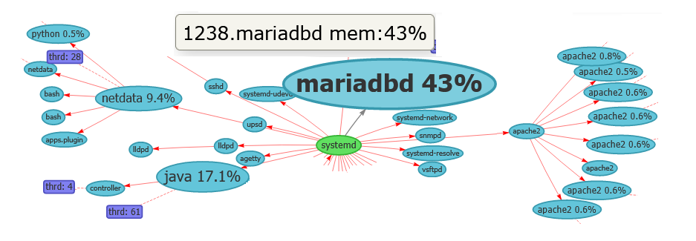
Processes with different memory usage

Slide 11
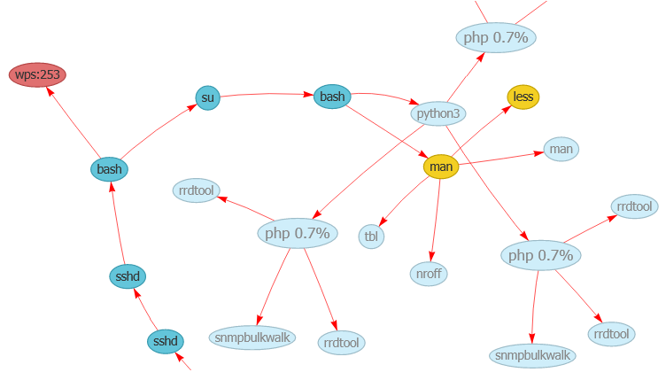
Dependencies between processes

Slide 12
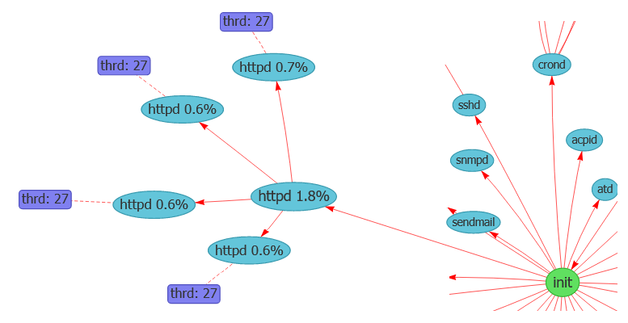
Startup httpd server started by init s

Slide 13
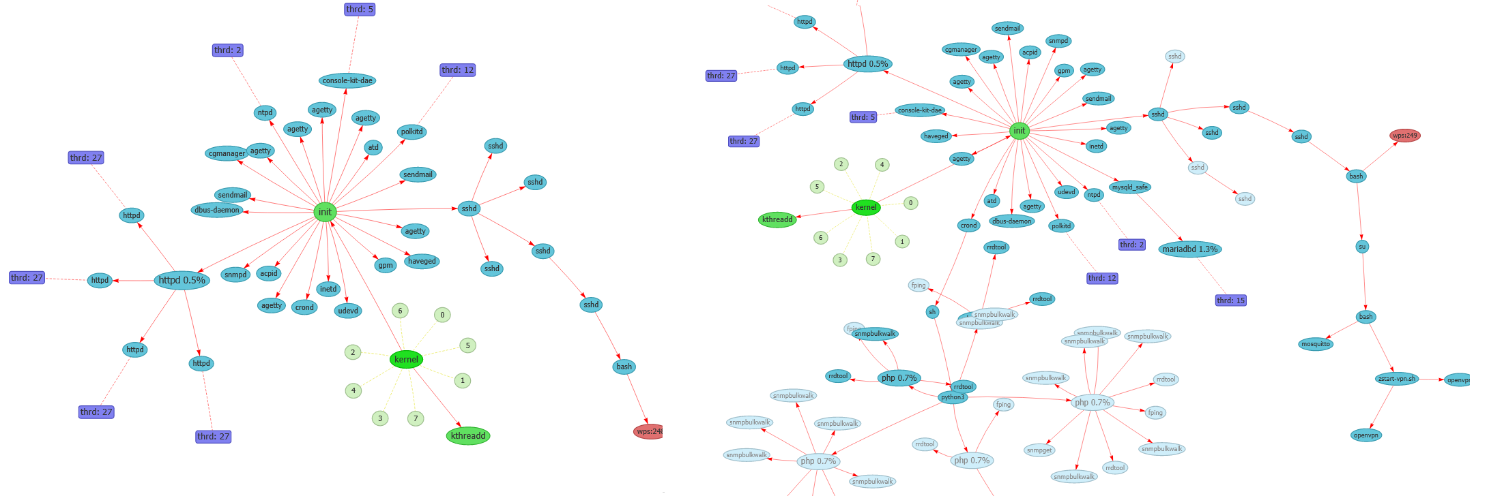
Dynamics of processes, in time

Slide 14
Conclusions
viztop aims at improving the understanding of dynamic of processes in OS;
compared the main tools used for process monitoring; enriched to provide extra potential for both OS education and administration;
FW: use viztop to perform some pedagogical research + further OS visualization counterparts (memory management, resource allocation, file system change)

Slide 15
Thank you! ☺

