Slide 1
Big Data Performance in Private Clouds. Some Initial Findings on Apache Spark Clusters Deployed in OpenStack
Marin FOTACHE (UAIC), Marius Iulian CLUCI (UAIC/HVM)

Slide 2
Main Ideas
Apache Spark is (one of) the most popular Big Data processing platform
Spark can process data in a large variety of formats, from which three most popular are: Avro, Orc and Parquet
Relative to other settings (memory vs disk) and the query complexity, do the source data formats affects the data processing performance in SparkSQL?
Three series of predictive models (based on MARS, Random Forest and XGBoost) for estimating:
  the queries’ execution duration
  the predictors’ importance

Slide 3
Research Design
Assessing the SQL query performance for an Spark-on-Hadoop cluster deployed on OpenStack
Out of 3 x 4 x 2 scenarios, 5527 queries were completed within 1000 seconds timeout
Outcome: log10_duration (since duration is severely skewed)
Predictors:
  Data formats: Apache Avro, Apache Parquet, Apache ORC and the generic file format (labelled as Basic)
  RDD memory settings (MEMORY_ONLY and MEMORY_AND_DISK)
  Database size (5GB, 10GB ang 50GB)
  Query complexity (by the SQL clauses: SELECT, FROM, WHERE, GROUP BY, HAVING, ORDER BY)
Models also estimate the predictor importance in accounting for the outcome variability
The Multivariate Adaptive Regression Splines (MARS) method:
  multivariate and non-parametric flexible recursive partitioning
  an extension of linear models that automatically models non-linearity and interactions between variables
Random Forest: grows trees by split-variable randomization
Extreme Gradient Boosting: iteratively combines "weak" learners to develop a "strong" learner

Slide 4
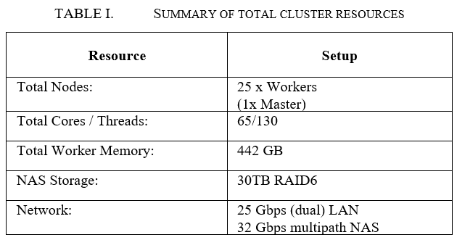
Experimental Setup (1)
OpenStack Wallaby for management and virtualization

Slide 5
Experimental Setup (2)
The virtual machines used an image with
  Ubuntu 18.04
  Apache Spark 3.1.2 with Scala 2.12.10 (sbt included) and OpenJDK 11.0.11,
  Hadoop 3.3.1 paired with OpenJDK 8u292
HDFS replication was set to 14, and the block size to 256MB.
25 instances and a master, each having 6 vcores and 25GB of RAM, out of which only 5 vcores and 17GB of RAM was used by the Spark worker.
The rest of the resources were reserved for the OS specific processes and HDFS.
The Master used the same specifications, also hosting the history server and the HDFS name node but has no Spark worker running or HDFS data node for avoiding bottlenecks.

Slide 6
Tools for Data Analysis / ML (R packages)
Data processing/preparation: the tidyverse ecosystem
Exploratory Data Analysis:
  tidyverse (readr, dplyr, tidyr, ggplot2)
  corrplot
Machine Leaning models building and tuning:
  the tidymodels ecosystem (rsamples, parnsnip, dials, tune, yardstick)
  ranger package for Random Forest models
  xgboost package for Extreme Gradient Boosting Models
Variable importance: package vip

Slide 7
Exploratory Data Analysis (1) – the outcome

Slide 8
Exploratory Data Analysis (2) - predictors

Slide 9
Exploratory Data Analysis (3) - correlations

Slide 10
MARS Models

Slide 11
MARS Models – performance and predictor importance
Generalized R2 of the final MARS model: 0.41
Generalized Cross-Validation R2: 0.43

Slide 12
Machine Learning Models
Algorithms:
  Random Forest (RF) – ranger engine (R)
  Extreme Gradient Boosting (XGB) – xgboost engine (R)
Resampling
  Cross-validation
  5-folds
  Repeated (10 times)
Tuning
  Two hyper-parameters in RF models, six in XGB
  Grid search (grid_max_entropy option) – 150 combinations
  Model selection based on RMSE metric (MAE, CCC, R2 also computed)

Slide 13
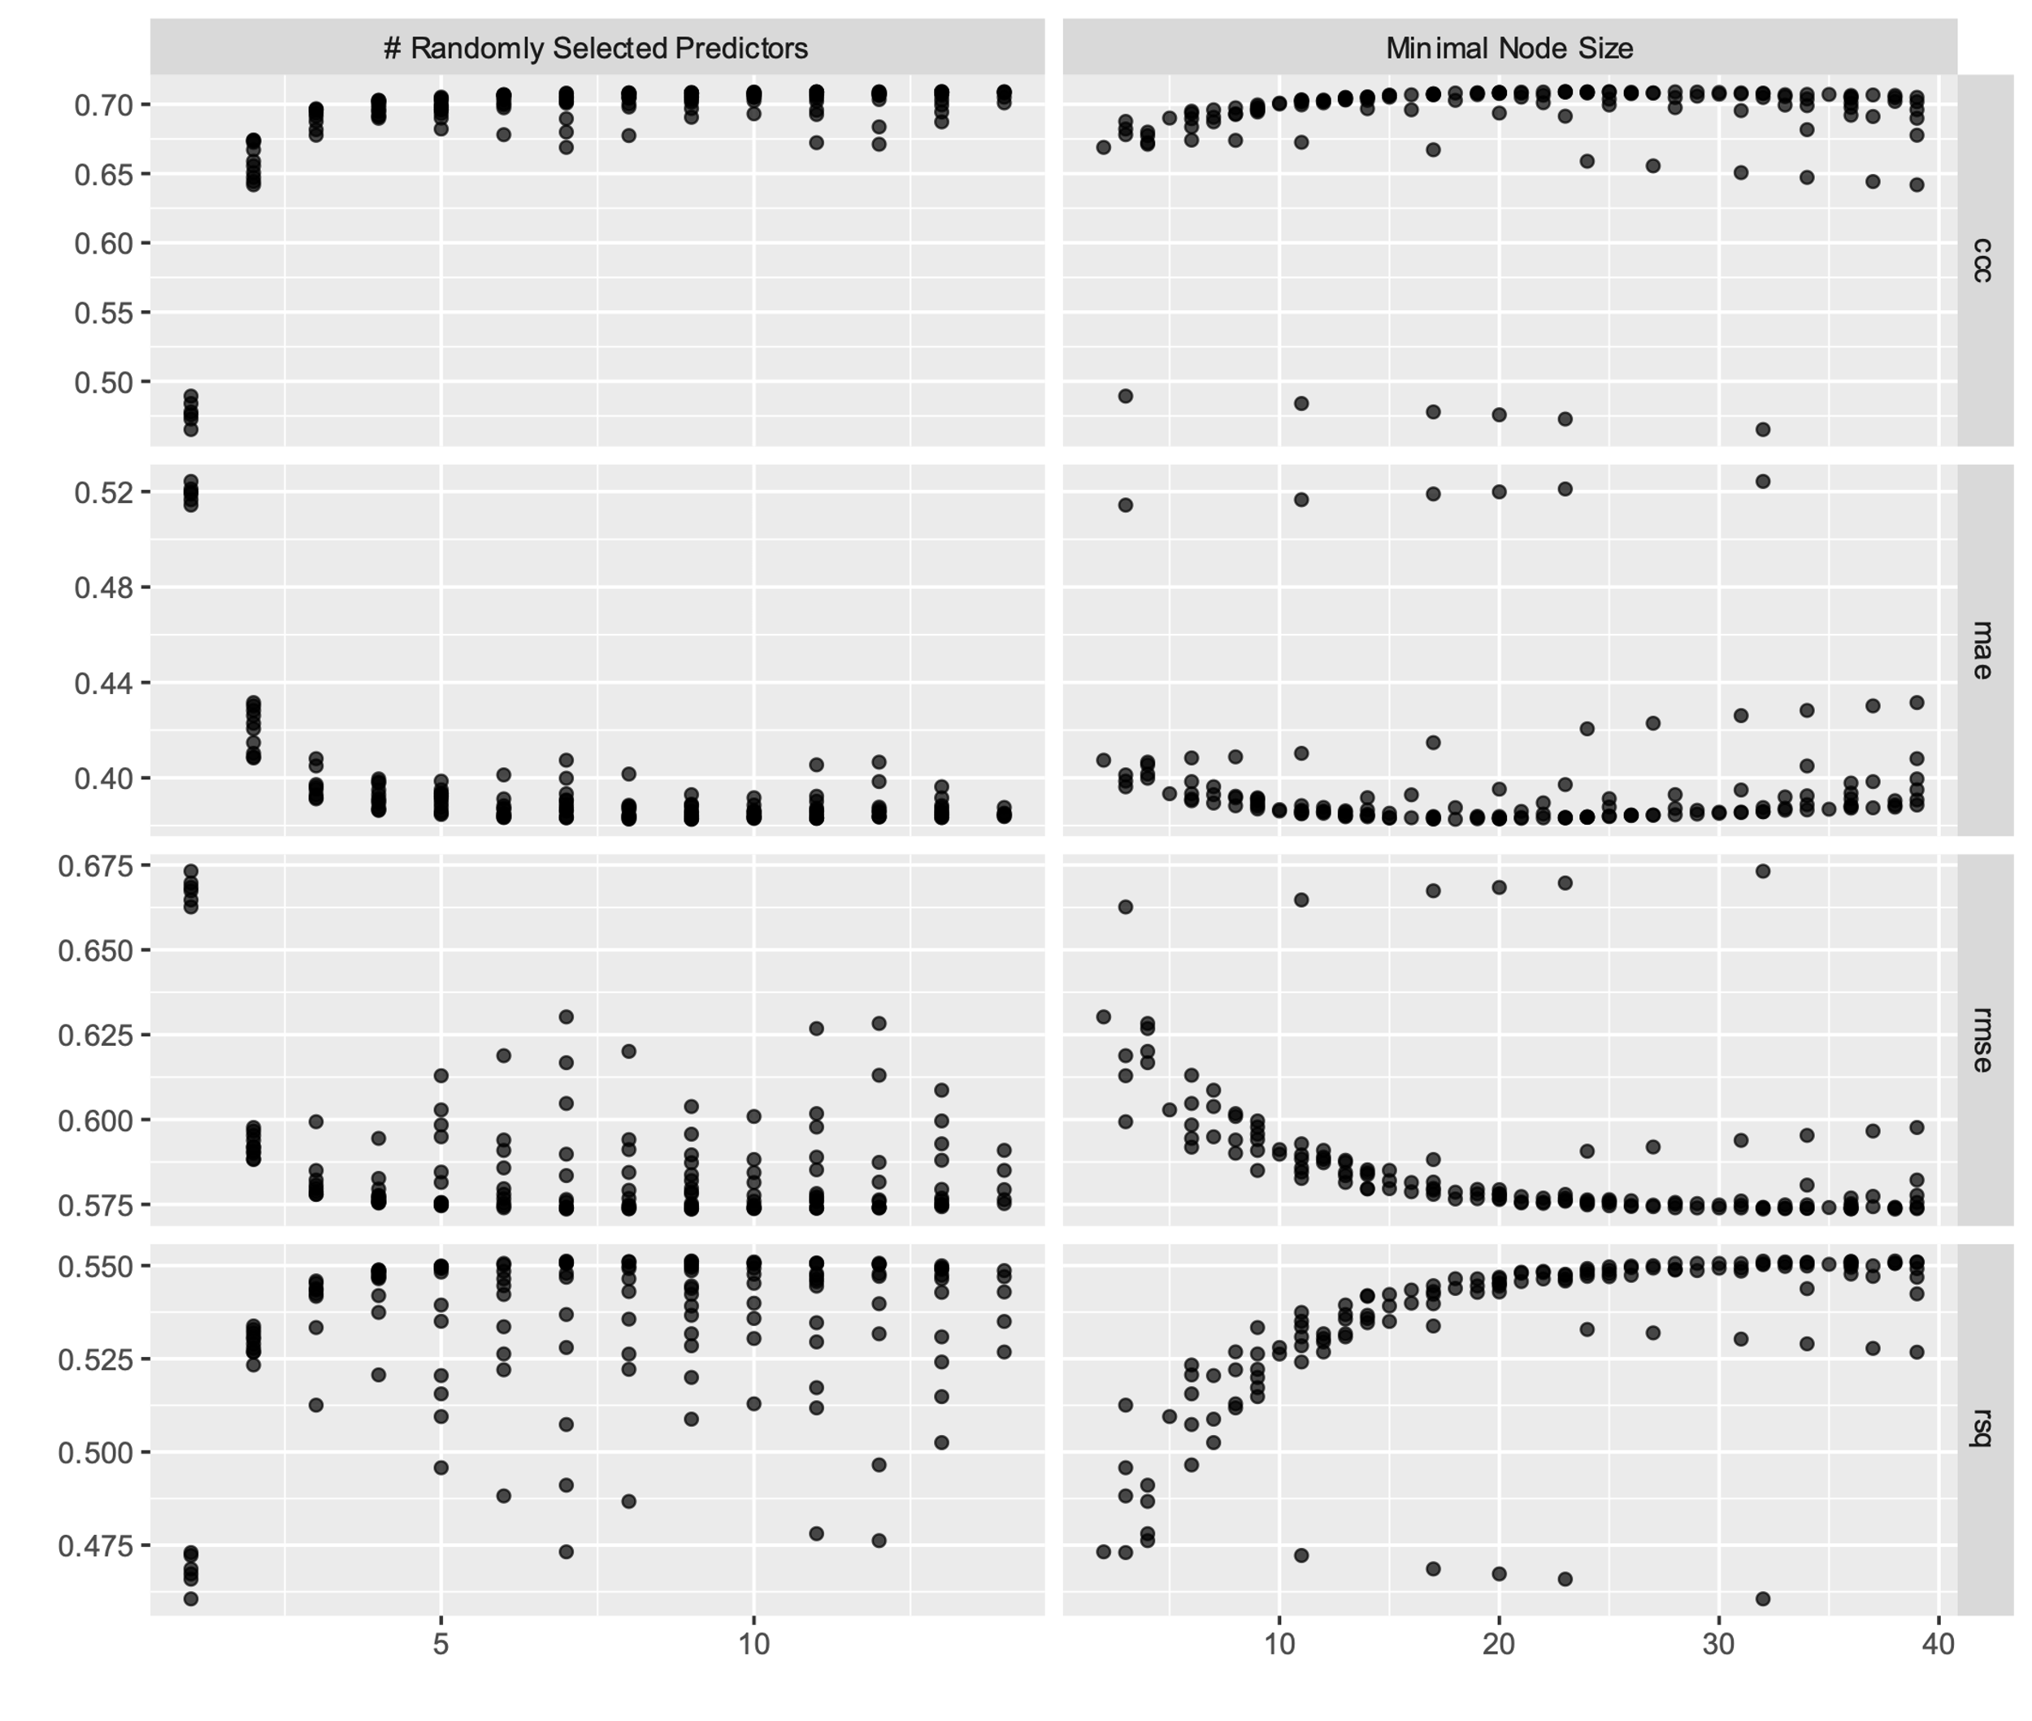
Model Tuning - RF

Slide 14
Model
Tuning - XGB

Slide 15
Model Performance on the Test Set
Best models:
  RF:
    mtry = 9
    min_n = 38
  XGB:
    mtry = 7
    min_n = 18
    tree_depth = 10
    learn_rate = 0.00420
    loss_reduction = 0.0000598
    sample_size = 0.710
Performance on the test set
  RF:
    RMSE:0.599
    R2: 0.525
  XGB:
    RMSE:0.600
    R2: 0.523

Slide 16
Variable Importance

Slide 17
Conclusions and limits
Three sets of randomly generated SQL queries were executing on 8 scenarios for 5GB, 10GB and 50GB) DB size
Less than 50 GB hardly qualifies as Big Data, so the results are just preliminary
Most important predictors associated with the SparkSQL query performance are mainly related to:
  the volume of processed data (number of records in the tables included in FROM clause)
  the complexity of the query
    number of joins,
    number of predicates in WHERE,
    number of aggregate and non-aggregate functions included in SELECT clause,
    number of ordering and grouping attributes.
Data source formats and the memory settings do not seem strongly associated with the query performance
Limits:
  Small database size(s)
  Just 4 data formats used
  HDFS I/O throughput
Further research:
  include additional file formats, both complex like Apache Arrow, Iceberg, Protocol Buffers and simple such as JSON, CSV
  different cluster managers (such as YARN or Kubernetes) might also affect the performance

Slide 18
Acknowledgments
This paper is partially supported by the Competitiveness Operational Programme Romania under project number SMIS 124759 - RaaS-IS (Research as a Service Iasi).
POC/398/1/1, SMIS 124759, ctr. nr. 236/21.04.2020

