Slide 1

Safety and Security of Citizens in Smart Cities
Authors: George Suciu, Ijaz Hussain, George Iordache, Cristian Beceanu, Robert Alfred Kecs, Marius-Constantin Vochin

Slide 2
Article Context-THE S4Allcities Project
The project we implement, “Smart Spaces Safety and Security for All Cities” (S4ALLCITIES), is dealing with Systems of Systems Architecture to deploy and validate its intelligent components and functionalities on actual environment, ensuring the delivery of solutions and services in line with smart cities emerging requirements, focused on: risk-based open smart spaces security management; cyber security shielding; and behavior tracking; real-time estimation of cyber-physical risks in multiple locations and measures activation for effective crisis management.
Safety and Security of Citizens in Smart Cities
2021 RoEduNet Conference: Networking in Education and Research, 4-6 November 2021, Iasi

Slide 3
Biography – Cristian beceanu
Graduated at “University Politehnica Bucharest”, Faculty of Power Engineering, specialization Power Systems
From 2017, research assistant at Beia Consult International, R&D department
Involved in several projects and proposals H2020,ITEA and CELTIC.

Slide 4
BEIA CONSULT INTERNATIONAL
BEIA is an SME with an experience of more than 25 years in over 5,000 turnkey projects for telephone and advanced communications solutions;
Ongoing projects: H2020 - Horizon 2020 is the EU's largest research and innovation program with nearly € 80 billion available over 7 years (2014-2020);
CitiSim: Integrates sensors and other data sources for continuously monitoring multiple variables of the city in a single platform;
SealedGrid: Scalable, trustEd, and interoperAble pLatform for sEcureD smart GRID. The platform will combine, for the very first time, technologies like Blockchain;
PARFAIT: Personal dAta pRotection FrAmework for IoT interoperability Personal dAta pRotection FrAmework for IoT interoperability, along with security and privacy of personal data;
SAFECARE: SAFEguard of Critical heAlth infrastructure.
VIRTUOSE: Virtualized Video Services.

Slide 5
summary
Abstract
Introduction
Related work
Distributed Edge Computing IoT
Beia’s Real-Time early Warning Platforms
Conclusions

Slide 6
Abstract
In this paper, we propose to integrate advanced technological solutions in a market-oriented unified Cyber–Physical Security Management framework, aiming at raising the resilience of cities’ infrastructures, services, ICT, IoT, and fostering intelligence and information sharing among city’s security.

Slide 7
Introduction
In this paper, we present a protective system, S4AllCities, with a dedicated cyber protection module that adds a module to protect against the new threats to adversarial attacks (tampering with IA).
The system proposes advanced technological concepts and methodologies for implementing City Digital Intelligence and makes it accessible in real-time to authorized and authenticated Security Practitioners
The project S4AllCities benefits from the System of Systems architecture which interconnects intelligent modules based on novel Digital Twins concepts that capture the digital intelligence of the city processes and actors upon its smart spaces with greater awareness and augmented reality

Slide 8
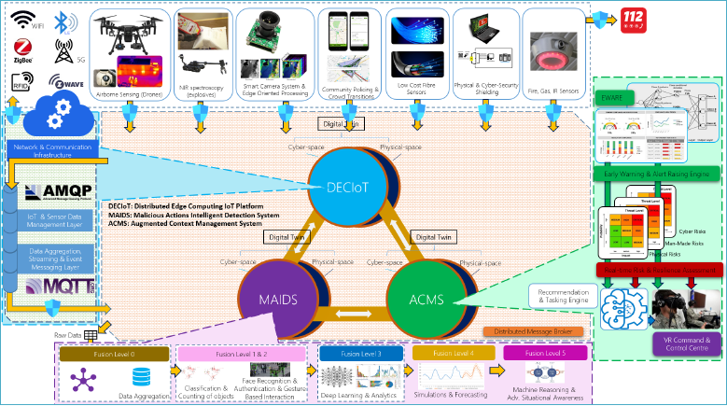
Related work
  System of Systems Architecture
System of Systems (SoS) as an “All Cities” digital processes simulator is built with integrated distributed software-based elements. These are independent but under a governance of a common overarching data model. This “lego-like” modular approach enables complete flexibility and reusability of the SoS in conjunction with city legacy smart systems under diverse threat scenarios in all cities’ smart spaces and beyond
High-level system architecture.

Slide 9
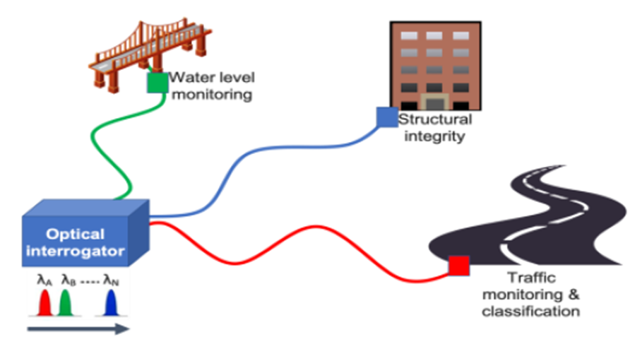
Related work
  Smart City Surveillance Through Low-Cost Fibre Sensors
A continuously growing number of urban cities have optical fibre networks supporting communications at their disposal. These optical fibre installations can also be utilized to convey low-data optical signals from many deployed sensors that are usually positioned in critical infrastructure locations. The technologies which are introduced are based on Fibre Bragg Grating (FBG) sensors that exhibit low-cost and high accuracy.
Concept of optical interrogation of heterogeneous sensors.
Safety and Security of Citizens in Smart Cities
2021 RoEduNet Conference: Networking in Education and Research, 4-6 November 2021, Iasi

Slide 10
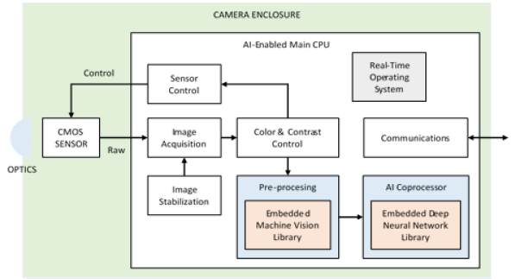
Related work
  Low cost and Edge-oriented resource-constrained image based processing
The solution for a low cost and edge-oriented resource-constrained image-based processing is based on a smart camera system that will integrate all the relevant components (optics, CMOS, CPU, etc.) to provide a low cost and smart platform ready to embed intelligence applications for video surveillance. The development will include the design and integration of several hardware and software components: camera optics and enclosure, sensors for use in different lighting conditions, different processing cores, Neural Network Accelerator (NNA), software for image stabilization, image treatment, AI-algorithms and decision-taking algorithms etc.
Block diagram of the smart camera system
Safety and Security of Citizens in Smart Cities
2021 RoEduNet Conference: Networking in Education and Research, 4-6 November 2021, Iasi

Slide 11
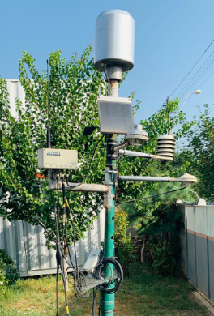
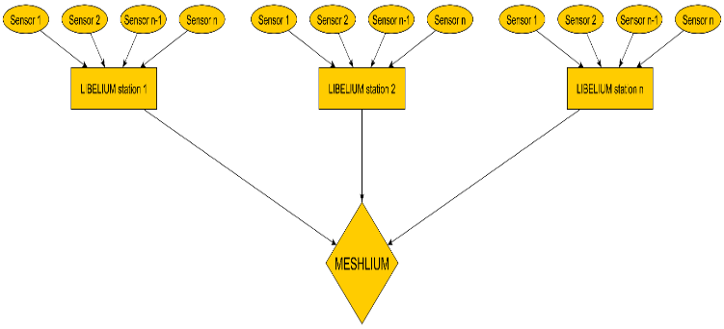
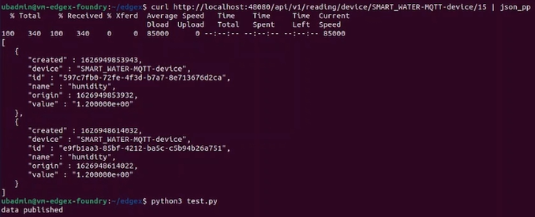
Related work
  Libelium and Adcon sensing platform
The Libelium and Adcon telemetry, equipments are successfully being used to collect the data using sensors installed on the targeted locations to monitor the air quality, events scanning, and toxic gases. Different types of sensors allocated in Libelium configuration as seen near, and sensors used in Libelium devices are listed in pictures.
We also used Kafka server and EdgeX Foundry for data transmission. The transmitted data of temperature and humidity is sent successfully to the Kafka server using EdgeX Foundry
Adcon Station
Entire Lybelium system
Sending data to Kafka server operation
Safety and Security of Citizens in Smart Cities
2021 RoEduNet Conference: Networking in Education and Research, 4-6 November 2021, Iasi

Slide 12
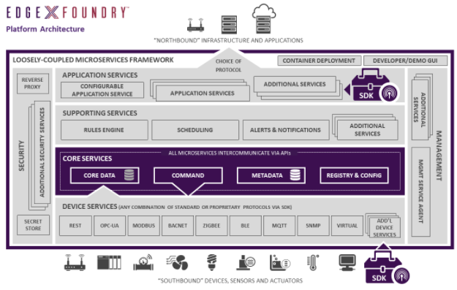
Distributed Edge Computing IoT
The proposed solution for the efficient implementation of the Digital Twin, DECIoT, at the edge and connectivity layer of the SoS is based on state-of-the-art edge computing and analytics technologies.
The DECIoT Digital Twin will build upon a collection of open-source micro-services that span from the edge of the physical realm on the Device Services Layer, with the Core Services Layer at the center. They also communicate through a common API.
DECIoT based on the Edge-X Foundry platform architecture

Slide 13
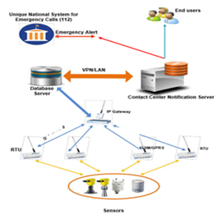
BEIA’s Real-Time early Warning Platforms
A real-time telemetry system for emergency situations represents a complex architecture that raises problems when it needs to be implemented in various environments and scaled up in those situations
The Elastic disaster early warning system application represents a “cloudified” early warning solution for natural disasters.
The application collects data from real-time sensors, processes the information, and provides warning services for the public.
Functional architecture of Beia’s real-time early warning platform

Slide 14
CONCLUSIONS
Complement legacy monitoring systems with the adaptation of state-of-the-art and beyond, low-cost surveillance technologies, and solutions that enhance Smart City preparedness and defense capability in both cyber and physical space are discussed in the article.
Hazards are detected such as structural health of public buildings, environmental conditions, such as temperature and rainfall, and traffic monitoring of city roads at low cost and real-time early warning system are presented along with the cyber-physical security risk and reliance assessment.
The work described in this article has the scope to implement a real-time warning system to detect unusual events in a city.

Slide 15
Acknowledgment
This paper was partially supported by UEFISCDI Romania and MCI through Eureka ITEA projects PREVENTION, HYDRO3D, PARFAIT and SOLOMON and funded in part by European Union's Horizon 2020 research and innovation program under grant agreements No. 872698 (HUBCAP) and No. 883522 (S4AllCities). The research leading to these results has received funding from the NO Grants 2014-2021, under Project contract no. 42/2021, RO-NO-2019-0499 -” A Massive MIMO Enabled IoT Platform with Networking Slicing for Beyond 5G IoV/V2X and Maritime Services” - SOLID-B5G.

Slide 16
Thank you for your atention.
Any questions?
For further references, please contact:
george@beia.ro
cristian.beceanu@beia.ro
george.iordache@beia.ro

