Slide 1

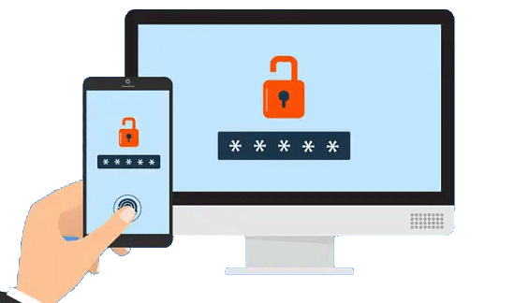

MOVING FORWARD PASSWORDLESS AUTHENTICATION:
CHALLENGES AND IMPLEMENTATIONS FOR THE PRIVATE CLOUD
20th RoEduNet Conference - Networking in Education and Research - 2021
Ionel Gordin, Adrian Graur, Sorin Vlad, Cezar Ion Adomniței
ionel.gordin@usv.ro, adrian.graur@usv.ro, sorinv@usm.ro, cezar.adomnitei@usm.ro
DECIDE
.USV.RO

Slide 2
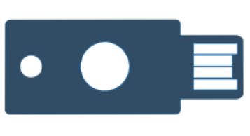
I. INTRODUCTION
Passwordless authentication
FIDO (2014) stands for Fast IDentity Online and represents an open standard developed by an industry consortium comprised of technology firms and other service providers.
FIDO2 (2018) architecture is composed of two core components:
WebAuthn API used by browsers, including Chrome, Edge, Mozilla, and WebKit.
Client to Authenticator (CTAP) protocol that provides FIDO 2 - capable devices an interface for external authenticators via NFC, Bluetooth or USB[2].

Slide 3
Fig. 1. Passwordless authentication vs other type of authentications

Slide 4
II. FIDO2 /WEBAUTHN OVERVIEW
FIDO2/WebAuthn provides strong authentication that is resistant to phishing and server breach attacks.
WebAuthn (Web Authentication) is the browser standard and API for authenticating users to web-based applications and services using public-key cryptography.
FIDO2 authentication is made to be decentralized. Users are verified locally by an authenticator. An online service validates the user credentials before allowing user access.
Fig. 2. FIDO2 / WebAuthn application architecture [3]

Slide 5
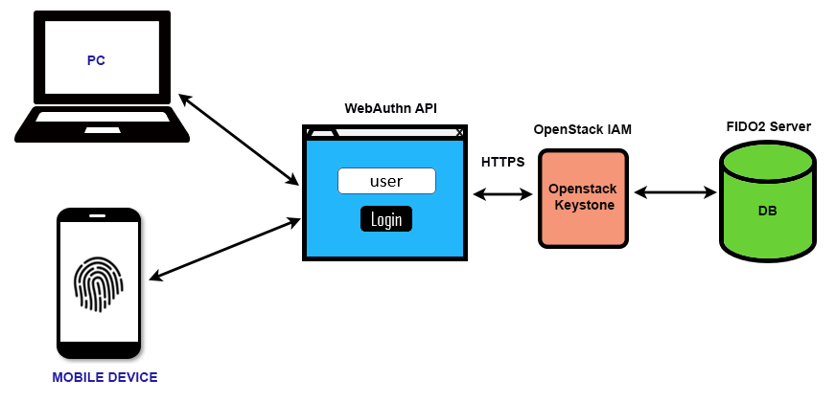
II. FIDO2 /WEBAUTHN OVERVIEW
To implement FIDO2 protocol there are several changes that must be made to the cloud authentication interface:
Modify Register and Login to permit passwordless authentication based on fingerprint scan
FIDO user Registration – develop user registration plugin module
Log in - develop user login plugin module
Adding a FIDO Server – integrating OpenStack Identity service (IAM) with FIDO2 authentication Server
Fig. 3. FIDO2 / WebAuthn integration with OpenStack

Slide 6
III. FIDO 2 APPLICATION FOR PRIVATE CLOUD
Actions performed during fingerprint registration:
GET get-challenge — browser sends an empty request containing the necessary cookie (the ID of the registering device).
generate-and-store-challenge — server generates a new challenge string for corresponding cookie and then saves it to the devices table.
create-public-key — browser invokes WebAuthn API to create a new public key. User scans their finger.
POST save-public-key — the new public key data is sent to the server for validation and storage.
validate-and-store-public-key — validate and store the public key data inside the devices record.
Fig. 4. The browser/server data flow while registering the fingerprint [6]

Slide 7
III. FIDO 2 APPLICATION FOR PRIVATE CLOUD
Actions performed during fingerprint verification:
a) GET get-challenge-and-publicKey — browser sends an empty request containing the necessary cookie (device ID).
b) The server generates a new challenge string for that cookie and saves it instead of the existing challenge to the devices table. It returns both the new challenge and the publicKey.
c) verify-public-key — browser invokes WebAuth API to create public key verification data. User scans their finger.
d) POST sign-in — the resulted data is sent to the server for verification.
e) verify-signature — server authorizes the signature using the previously stored attestation Object and issues authorisation token.
Fig. 5. The browser/server data flow while verifying the fingerprint and authorizing the user [6]

Slide 8
III. FIDO 2 APPLICATION FOR PRIVATE CLOUD
Integration of FIDO server in OpenStack environment can be performed with the help of Identity and Access Management module (IAM).
The Identity service generates the necessary authentication tokens that permit access to the OpenStack services REST APIs. Clients receive this token and the corresponding URL endpoints for other service APIs when a successful authentication is made.
Fig. 6. Openstack passwordless authentication structure

Slide 9


IV. ADVANTAGES / DISAVANTAGES OF PASSWORDLESS SOLUTIONS FOR PRIVATE CLOUD
ADVANTAGES
DISADVANTAGES
high security and assurance
fast and convenient
nontransferable
reduced administration overhead
almost spoof-proof
higher cost
tracking and data
false positives and inaccuracy
troubleshooting and getting acquainted
with new technology

Slide 10

V. CONCLUSION
Passwordless authentication is more convenient than classical authentication because the password now is removed and replaced with something we have, and it cannot be forgotten.
Users can access their workstation, application, or network by just using their fingerprint, eye scan or voice recognition[7].
Current article presents as a novelty, a passwordless implementation solution for OpenStack private cloud. The solution can be implemented with minimal configuration changes also on other private cloud environments[4]. Passwordless authentication is performed with the help of a plugin module that integrates with OpenStack Identity service (part of Keystone component).
A comparison between classic authentication and passwordless is made at the end of the article with the purpose of understanding the advantages and disadvantages of this authentication system[8].

Slide 11
References
[1] Verizon, “Results and analysis,” Verizon, 2019. [Online]. Available: https://enterprise.verizon.com/resources/reports/dbir/2019/results-and-analysis/.
[2] “FIDO Alliance Specifications Overview,” FIDO, [Online]. Available: https://fidoalliance.org/specifications/.
[3] “FIDO2/WebAuthn Overview,” Yunico, [Online]. Available: https://developers.yubico.com/WebAuthn/WebAuthn_Developer_Guide/Overview.html.
[4] R. Laborde, A. Oglaza, S. Wazan, F. Barrere, A. Benzekri, D. W. Chadwick and R. Venant, "A User-Centric Identity Management Framework based on the W3C Verifiable Credentials and the FIDO Universal Authentication Framework," in IEEE 17th Annual Consumer Communications & Networking Conference (CCNC), Las Vegas, NV, USA, 2020.
[5] I. Gordin, A. Graur and A. Potorac, "Two-factor authentication framework for private cloud," in International Conference on System Theory Control and Computing, Sinaia, Romania 2019.
[6] V. Boroviak, "Biometrics (fingerprint) auth in your web apps," [Online]. Available: https://itnext.io/biometrics-fingerprint-auth-in-your-web-apps-d5599522d0b3.
[7] S. G. Lyastani, M. Schilling, M. Neumayr, M. Backes and S. Bugiel, "Is FIDO2 the Kingslayer of User Authentication? A Comparative Usability Study of FIDO2 Passwordless Authentication," in IEEE Symposium on Security and Privacy (SP), San Francisco, CA, USA, 2020.
[8] A. Roy, N. Memon and A. Ross, "MasterPrint: Exploring the Vulnerability of Partial Fingerprint-Based Authentication Systems," IEEE transactions on information forensics and security, vol. 12, no. 9, pp. 2013 -2025, 2017.

Slide 12

ACKNOWLEDGEMENT
This research project is supported by project DECIDE.
Project is co-financed by the European Social Fund through the Human Capital Operational Program 2014-2020. (http://www.decide.usv.ro)

