Slide 1
Edge computing for autonomous vehicles. A scoping review
2021 RoEduNet Conference: Networking in Education and Research
November 2021
ing. Cristian Sandu
Prof. dr. ing. Ioan Şuşnea

Slide 2
Context
Autonomous vehicles, or vehicles that are very close to achieving fully autonomous operation would have great benefits.
Human error is one of the leading causes for car accidents, which lead to more than 1.35 million deaths every year, according to estimation of the WHO.
Other important benefits of such vehicles include but are not restricted to
reducing pollution
improving the mobility of the elderly or people with mobility issues
increasing focus time on other more important activities

Slide 3
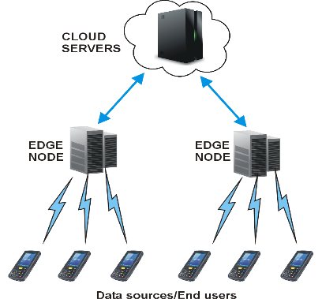
What is edge computing
Designates a network topology where some processing devices are placed at the edge of the network, (i.e. outside the cloud) close to the data sources/end users, in order to save bandwidth and reduce latency.
Works well in situations where internet connectivity is not always present or always necessary.
Much easier to replace and upgrade.
Better privacy, security and better scalability.

Slide 4
Motivation
Autonomous vehicles heavily rely on on-board equipment for the navigation and vision tasks.
This translates to high costs, high energy consumption, and even cutting corners when it comes to the overall accuracy.
These systems are hard to upgrade and in a fast developing ecosystem that could pose a serious problem.
We believe that relocating some tasks to the edge infrastructure is an approach worth investigating, which could lead to faster adoption of the AV.
In this paper we present an edge computing framework which to be used for task offloading.

Slide 5
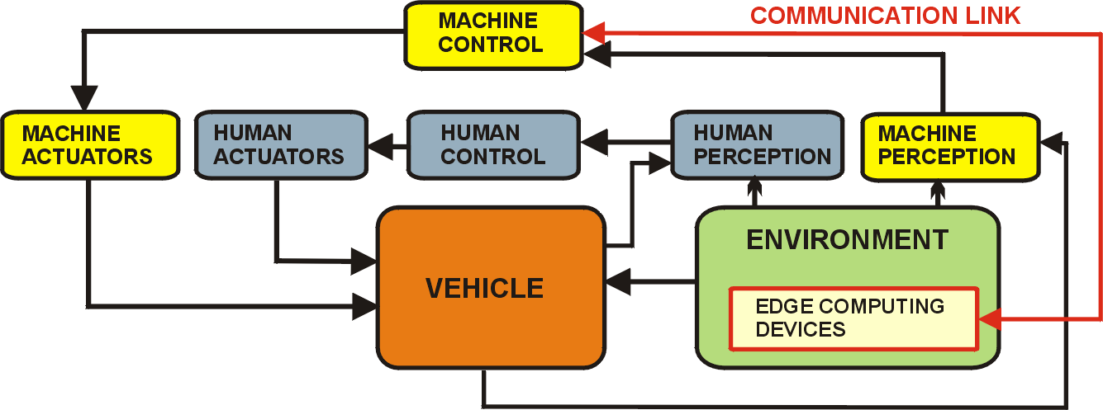
Edge computing for autonomous vehicles
Using edge devices opens up the possibility of adopting the idea of autonomous driving as a service.
Faster hardware is easier to deploy in fixed locations that are not restricted by energy usage.
Edge devices can be part of a cluster which can increase the processing power substantially.
Can be used in remote locations as well as crowded urban scenarios, since they wouldn’t rely on permanent internet connectivity.
Can use the best detection/vision/perception methods for the specific location, which is a major advantage over fixed onboard software.

Slide 6
Edge offloading framework proposal
We consider task offloading the externalization of any service that the vehicle would use, such as, but not restricted to, obtaining information about the status of the traffic lights. Currently, systems such as Tesla Autopilot use complex algorithms and forward-facing cameras to identify their status.
The proposed framework would be ready to advertise the available services that the location supports and then accept requests for obtaining information, downloading data or making requests to services in the cloud.

Slide 7
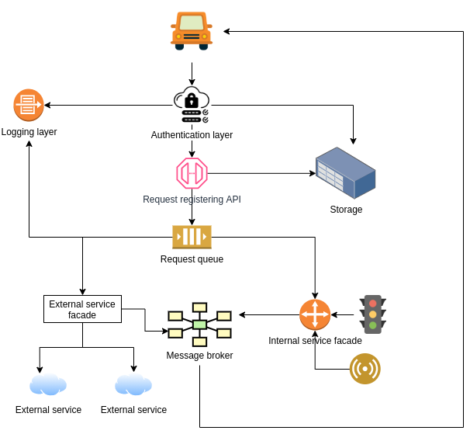
Edge offloading framework proposal
The Authentication Component
It would authorize and authenticate the requests that are made against the framework.
The most suitable authentication mechanisms are the ones that support machine to machine communication.
For that, HMAC authentication or the OpenID connect client credentials grant would provide suitable options.

Slide 8
Edge offloading framework proposal
The Communication API
Comprised of an endpoint that advertises the available services.
Communication would be done using a standard specification which would be part of the framework.
RESTful APIs work well for IoT applications, and would work reasonably well for non critical applications.

Slide 9
Edge offloading framework proposal
The Storage Layer
High-capacity storage can easily be placed in the edge, and it can be used both for downloading data stored onboard the vehicle for later upload to the cloud or as a persistence layer for the other components.
Easily expandable and easy to backup.

Slide 10
Edge offloading framework proposal
The Request Queue
This component is necessary because the framework must handle requests from a large number of vehicles.
Placing them in a queue, that could later on use some form of mechanism for prioritization is important to ensure the system will take care of all the requests and will avoid concurrency issues and locking of resources.

Slide 11
Edge offloading framework proposal
The Service Facade
It is unlikely that the services will be fully compatible.
It is important to provide a standardized way of communication with services.
This would help ensure an easy and step by step integration of heterogeneous technologies and components.

Slide 12
Edge offloading framework proposal
The Logging Layer
Like in the case of a typical software product, logging can be split into access logging and error logging.
Both are important and should be collected all the time.
Also provides insightful information into the performance of the system and areas that can be improved.

Slide 13
Edge offloading framework proposal
Final considerations
Reliable communication methods are presented in surveyed papers with reasonable latencies for up to 60 vehicles at a time and more, however, mentioning concrete proposals for this hardware component are not in the scope of this paper.
The framework is built around a microservices architecture and the components run individual pieces of software, each in their own container, using OCI-compatible containerization solutions, such as Docker and Kubernetes for orchestration.

Slide 14
References
World Health Organization, Global status report on road safety 2018. Geneva: World Health Organization, 2018
S. Banerjee, “Autonomous vehicles: a review of the ethical, social and economic implications of the AI revolution,” INTERNATIONAL JOURNAL OF INTELLIGENT UNMANNED SYSTEMS, doi: 10.1108/IJIUS-07-2020-0027
F. Arena, G. Pau, and A. Severino, “An Overview on the Current Status and Future Perspectives of Smart Cars,” Infrastructures, vol. 5, no. 7, p. 53, Jun. 2020, doi: 10.3390/infrastructures5070053.
B. W. Weaver and P. R. DeLucia, “A Systematic Review and Meta-Analysis of Takeover Performance During Conditionally Automated Driving,” Hum Factors, p. 001872082097647, Dec. 2020, doi: 10.1177/0018720820976476.
A. M. Nascimento et al., “A Systematic Literature Review About the Impact of Artificial Intelligence on Autonomous Vehicle Safety,” IEEE TRANSACTIONS ON IN℡LIGENT TRANSPORTATION SYSTEMS, vol. 21, no. 12, pp. 4928–4946, Dec. 2020, doi: 10.1109/TITS.2019.2949915.
A. H. Ahangarnejad, A. Radmehr, and M. Ahmadian, “A review of vehicle active safety control methods: From antilock brakes to semiautonomy,” Journal of Vibration and Control, Aug. 2020, doi: 10.1177/1077546320948656.
J. Fayyad, M. A. Jaradat, D. Gruyer, and H. Najjaran, “Deep Learning Sensor Fusion for Autonomous Vehicle Perception and Localization: A Review,” Sensors, vol. 20, no. 15, p. 4220, Jul. 2020, doi: 10.3390/s20154220.
F. Golbabaei, T. Yigitcanlar, and J. Bunker, “The role of shared autonomous vehicle systems in delivering smart urban mobility: A systematic review of the literature,” International Journal of Sustainable Transportation, pp. 1–18, Jul. 2020, doi: 10.1080/15568318.2020.1798571.
S. Ahmed, M. N. Huda, S. Rajbhandari, C. Saha, M. Elshaw, and S. Kanarachos, “Pedestrian and Cyclist Detection and Intent Estimation for Autonomous Vehicles: A Survey,” Applied Sciences, vol. 9, no. 11, p. 2335, Jun. 2019, doi: 10.3390/app9112335.
E. Khatab, A. Onsy, M. Varley, and A. Abouelfarag, “Vulnerable objects detection for autonomous driving: A review,” Integration, vol. 78, pp. 36–48, May 2021, doi: 10.1016/j.vlsi.2021.01.002.
M. Hnewa and H. Radha, “Object Detection Under Rainy Conditions for Autonomous Vehicles: A Review of State-of-the-Art and Emerging Techniques,” IEEE Signal Process. Mag., vol. 38, no. 1, pp. 53–67, Jan. 2021, doi: 10.1109/MSP.2020.2984801.
A. Christensen et al., “Key considerations in the development of driving automation systems,” In 24’th Enhanced safety vehicles conference. Gothenburg, Sweden. 2015.
P. Nelson. “Just one autonomous car will use 4,000 gb of data/day”, 2016. Available online: http://www.networkworld.com/article/3147892/internet/one-autonomous-car-will-use-4000-gb-of-dataday.html (retrieved May, 2021)
MIT MTL, "Trends, Opportunities and Challenges Driving Architecture and Design of Next Generation Mobile Computing and IoT Devices," (2014) Available online: https://www.mtl.mit.edu/seminars/trends-opportunities-and-challenges-driving-architecture-and-design-next-generation-mobile#paragraphs-responsive-tabs-parent--field-seminar-tabs2, Retrieved May 2021.
I. Susnea, G. Vasiliu, A. Filipescu, and G. Coman, “On the Implementation of a Robotic Assistant for the Elderly. A Novel Approach,” in 7 WSEAS Int. Conf. on Computational, Iintelligence Manmachine Systems and Cybernatics (CIMMACS’08), 2008, pp. 215–220.
ETSI “MEC Multi-access Edge Computing” Available online: https://www.etsi.org/technologies/multi-access-edge-computing, Retrieved May 2021.
L. Liu, C. Chen, Q. Pei, S. Maharjan, and Y. Zhang, “Vehicular edge computing and networking: A survey”, Mobile Networks and Applications, pp. 1–24, preprint 2020
Iturbe, X., Venu, B., Jagst, J., Ozer, E., Harrod, P., Turner, C., & Penton, J. (2018). Addressing functional safety challenges in autonomous vehicles with the arm TCL S architecture. IEEE Design & Test, 35(3), 7-14.
Nokia. (2018). Edge Cloud Takes Compute Capacity to Where the Traffic is. Available online: https://networks.nokia.com/solutions/edge-cloud

Slide 15
References
Kubernets info. Available online: https://kubernetes.io/docs/concepts/overview/what-is-kubernetes/ Retrieved May 2021.
J. Tang, R. Yu, S. Liu and J. Gaudiot, "A Container Based Edge Offloading Framework for Autonomous Driving,", IEEE Access, vol. 8, pp. 33713-33726, 2020, doi: 10.1109/ACCESS.2020.2973457.
V. Sze, Y.-H. Chen, J. Emer, A. Suleiman, and Z. Zhang, “Hardware for machine learning: Challenges and opportunities,” in 2017 IEEE Custom Integrated Circuits Conference (CICC), 2017, pp. 1–8.
Khayyat, Mashael, et al. "Advanced deep learning-based computational offloading for multilevel vehicular edge-cloud computing networks." IEEE Access 8 (2020): 137052-137062.
L. M. Vaquero, L. Rodero-Merino, Finding Your Way in the Fog: To- wards a Comprehensive Definition of Fog Computing, SIGCOMM Com- put. Commun. Rev. 44 (5) (2014) 27–32. doi:10.1145/2677046.2677052.
Sun, Yuxuan, et al. "Adaptive learning-based task offloading for vehicular edge computing systems." IEEE Transactions on vehicular technology 68.4 (2019): 3061-3074.
Tang, Jie, et al. "Lopecs: A low-power edge computing system for real-time autonomous driving services." IEEE Access 8 (2020): 30467-30479.
Liu, Shaoshan, et al. "Edge computing for autonomous driving: Opportunities and challenges." Proceedings of the IEEE 107.8 (2019): 1697-1716.
Feng, Jingyun, et al. "Mobile edge computing for the internet of vehicles: Offloading framework and job scheduling." IEEE vehicular technology magazine 14.1 (2018): 28-36.
https://www.motortrend.com/news/tesla-autopilot-fsd-traffic-light-recognition-intersections. Online, Obtained October 2021.
Ray, Partha Pratim. "A survey of IoT cloud platforms." Future Computing and Informatics Journal 1.1-2 (2016): 35-46.
Choo, Sukjin, Joonwoo Kim, and Sangheon Pack. "Optimal task offloading and resource allocation in software-defined vehicular edge computing." 2018 International conference on information and communication technology convergence (ICTC). IEEE, 2018.
Pham, Xuan-Qui, et al. "Joint node selection and resource allocation for task offloading in scalable vehicle-assisted multi-access edge computing." Symmetry 11.1 (2019): 58.
Wang, Shupeng, et al. "Joint Optimization of Task Offloading and Resource Allocation Based on Differential Privacy in Vehicular Edge Computing." IEEE Transactions on Computational Social Systems (2021).
Tareq, Md Mostofa Kamal, et al. "Ultra reliable, low latency vehicle-to-infrastructure wireless communications with edge computing." 2018 IEEE Global Communications Conference (GLOBECOM). IEEE, 2018.
Elbamby, Mohammed S., et al. "Wireless edge computing with latency and reliability guarantees." Proceedings of the IEEE 107.8 (2019): 1717-1737.

Slide 16
Q&A

Slide 17
Thank you for your time!

