Slide 1

Video Streaming Evaluation Using Priority Queuing in P4 Programmable Networks
Calin-Marian IURIAN, Robert BOTEZ,
Iustin-Alexandru IVANCIU, Virgil DOBROTA
Technical University of Cluj-Napoca
Cluj-Napoca, Romania
Marian.Iurian@com.utcluj.ro

Slide 2
Outline
Introduction
Related Work
Implementation
Experimental Results
Conclusions
References
9/15/2022
Technical University of Cluj-Napoca
2

Slide 3
Introduction
The concept of network programmability
OpenFlow – the decoupled control plane & data plane
P4 – Programming Protocol – Independent Packet Processor
Determines how packets are processed by data plane
9/15/2022
Technical University of Cluj-Napoca
3

Slide 4
Introduction
Differences between OpenFlow and P4:
OpenFlow - control plane separated from the forwarding plane
P4 – program the functionality of any network device
9/15/2022
Technical University of Cluj-Napoca
4

Slide 5
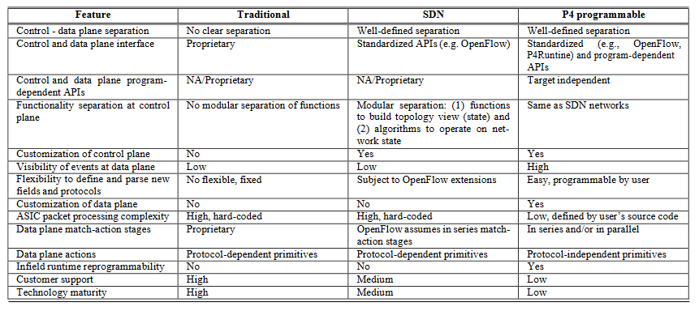
Introduction
Differences between OpenFlow and P4:
Table 1. Features, traditional, SDN, and P4 programmable devices (@copyright [3])
9/15/2022
Technical University of Cluj-Napoca
5

Slide 6
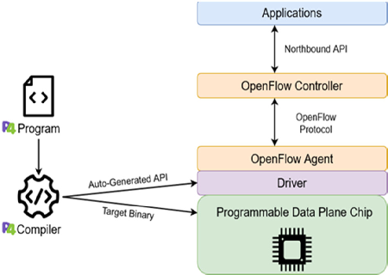
Introduction
The problem with SDN switches?
Figure 1. P4 and OpenFlow
9/15/2022
Technical University of Cluj-Napoca
6

Slide 7
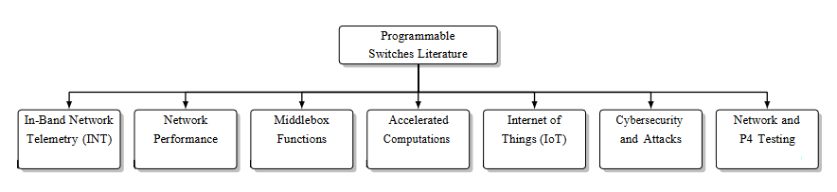
Related Work
Figure 2. Taxonomy of programmable switches literature based upon relevant, explored research areas
9/15/2022
Technical University of Cluj-Napoca
7

Slide 8
Implementation
Video transmission with background traffic mapped to the same priorities in 2 scenarios
Network delay was identical
P4-based video streaming solution with P4 utils and BMv2
Figure 3. Video streaming architecture
9/15/2022
Technical University of Cluj-Napoca
8

Slide 9
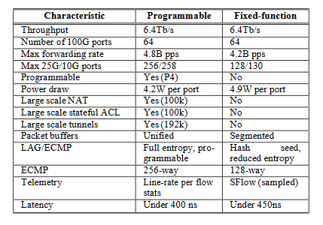
Implementation
Table 2. Comparison between a P4 programmable switch and a fixed-
function switch (@copyright [2])
9/15/2022
Technical University of Cluj-Napoca
9

Slide 10
Implementation
P4 Switch
V1ModelP4 Switch
Figure 4. V1Model Architecture
9/15/2022
Technical University of Cluj-Napoca
10

Slide 11
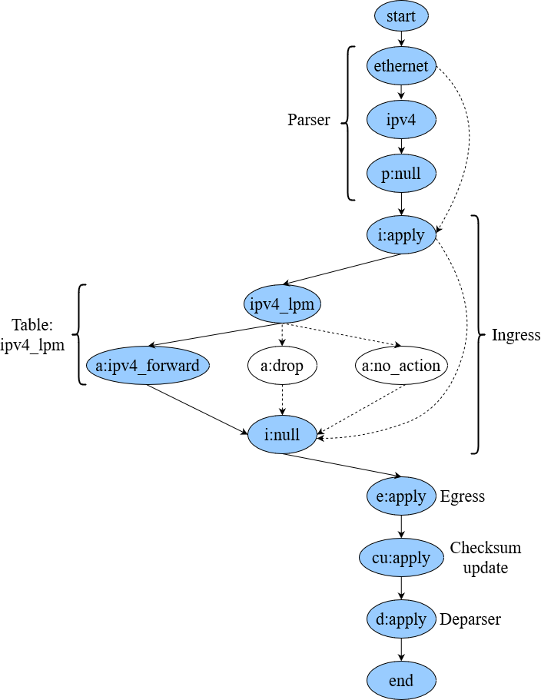
Implementation
P4 Switch
Figure 5. Control-flow graph for a P4-based switch
9/15/2022
Technical University of Cluj-Napoca
11

Slide 12
Implementation
BMv2 Metadata
The execution paths for a P4 switch
if (hdr.ipv4.srcAddr == 0x0a000101){
standard_metadata.priority = (bit<3>)0..7;
}
Figure 6. Priority queuing
9/15/2022
Technical University of Cluj-Napoca
12

Slide 13
Implementation
The packet sending rate from port i to pork k:
simple_switch_CLI –thrift-port 9090
...
RuntimeCmd: set_queue_depth 50
RuntimeCmd: set_queue_rate 100
9/15/2022
Technical University of Cluj-Napoca
13

Slide 14
Experimental Results
Highest Priority
Video traffic from H1 to H3
Figure 7. Video traffic details
9/15/2022
Technical University of Cluj-Napoca
14

Slide 15
Experimental Results
Figure 8. MPEG-TS packets over UDP
UDP traffic as background traffic
Figure 9. Video and background traffic in Wireshark
9/15/2022
Technical University of Cluj-Napoca
15

Slide 16
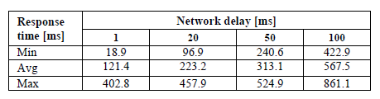
Experimental Results
Adopt the network configuration to several delay values
Table 3. Network delay vs response time
9/15/2022
Technical University of Cluj-Napoca
16

Slide 17
Experimental Results
Longer end-to-end delay -> Low-quality performance
Figure 10. Response time – Network delay comparison
9/15/2022
Technical University of Cluj-Napoca
17

Slide 18
Experimental Results
Lowest priority
if (hdr.ipv4.srcAddr == 0x0a000101){
standard_metadata.priority = (bit<3>)0;
Figure 11. Failed video packets
9/15/2022
Technical University of Cluj-Napoca
18

Slide 19
Conclusions
Conclusions:
  The role of priority queuing for video streaming
  Well defined queuing mechanism – high level of performance
  How video traffic must be mapped?
  Important to maintain an end-to-end delay as short as possible
Future work:
  Testbed in a private or public cloud
  Cloud VMs
  P4 on a dedicated hardware
  We expect that the overall performance will be improved
9/15/2022
Technical University of Cluj-Napoca
19

Slide 20
References
N. Anerousis, P. Chemouil, A. A. Lazar, N. Mihai and S. B. Weinstein, "The Origin and Evolution of Open Programmable Networks and SDN," in IEEE Communications Surveys & Tutorials, vol. 23, no. 3, pp. 1956-1971, thirdquarter 2021, doi: 10.1109/COMST.2021.3060582.
C.H. Ke, S.J. Hsu, "Load Balancing Using P4 in Software-Defined Networks," Journal of Internet Technology, vol. 21, no. 6 , pp. 1671-1679, Nov. 2020.
B. Isyaku, M.S. Mohd Zahid, M. Bte Kamat, K. Abu Bakar, F.A. Ghaleb, “Software Defined Networking Flow Table Management of OpenFlow Switches Performance and Security Challenges: A Survey”, Future Internet 2020, 12, 147 https://doi.org/10.3390/fi12090147.
“The P4 Language Specification Version 1.0.3.”, P4.org, 2017, [Online], Available: https://p4.org/p4-spec/docs/P4-16-v1.0.0-spec.html.
P. Zanna, P. Radcliffe and K. G. Chavez, "A Method for Comparing OpenFlow and P4," 2019 29th International Telecommunication Networks and Applications Conference (ITNAC), 2019, pp. 1-3, doi:10.1109/ITNAC46935.2019.9077951.
Technical University of Cluj-Napoca

