Slide 1
The Role of Load Balancer Mechanisms in Securing IoT Platforms
Daniel-Florin Hrițcan, Doru Balan
Dept. of Computers, Automation and Electronics
University “Ștefan cel Mare” Suceava

Slide 2
Load Balancer Mechanisms
A load balancer is a subsystem that has the main purpose of forwarding requests based on the rules of load balancing. It can accept a request and then will search for the specific service installed on a local server respecting the request URL.

Slide 3
Load Balancer Types
Hardware Load Balancer
Software Load Balancer

Slide 4
Solution Overview

Slide 5
Management Dashboard

Slide 6
Cloudflare DNS Records

Slide 7
Content Matching Rules

Slide 8
Packet capture for HTTP

Slide 9
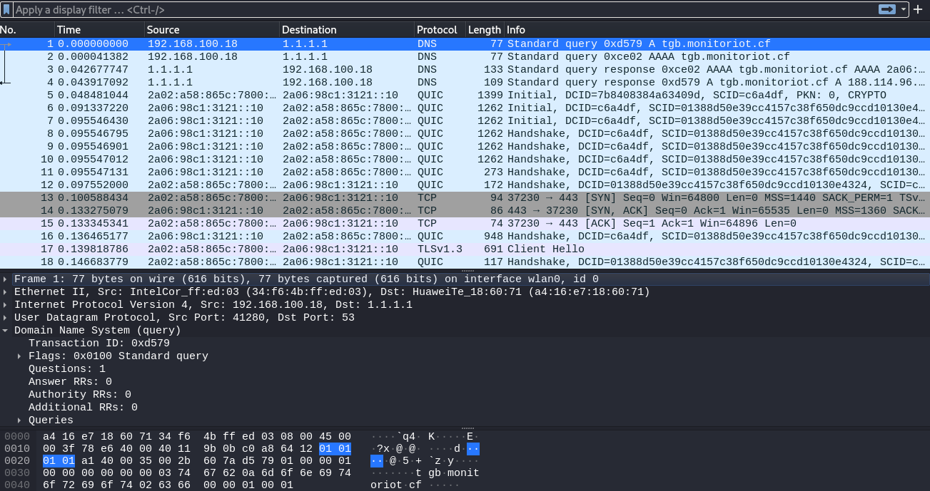
Packet capture for HTTPS

Slide 10
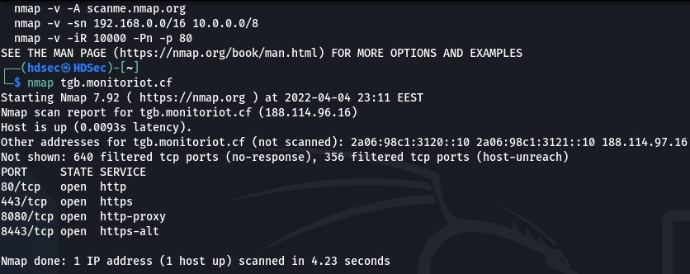
Port scanning with protection enabled

Slide 11
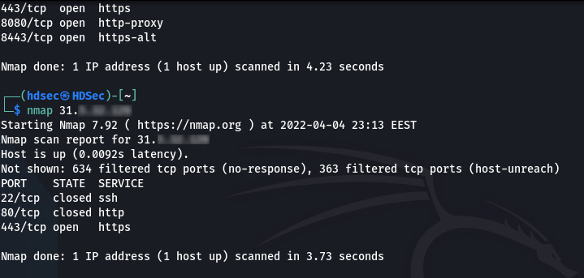
Port scanning on public IP

Slide 12
Thank you for your attention

