Slide 1
Network Congestion Solution for FTP Services Based on Distributed Firewall and Snort
Andrei-Daniel TUDOSI, Adrian GRAUR, Doru BALAN and Alin POTORAC
Department of Computers, Electronics and Automation
Stefan cel Mare University of Suceava
Suceava, Romania

Slide 2
Table of contents
Introduction
Concept Architecture
UDP Flood Attack Model
Software Used
Measurement Analysis
Conclusions And Future Work
Ending

Slide 3
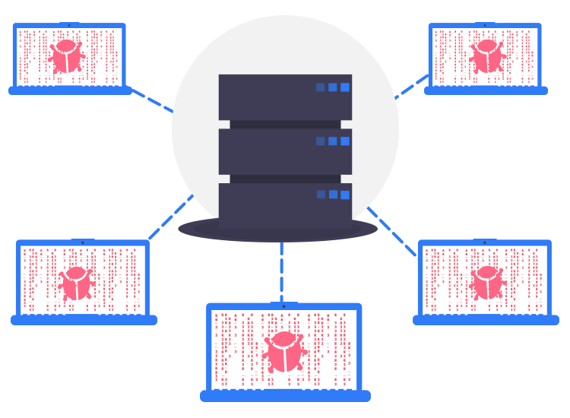
Introduction
Virtual machine - compute resource that uses software to run programs and deploy apps
Hypervisor - creates and runs virtual machines
FTP - protocol used for uploading and downloading files
UDP - protocol used for communication
VSFTPD - FTP server
IDS - system that monitors network traffic
Flooding attack
very high volume of traffic sent to a system so that it cannot examine and allow permitted network traffic

Slide 4
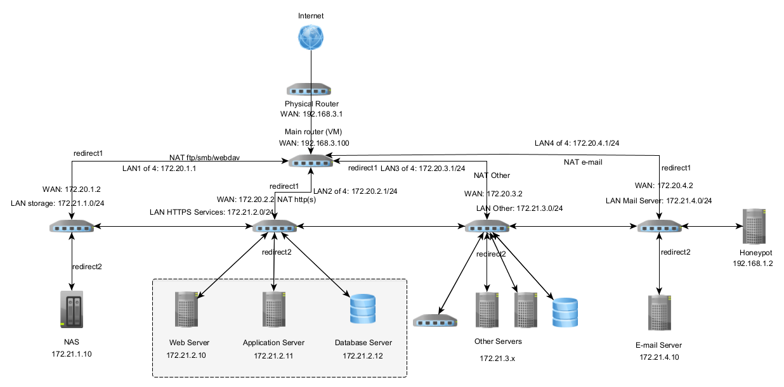
Concept Architecture – Distributed Firewall

Slide 5
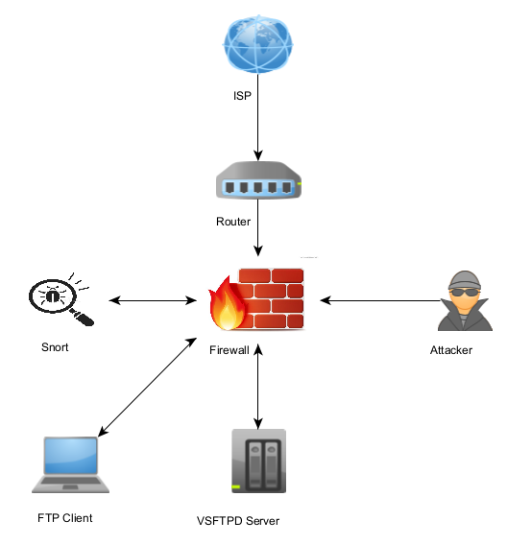
UDP Flood attack model

Slide 6
Software used
Name | Consisting of | Operating System | CPU (cores)
Firewall | pfSense with Snort | FreeBSD | 6
Target | VSFTPD | Ubuntu | 4
Attacker | LOIC | Windows 10 | 4
LOIC
Target IP | 172.21.3.100
Timeout | 9001
Port | 20
Method | UDP
Threads | 1000
Wait for reply | Yes
Speed | Faster

Slide 7
Snort rule configuration for UDP flood
drop udp any any -> $HOME_NET any (msg: "LOIC DDos Flood Attempt in UDP mode"; flags:0; ttl: 128; flow: stateless; detection_filter: track by_dst, count 90000, seconds 60; sid:3; rev:001;)

Slide 8
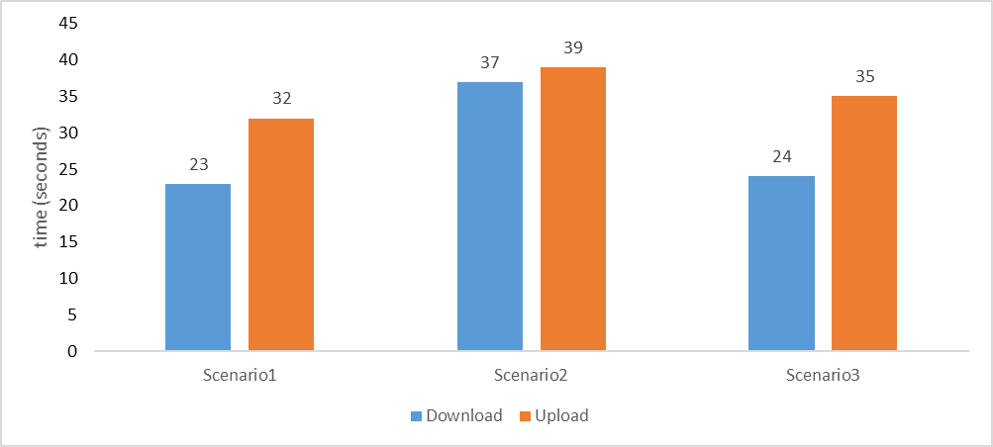
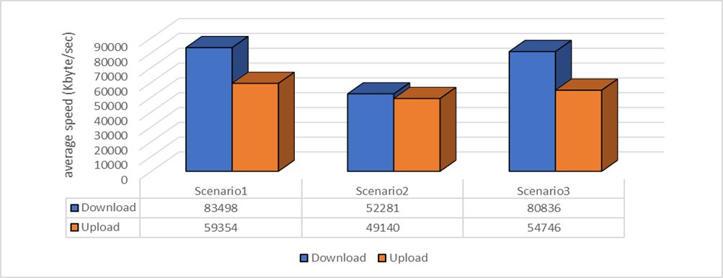
Differences between transfer duration in different scenarios
Differences between average speed in different scenarios

Slide 9
Conclusions And Future Work
In this paper, we proposed an optimization for pfSense through a Snort rule to detect and suppress flood on protocol UDP. Our work shows a significant improvement in performance in this kind of attack inside a network. The results demonstrate that our development of Snort rules makes pfSense use less CPU and network bandwidth when UDP flood occurs. The time of file transfer was significant improved with our study, and can be observed in figures presented previously. The entire network security is improved, and the congestion problem is solved. We are hoping that our work can help other researchers in their study and also network administrators from different sectors.
As a continuation of our work, we propose as future plans to find a way to manage the manner that pfSense administers traffic logs. Optimizing the process of writing the logs after the target is blocked would improve the CPU usage of pfSense. Virtualized networks have a huge number of benefits because of the low cost of implementation and easy maintenance price. They are flexible, improve control over network traffic, and give businesses scalability and extensibility.

Slide 10
Thank you!

