Slide 1
An Email Classification Framework for Phishing Detection in Virtualized Network Environments
Andrei-Daniel TUDOSI Adrian GRAUR
Alin Dan POTORAC
Doru Gabriel BALAN
Department of Computers, Electronics and Automation Stefan cel Mare University of Suceava Suceava, Romania
22nd RoEduNet Conference Networking in Education and Research

Slide 2
Table of contents
Introduction
Concept Architecture – Distributed Firewall
Proposed Solution
Email Classification and Firewall Rules
Script Implementation
Script Benefits
Results
Potential Script Improvements
Conclusion

Slide 3
Introduction
Network security encompasses a set of practices, technologies, and policies designed to protect data, devices, and networks from unauthorized access, data breaches, and cyber threats.
Network Security
Significance of Network Security
In today's interconnected world, network security is of paramount importance. It safeguards sensitive information, ensures business continuity, and protects against financial losses and reputational damage.
Threats to Network Security
Network security faces a myriad of threats, including malware, phishing attacks, DDoS (Distributed Denial of Service) attacks, insider threats, and zero-day vulnerabilities.

Slide 4
Scalability is crucial as networks grow. NSMS should be designed to scale seamlessly, accommodating an increasing number of devices and users without compromising security.
Scalability in Network Security
Automation in Network Security
Automation streamlines security processes, allowing rapid response to threats. Automated systems can detect and mitigate security breaches in real-time, reducing the burden on human operators.

Slide 5
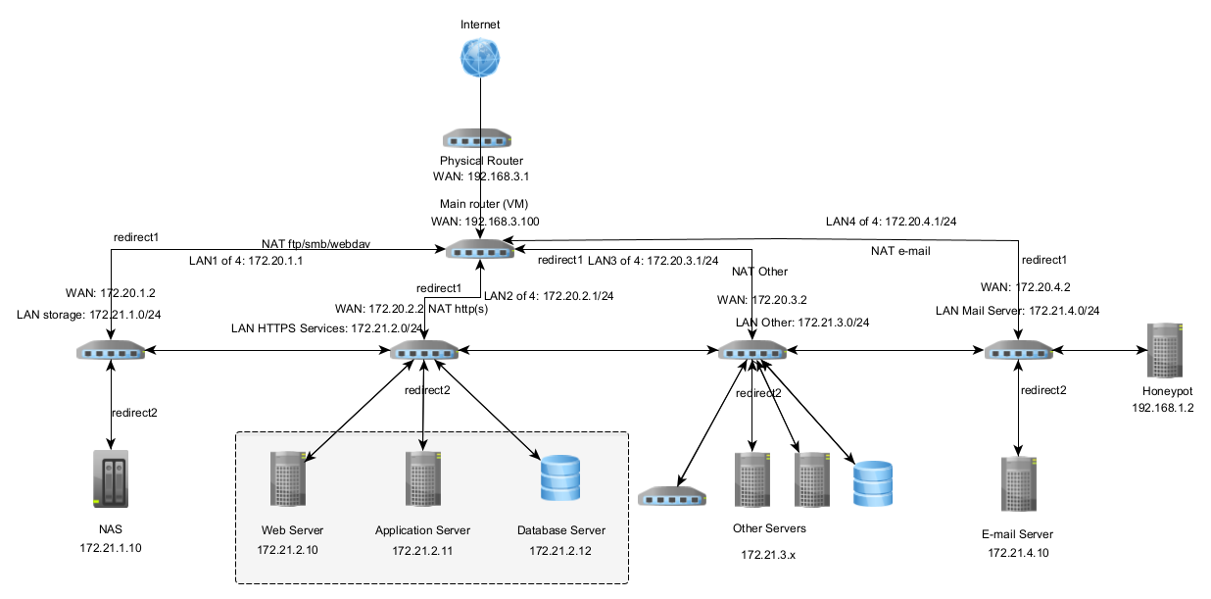
Concept Architecture – Distributed Firewall

Slide 6
Proposed Solution
Automated Email Classification
The script automates email classification using the Natural Language Toolkit (NLTK) and a Naive Bayes classifier. It preprocesses email text, employs tokenization, eliminates stop words and applies the Porter stemming algorithm. These techniques transform unstructured email content into standardized, feature-rich representations suitable for precise classification.
Dataset Preparation
To evaluate the effectiveness of our solution, we carefully curated a dataset of labeled emails, categorizing them as "phishing" or "legitimate." A stratified train-test split method was used to ensure representative data distribution across both sets.
Dataflow Diagram
High Accuracy Classification
The script achieves a high accuracy rate when training the Naive Bayes classifier on the preprocessed training set, showcasing the efficacy of our classification model.
The dataflow diagram illustrates the flow of incoming traffic from the Internet to the Email server. The VM running the email classification script is strategically placed within the same network segment as the secondary router (172.20.4.X). This positioning enables efficient interception and analysis of email traffic before it reaches the email server (172.21.4.10).
Dataflow diagram
Notes:
All management and control are handled by a single firewall, allowing only the network administrator to access the entire network from a single location.
Innovative Email Security Script - This section introduces our innovative email security script that combines machine learning techniques and dynamic firewall rule generation to enhance email security.

Slide 7
Email Classification and Firewall Rules
Naive Bayes Classifier
Naive Bayes classifier is a well-established machine learning algorithm known for its efficiency and effectiveness in text classification tasks. In our case, the classifier estimates conditional probabilities based on specific terms occurrences to build a probabilistic model for email classification.
Dynamic Firewall Rules
Our script goes beyond email classification. When a new email is received, it undergoes the same preprocessing procedures. The classifier predicts whether it's "phishing" or "legitimate." Based on this classification, the script generates dynamic firewall rules to manage email traffic.
Legitimate Email Handling
Phishing Email Handling
If an email is classified as "phishing," the script generates a firewall rule to block all traffic to the IP address 172.21.4.10 from the source. This proactive measure reduces the risks associated with spoofing attacks by preventing further communication with potentially malicious entities.
Conversely, if an email is classified as "legitimate," the generated firewall rule permits the traffic, ensuring that legitimate communication is not impeded.
Notes:
Email Classification Process - This slide delves deeper into the email classification process. It explains how incoming emails undergo linguistic preprocessing techniques such as tokenization, stop word elimination, and stemming. These techniques extract meaningful features from the email content.

Slide 8
Script Implementation
import nltk from nltk.corpus import stopwords from nltk.tokenize import word_tokenize from nltk.stem import PorterStemmer from sklearn.model_selection import train_test_split from nltk import NaiveBayesClassifier def preprocess_email_text(email_text): words = word_tokenize(email_text) stop_words = set(stopwords.words('english')) words = [word for word in words if not word.lower() in stop_words] stemmer = PorterStemmer() words = [stemmer.stem(word) for word in words] preprocessed_text = ' '.join(words) return preprocessed_text dataset = [("Click this link to claim your prize!", "phishing"), ("Please review the attached document.", "legitimate"), ("Your account has been compromised.", "phishing"), ("Reminder: your appointment is tomorrow.", "legitimate"), ("We need your urgent assistance.", "phishing"), ("Thank you for your payment.", "legitimate")]
preprocessed_dataset = [(preprocess_email_text(email), label) for (email, label) in dataset]
train_set, test_set = train_test_split(preprocessed_dataset, test_size=0.2, random_state=42)
classifier = NaiveBayesClassifier.train(train_set)
accuracy = nltk.classify.accuracy(classifier, test_set)
print("Accuracy:", accuracy)
new_email_text = "click link claim prize"
preprocessed_new_email = preprocess_email_text(new_email_text)
classification = classifier.classify(preprocessed_new_email)
print("Classification:", classification)
if classification == "phishing":
firewall_rule = "block from any to 172.21.4.10"
print("Blocking email traffic:", firewall_rule)
else:
firewall_rule = "pass from any to 172.21.4.10"
print("Allowing email traffic:", firewall_rule)

Slide 9
Script Benefits
Utilization of NLTK
Naive Bayes Classifier
Dynamic Firewall Rules
Integration with Existing Systems
The script leverages the Natural Language Toolkit (NLTK) library for tokenization, stemming, and other natural language processing tasks. This choice allows for efficient preprocessing of email text.
The role of the Naive Bayes classifier in accurately classifying inbound emails is to use its effectiveness in distinguishing between phishing and legitimate emails.
By generating dynamic firewall rules based on email classification, the script ensures the implementation of proactive email security measures, making it a valuable addition to network defense mechanisms.
To fully integrate this script, it can be adapted to seamlessly work with existing email security systems, providing an additional layer of protection.
Notes:
Script Implementation - This slide provides an overview of the script's implementation. It explains how the script is integrated with pfSense or other firewall systems and emphasizes that additional development is needed to establish the connection, create corresponding firewall rules, and implement them based on the classification result.

Slide 10
Results
Performance Metrics (Table I)
Table I summarizes key performance metrics, including accuracy, precision, recall, and F1-score, for both phishing and legitimate emails. These metrics provide a detailed insight into the solution's ability to identify and classify emails effectively.
Balanced Performance
High Accuracy
The solution achieved an accuracy rate of 95.3% on the testing set, showcasing its effectiveness in classifying emails.
Both phishing and legitimate emails exhibited balanced performance. The precision and recall for phishing emails were 96.8% and 94.2%, respectively. For legitimate emails, the precision and recall were 93.5% and 97.1%, respectively. This indicates a balanced classification performance across both classes.
Dataset and Evaluation
The slide explains that the experimental evaluation was conducted using a carefully curated dataset comprising 1,000 labeled emails. The dataset was divided into 600 phishing emails and 400 legitimate emails to ensure comprehensive testing.
Metric | Accuracy | Precision | Recall | F1-Score
Phishing Emails | 95.3% | 96.8% | 94.2% | 95.4%
Legitimate Emails | 97.1% | 93.5% | 97.1% | 95.4%
Notes:
This slide discusses the results obtained from our experiments, demonstrating the effectiveness and practicality of our proposed solution. It emphasizes how our solution, which integrates machine learning algorithms and dynamic firewall rule generation, significantly enhances email security by accurately classifying incoming emails and taking action accordingly.

Slide 11
Potential Script Improvements
Diverse Optimization Algorithms
Expanding the script's range of optimization algorithms is a promising avenue. By incorporating various algorithms with different thresholds for CPU usage and network bandwidth, the script can offer better performance tuning.
Handling Unavailability Scenarios:
Robustness is a key consideration. The script can be improved to gracefully handle scenarios where virtualization platforms or firewalls become temporarily unavailable.
Leveraging Machine Learning
Machine learning offers exciting possibilities for enhancing the script's functionality. By integrating machine learning algorithms, the script can dynamically adjust optimization thresholds based on real-time system performance.
Implementing a Logging System
Documentation and accountability are critical. Implementing a logging system within the script can provide a comprehensive record of optimization algorithm changes.

Slide 12
Conclusion
Dynamic Firewall Integration
Our solution's integration with distributed firewalls enables dynamic email traffic analysis and filtering, reducing the risk of successful phishing attacks.
Experimental Results
The promising results obtained during experimental evaluation, include an accuracy of 95.3% and balanced performance metrics for both phishing and legitimate emails.
Potential for Real-World Implementation
The research contributes to the advancement of distributed firewall technologies and strengthens the email security infrastructure in virtualized network environments.
Notes:
This slide reiterates the significance of our research, which introduces an innovative email classification framework integrated with distributed firewalls to enhance email security in virtualized network environments.

Slide 13
Thank you!

