Slide 1
Design and Implementation of a Distributed Firewall Management System for Improved Security
Andrei-Daniel TUDOSI Adrian GRAUR
Alin Dan POTORAC
Doru Gabriel BALAN
Department of Computers, Electronics and Automation Stefan cel Mare University of Suceava Suceava, Romania
22nd RoEduNet Conference Networking in Education and Research

Slide 2
Table of contents
Introduction
Concept Architecture – Distributed Firewall
Network Security Management Systems
Centralized vs. Distributed Systems
Advantages of Distributed Network Security Management
Proposed Solution
Diagram of algorithm
Results
Potential Script Improvements

Slide 3
Introduction
Network security is a multifaceted discipline dedicated to safeguarding computer networks and connected devices against a broad spectrum of threats.
These threats encompass malicious activities, unauthorized access, data breaches, and various forms of cyberattacks.
Network Security
In an era marked by digital transformation and data-driven operations, network security assumes critical importance.
Network security is essential to maintaining trust with customers, clients, and stakeholders, as data breaches can have severe repercussions on reputation and financial stability.
Significance of Network Security
Notes:
Significance of Network Security - It plays a pivotal role in preserving the confidentiality, integrity, and availability of sensitive information and critical systems.

Slide 4
The landscape of network security is continuously evolving, presenting new and sophisticated challenges.
Threats can originate from various sources, including hackers, malware, and external attacks.
These threats can compromise not only data but also disrupt operations and compromise the trust of users.
Challenges and Threat Landscape
To address these challenges, organizations turn to network security management systems.
These systems are designed to provide a comprehensive and proactive approach to network protection.
They encompass a range of technologies, tools, and practices aimed at detecting, preventing, and responding to security threats.
Introducing Network Security Management Systems
Notes:
Introducing Network Security Management Systems - They encompass a range of technologies, tools, and practices aimed at detecting, preventing, and responding to security threats.
In the context of this presentation, we will delve into the concept of a network security management system, exploring its components and benefits.

Slide 5
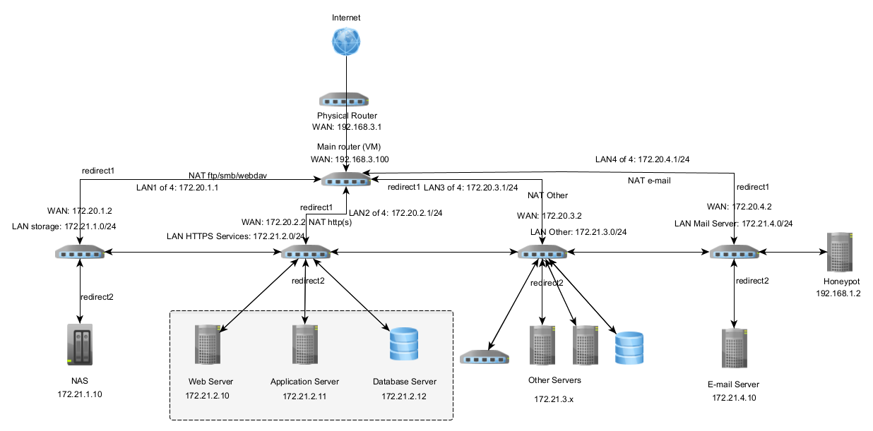
Concept Architecture – Distributed Firewall

Slide 6
Network Security Management Systems
Role of Key Components
Firewalls serve as the first line of defense, preventing unauthorized access and filtering incoming and outgoing network traffic.
Virtual Private Networks (VPNs) enable secure remote access to networks, ensuring that data transmitted between endpoints remains encrypted and confidential.
Intrusion Prevention Systems (IPS) work in tandem with firewalls, actively monitoring network traffic for suspicious patterns and taking immediate action to thwart potential threats.
Notes:
Network security management systems rely on a combination of critical components to fortify defenses. Three primary components stand out: firewalls, intrusion prevention systems (IPS), and virtual private networks (VPNs).

Slide 7
Centralized vs. Distributed Systems
In centralized systems, security controls and monitoring are concentrated in a single location or device. This approach offers simplicity and ease of management but may struggle to scale effectively in large or complex networks.
Conversely, distributed network security management systems are designed for scalability and adaptability. They employ a network of interconnected security devices and components spread across the network infrastructure.
The presentation will delve into the merits of distributed systems, which provide highly scalable and adaptable protection for large or intricate networks.
Notes:
Network security management systems can be categorized into two main architectures: centralized and distributed.

Slide 8
Advantages of Distributed Network Security Management
Improved Scalability
One of the standout advantages of distributed systems is their inherent scalability. These systems can effortlessly adapt to the evolving needs of networks, accommodating growth, and increased complexity.
Enhanced Adaptability
Distributed systems provide a high degree of adaptability, making them ideal for large or intricate networks. Their architecture allows for the flexible deployment of security components, tailored to specific network segments or needs.
Efficiency Through Automation
Automation is a cornerstone of distributed network security management systems. By leveraging scripts, tools, and orchestrated processes, these systems streamline security operations.
Centralized Control with Distributed Benefits
While distributed systems offer decentralized security components, they often feature centralized control and management.
This combination allows network administrators to maintain oversight of the entire network security posture while benefiting from the agility and adaptability offered by distributed architecture.
Notes:
Distributed network security management systems offer a myriad of advantages that are instrumental in fortifying network defenses and ensuring robust protection. Let's delve into some of these key benefits:

Slide 9
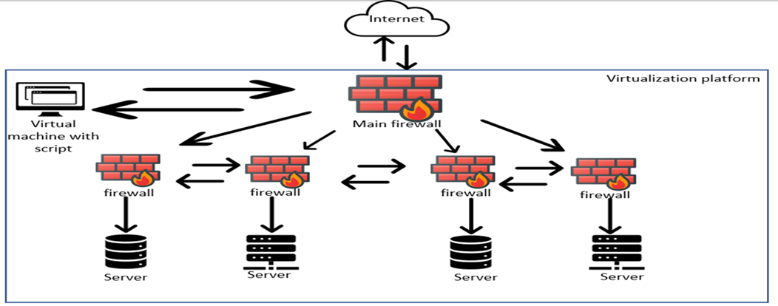
Proposed Solution
Notes:
All management and control are handled by a single firewall, allowing only the network administrator to access the entire network from a single location.

Slide 10
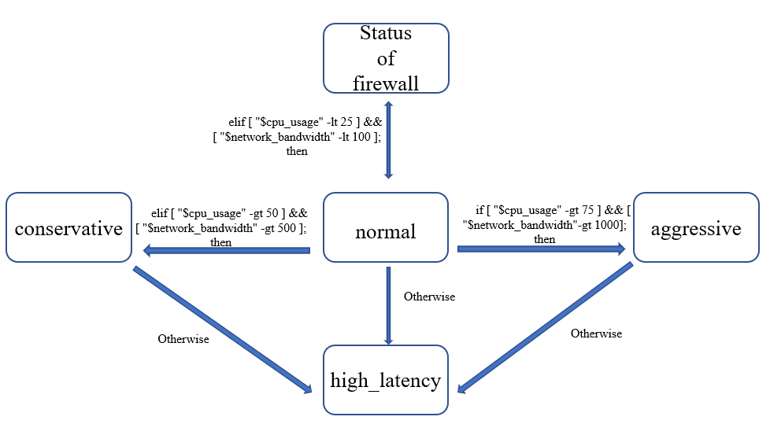
Diagram of algorithm
if [ "$cpu_usage" -gt 75 ] && [ "$network_bandwidth" -gt 1000 ]; then
optimization_algorithm="aggressive"
elif [ "$cpu_usage" -gt 50 ] && [ "$network_bandwidth" -gt 500 ]; then
optimization_algorithm="conservative"
elif [ "$cpu_usage" -lt 25 ] && [ "$network_bandwidth" -lt 100 ]; then
optimization_algorithm="normal"
else
optimization_algorithm="high_latency"
fi

Slide 11
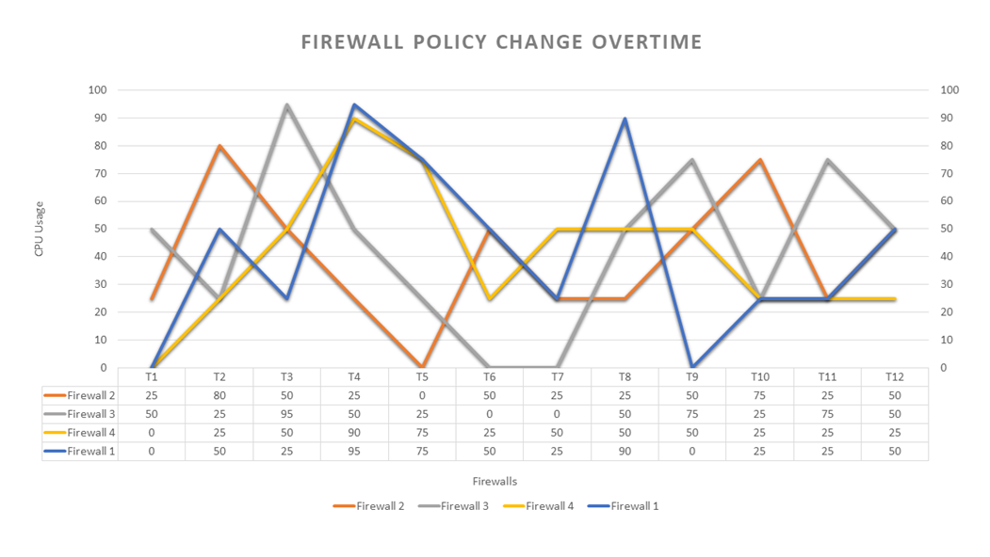
Results

Slide 12
Potential Script Improvements
Diverse Optimization Algorithms
Expanding the script's range of optimization algorithms is a promising avenue. By incorporating various algorithms with different thresholds for CPU usage and network bandwidth, the script can offer better performance tuning.
Handling Unavailability Scenarios:
Robustness is a key consideration. The script can be improved to gracefully handle scenarios where virtualization platforms or firewalls become temporarily unavailable.
Leveraging Machine Learning
Machine learning offers exciting possibilities for enhancing the script's functionality. By integrating machine learning algorithms, the script can dynamically adjust optimization thresholds based on real-time system performance.
Implementing a Logging System
Documentation and accountability are critical. Implementing a logging system within the script can provide a comprehensive record of optimization algorithm changes.

Slide 13
Conclusion
Bash Script's Contribution
The Bash script presented today stands as a testament to the power of automation in network security management.
Efficiency and Effectiveness
By automating distributed firewall management, the script not only increases efficiency but also bolsters the effectiveness of network security operations.
Ensuring Compliance and Trust
In today's regulatory environment, compliance is paramount. Automated security policy management aids in regulatory adherence, reducing the potential for fines and penalties.

Slide 14
Thank you!

