Slide 1
Improving the security of a webservice: best practices and attack simulations
Automatic Control and Industrial Informatics Department
Faculty of Automatic Control and Computers

Slide 2
Table of content
Abstract & Introduction
Objectives
Related work
Security methods
Experimental results
Conclusions

Slide 3
Abstract & Introduction
Most of the nowadays applications are client-server based
Main target: expose a webservice from a low-level programming language
Focus on best practices and security methods

Slide 4
Objectives
Developing a webservice using C++
Gradually improve the security of the webservice
Check internal and external dependencies
Automate the management of resources
Encrypt the communication between client and server
Analyze all data from empirical approach
Generate a series of conclusions

Slide 5
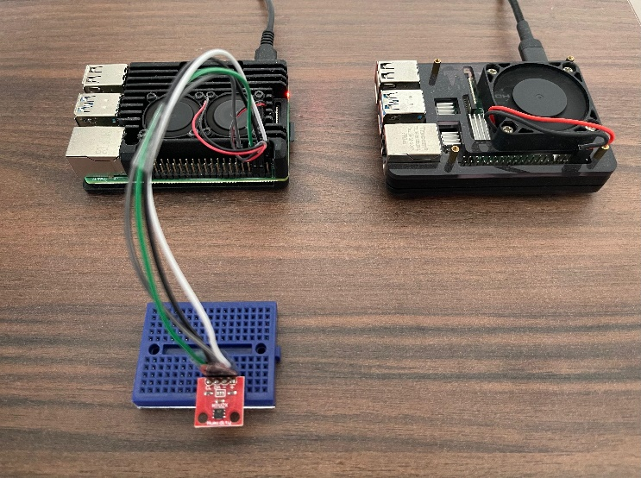
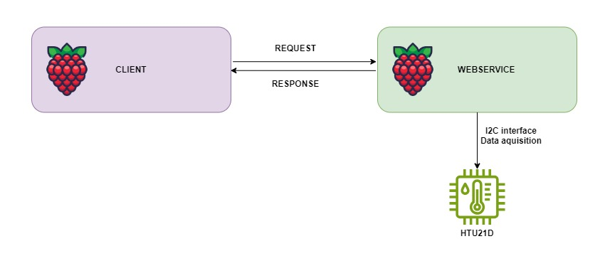
Related work
Developed webservice:
Armhf architecture
Raspberry PI
HTU21D humidity and temperature sensor
Get all data over I2C interface
Fig. 1. Data flow from client to server
Fig. 2. Physical systems – server and client

Slide 6
Security methods
Checking internal and external dependencies
How to: check for all exploits found up to this point
National Vulnerability Database NIST
CVE Numbering Authorities
Result: Avoiding potential exploits / Accepting and analyzing some possible consequences
Concrete example - webservice dependencies:
Restbed: no exploits have been reported
RapidJSON: no exploits have been reported
OpenSSL: all versions have vulnerabilities
Ex: version 3.0.11 – CVE-2022-1434 (related to RC4-MD5 algortithm)

Slide 7
Security methods
Automating the resource management
How to: Smart pointers & RAII idiom
Result: Avoiding memory leaks
Why is important to avoid memory leaks?
Such a small and seemingly harmless mistake can represent a significant opportunity for the attacker
Talk about a concrete example: a webservice which collects data from pressure, temperature and humidity sensors within an automated pipeline for the automotive industry
Encrypting the communication between client and server
How to: digital certificates and HTTPS
Result: encrypted communication - end to end (confidentiality and integrity of data)

Slide 8
Experimental results
Empirical approach for validating the security methods
All tests were conducted into a controlled environment
Everything was done solely to validate some results and discover new possible exploits
Man in the middle attack simulation
Method: ARP poisoning
Purpose: to validate the effectiveness of the TLS protocol

Slide 9
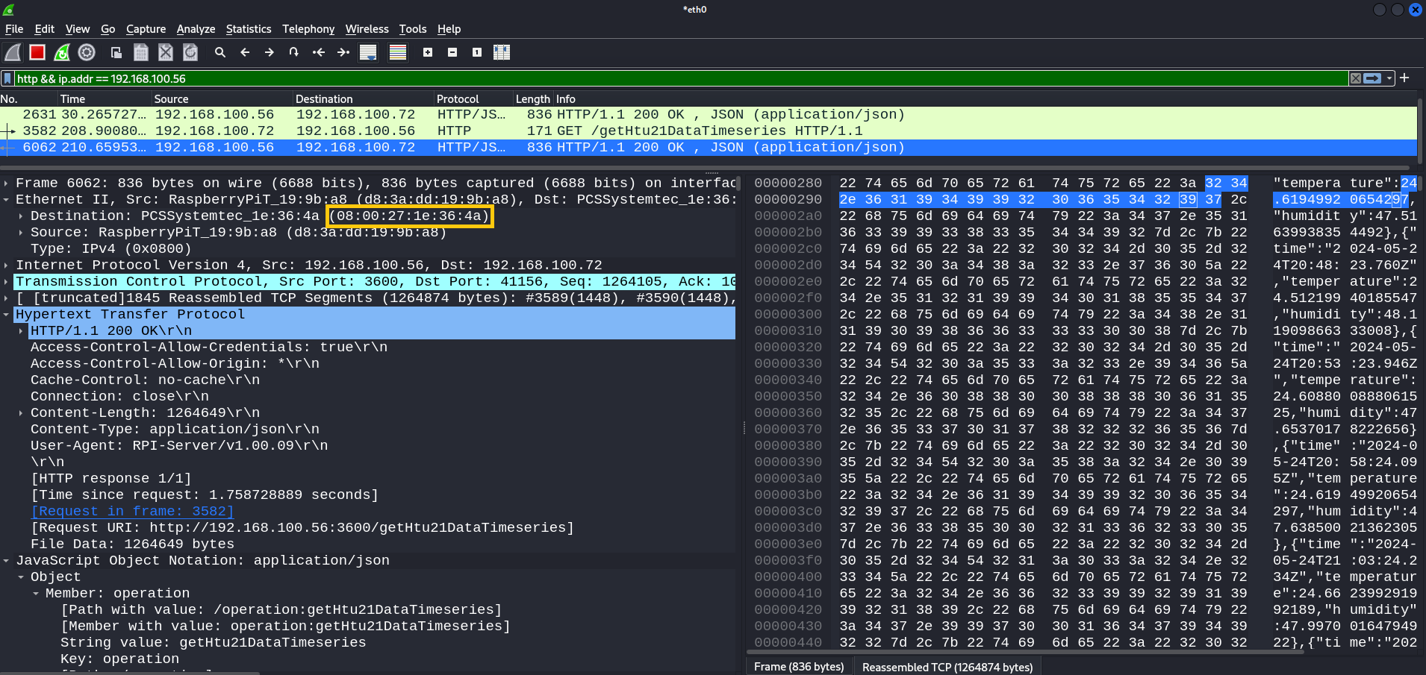
Experimental results
Fig. 3. Man-in-the-middle attack, HTTP protocol, no digital certificate and TLS disabled

Slide 10
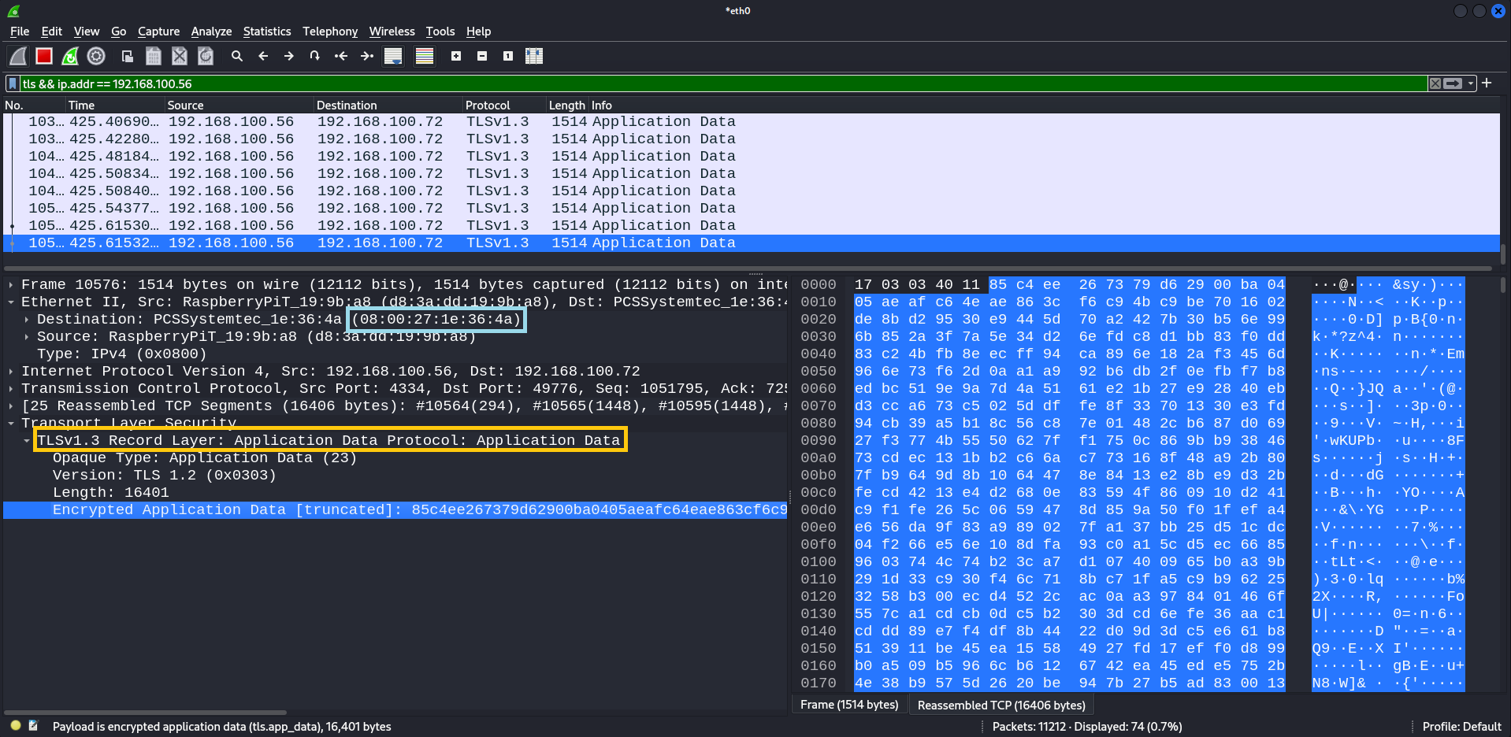
Experimental results
Fig. 4. Man-in-the-middle attack, TLS protocol enabled, digital certificate on server side

Slide 11
Conclusions
Combined a theoretical and empirical approach to improve the security of a webservice
Proposed a series of good practices to be applied for avoiding memory leaks
Our personal thoughts:
Digital certificates play an important role in mitigating MITM attacks
However, we did not find any scientific research which validates that this method provides 100% protection against MITM
The presence of digital certificates and TLS protocol do not guarantee that such an attack cannot be successfully executed

Slide 12
Thank you for your time and attention!

