Slide 1
Advanced Persistent Threats

Slide 2
A short intro of APTs
APTs are sophisticated, prolonged cyberattacks.
Target organizations for long-term, persistent exploitation.
Often conducted by nation-states or organized crime.
Objective: Gain unauthorized access, remain undetected, exfiltrate sensitive data.

Slide 3
Network Security in the Digital Age
Essential services depend on secure network infrastructures
Information technology is increasingly interconnected
Need for robust practices, protocols, and technologies

Slide 4
Understanding APT Attack Taxonomy
Taxonomies provide structured classifications for attacks
Enable security analysts to anticipate threats and enhance defenses
APTs employ various tactics and procedures for infiltration and persistence

Slide 5
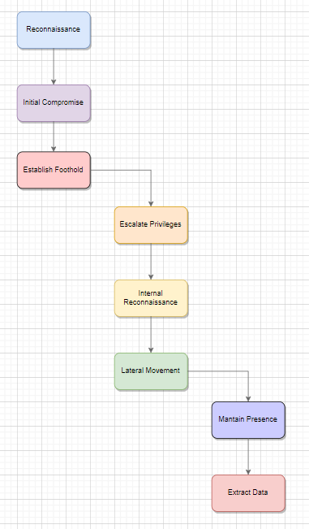
The Lifecycle of an APT Attack
Reconnaissance
Initial Compromise
Establishing Foothold
Lateral Movement
Privilege Escalation
Command & Control
Data Exfiltration

Slide 6
Techniques Used in APTs
Spear Phishing: Targeted emails to compromise systems
Watering Hole Attacks: Compromising frequently visited websites
Supply Chain Attacks: Exploiting vulnerabilities in suppliers
Persistence Mechanisms: Installing backdoors, using rootkits.

Slide 7
Expanding Access within the Network
Lateral movement via stolen credentials or remote desktop protocol
Escalating privileges using OS vulnerabilities and credential dumping

Slide 8
Data Exfiltration and Remaining Undetected
Data compression, encryption, DNS tunneling for covert exfiltration
Evasion techniques: fileless malware, log tampering, time stomping

Slide 9
Case Study: Stuxnet Worm
Target: Iran’s Natanz nuclear facility
Exploited Siemens ICS via USB drives and zero-day vulnerabilities
Physical damage to centrifuges; delayed nuclear enrichment
Showcased vulnerabilities in critical infrastructure.

Slide 10
Defending Against APTs
Network Segmentation: Limit lateral movement by isolating critical assets
Multi-Factor Authentication (MFA): Adds security layers
Patch Management: Regularly update and fix software vulnerabilities
Intrusion Detection Systems (IDS): Monitor and detect unusual activities.

Slide 11
Advanced Techniques to Combat APTs
Endpoint Detection & Response (EDR): Real-time monitoring of endpoints
Security Information & Event Management (SIEM): Aggregate logs for early detection
User Training: Educate employees on phishing and social engineering

Slide 12
Key Takeaways
APTs are complex and require robust, multifaceted defense strategies
Proactive detection and segmentation are key to limiting damage
Continuous monitoring and educating employees help mitigate risk
Importance of understanding and staying ahead of evolving APT tactics.

Slide 13
Q&A
Thanks!

