Slide 1

Deploying Machine Learning at the Edge for Real-Time Vehicular CO2 Emission Monitoring
Authors: Medvei Mirabela, Ștefania Ștefănescu, Nicolae Țăpuș

Slide 2
Contents
1. Context & Motivation
2. Related work
3. Proposed Solution
4. System Architecture
5. Edge Deployment
6. Conclusions & Future work

Slide 3
1. Context & Motivation
Transportation = major contributor to CO2 emissions
Passenger vehicles → up to 23% of global CO2 output
Need: accurate, scalable, real-time CO2 monitoring

Slide 4
2. Related work
Early efforts focused on integrating ML components into established modeling frameworks:
  Computer Programme to Calculate Emissions from Road Transport (COPERT)
  Reevaluation of the Environmental Parameters of Automotive Systems (REPAS)
  Comprehensive Modal Emission Model (CMEM)
  MOtor Vehicle Emission Simulator (MOVES)
Recent ML models used in CO2 predictions:
  Regression models(e.g., linear regression, gradient boosting regression, and other supervised regression techniques)
  Random Forest
  Decision Trees
  Support Vector Machines (SVM)
  K-Nearest Neighbors (KNN)
Advanced architectures:
  Multilayer Percep-trons (MLP)
  Recurrent Neural Networks (RNN)
  Long Short-Term Memory (LSTM) networks
  Gated Recurrent Units (GRU)

Slide 5
3. Proposed Solution
Video-based, non-intrusive CO₂ monitoring within an Internet of Vehicles (IoV) framework at traffic intersections
Machine Learning with SHAP (Shapley Additive exPlanations) integration for interpretable analysis
Deployment on FPGA edge hardware for real-time, low-latency performance

Slide 6
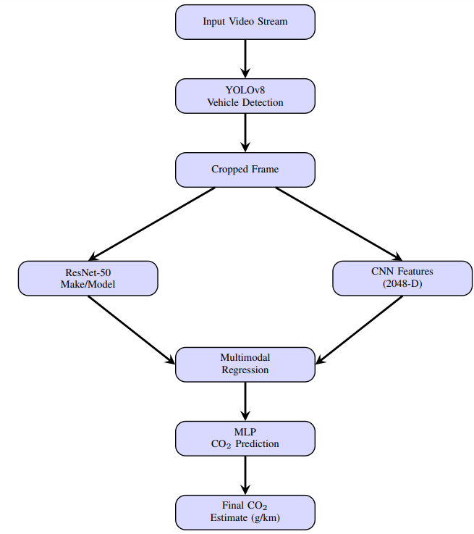
4. System Architecture
4-stage pipeline:
  1. Vehicle Detection: YOLOv8 object detector
  2. Vehicle Classification: ResNet-50 classifier to predict the vehicle’s make and model.
  3. Multimodal Specification Regression: estimate engine size, cylinders, fuel use
  4. CO2 Estimation: MLP

Slide 7
CO2 PREDICTION MODEL (MLP)
Dataset
Dataset:
  Canadian Government’s open dataset on light-duty vehicles
  Features: engine size, cylinders, transmission type, fuel consumption , CO2 emissions (g/km)
  Augmentation strategy: Gaussian noise + duplication → tripled dataset size

Slide 8
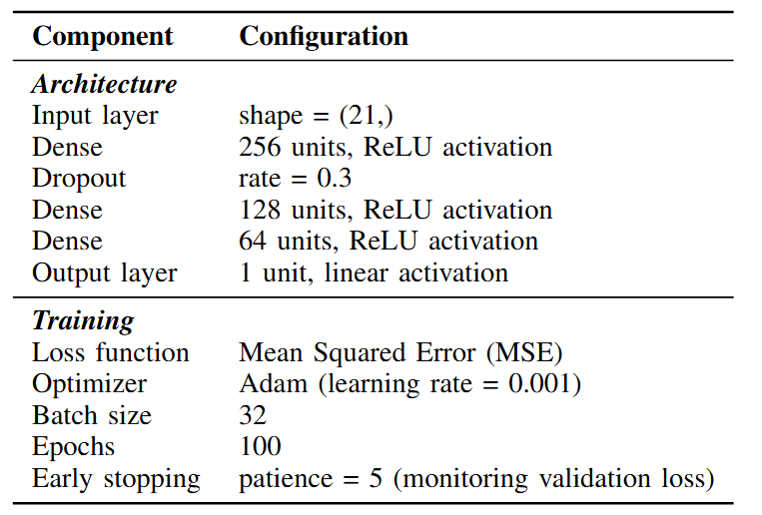
CO2 PREDICTION MODEL (MLP)
Architecture & Training

Slide 9
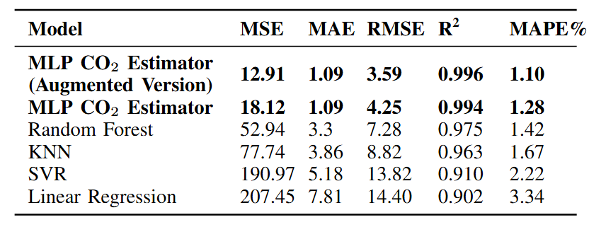
CO2 PREDICTION MODEL (MLP)
Model Performance
Outperforms baselines: Random Forest, KNN, SVR and Linear Regression
Augmentation significantly improved accuracy

Slide 10
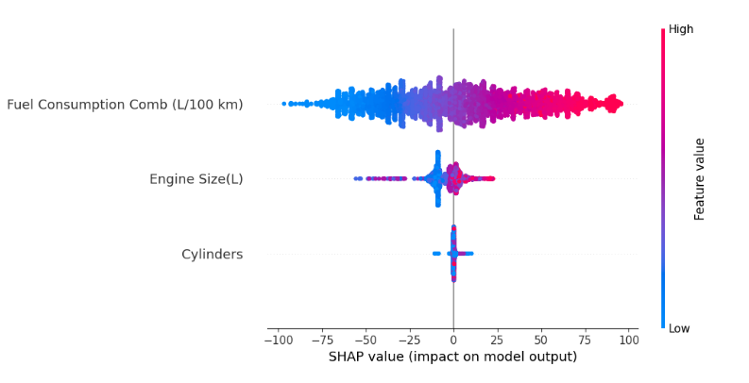
CO2 PREDICTION MODEL (MLP)
Explainable AI (SHAP)
SHAP(SHapley Additive exPlanations) shows how each feature contributes to CO2 prediction
Key features: fuel consumption > engine size > cylinders

Slide 11
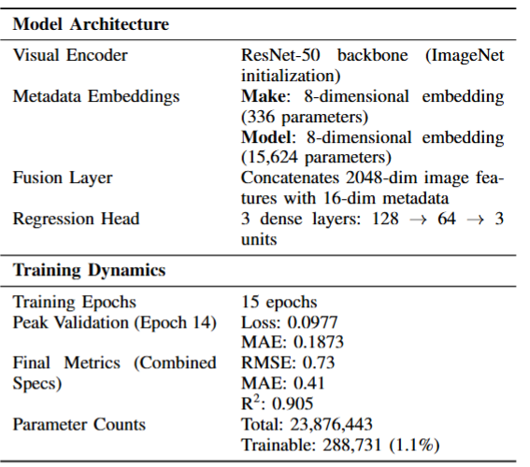
VEHICLE DETECTION AND CLASSIFICATION MODEL
Custom dataset: 22,390 images, each labeled with engine size, cylinder count and fuel consumption.
Flow:
  YOLOv8 detects vehicles in video
  ResNet-50 classifies make/model: cropped car images (224x224) were fed into a ResNet-50 classifier fine-tuned on our scraped dataset of vehicle images.
  Multimodal Specification Regression: predicts engine size, cylinders, fuel use
    R² > 0.9 across all targets (engine size, cylinders, fuel consumption)

Slide 12
SYSTEM Deployment
Architecture optimized for real-time inference and is well-suited for deployment on lightweight edge computing platforms.
Target platform: Xilinx Zynq UltraScale+ZCU104 FPGA.
  Vehicle Detection: The YOLOv8 object detector is deployed on a ZCU104 board using SATAY, a streaming architecture toolflow designed to accelerate YOLO models on FPGA platforms.
  Make and Model Classification: The ResNet-50-based classifier is quantized using Vitis AI, Xilinx’s deep learning optimization toolchain, and deployed on the ZCU104’s DPU for efficient inference.
  Vehicle Specification Regression and CO2 Emissions Prediction model: executed on the ZCU104’s ARM processor.

Slide 13
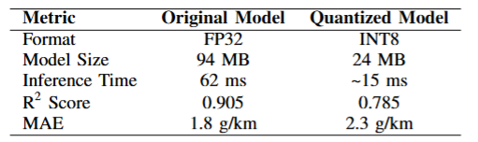
Model Quantization and Deployment Efficiency
deployment on Xilinx Zynq UltraScale+ZCU104 FPGA platform
post-training quantization of the ResNet-50 model using Vitis AI Quantizer and Vitis AI Compiler to produce a deployable format optimized for the platform’s Deep Processing Unit (DPU)
4–5× speedup, 75% smaller model
Accuracy drop: R² 0.905 → 0.785

Slide 14
Conclusions
Key contributions
  Real-time CO2 emission monitoring from video input only
  Edge deployment on FPGA → scalable & efficient, practical for smart cities & IoV integration
  SHAP-based explainability for transparency
  Strong performance vs. classical models

