Slide 1

An IoT View on Network Performance Evaluation
Adrian Diaconita, Dr. Radu Nicolae Pietraru, Dr. Olteanu Adriana
National University of Science and Technology Politehnica Bucharest
Notes:
Slide 1 – Title
“Good [morning/afternoon], my name is Adrian Diaconita, and today I will present our work An IoT View on Network Performance Evaluation, carried out together with Dr. Radu Nicolae Pietraru and Dr. Olteanu Adriana at the National University of Science and Technology Politehnica Bucharest. This research looks at how IoT devices can be used not only for their original purposes but also to monitor network performance in a simple and low-cost way.”

Slide 2
Motivation & Context
75B devices expected by 2025, 70% IoT sensors & devices
IoT widely used in smart buildings (e.g., air quality monitoring)
Opportunistic sensing: reusing IoT infrastructure for Wi-Fi monitoring
Notes:
“In 2023, forecasts predicted that by 2025 more than 75 billion devices will be connected to the Internet. Interestingly, only about 30% will be traditional devices like smartphones or PCs. The rest will be IoT sensors and embedded devices.
One of the most popular IoT applications today is air quality monitoring in smart buildings. But we asked ourselves: could we repurpose the same infrastructure for something more? This led us to the idea of opportunistic sensing, where IoT devices serve a dual role—measuring not just environmental data but also network performance.”

Slide 3
Problem Statement
Existing solutions: Cisco DNA Center, UniFi
Enterprise-level → high cost, complex
Need: simple, affordable, real-time Wi-Fi monitoring
Notes:
“Current network monitoring tools like Cisco DNA Center or Ubiquiti UniFi provide excellent performance insights, but they are enterprise-grade solutions. They require expensive licenses, dedicated hardware, and specialized training.
For smaller environments, such as university campuses or offices, this is overkill. What we need is a low-cost, simple, and flexible way to continuously monitor Wi-Fi performance without adding new infrastructure.”

Slide 4
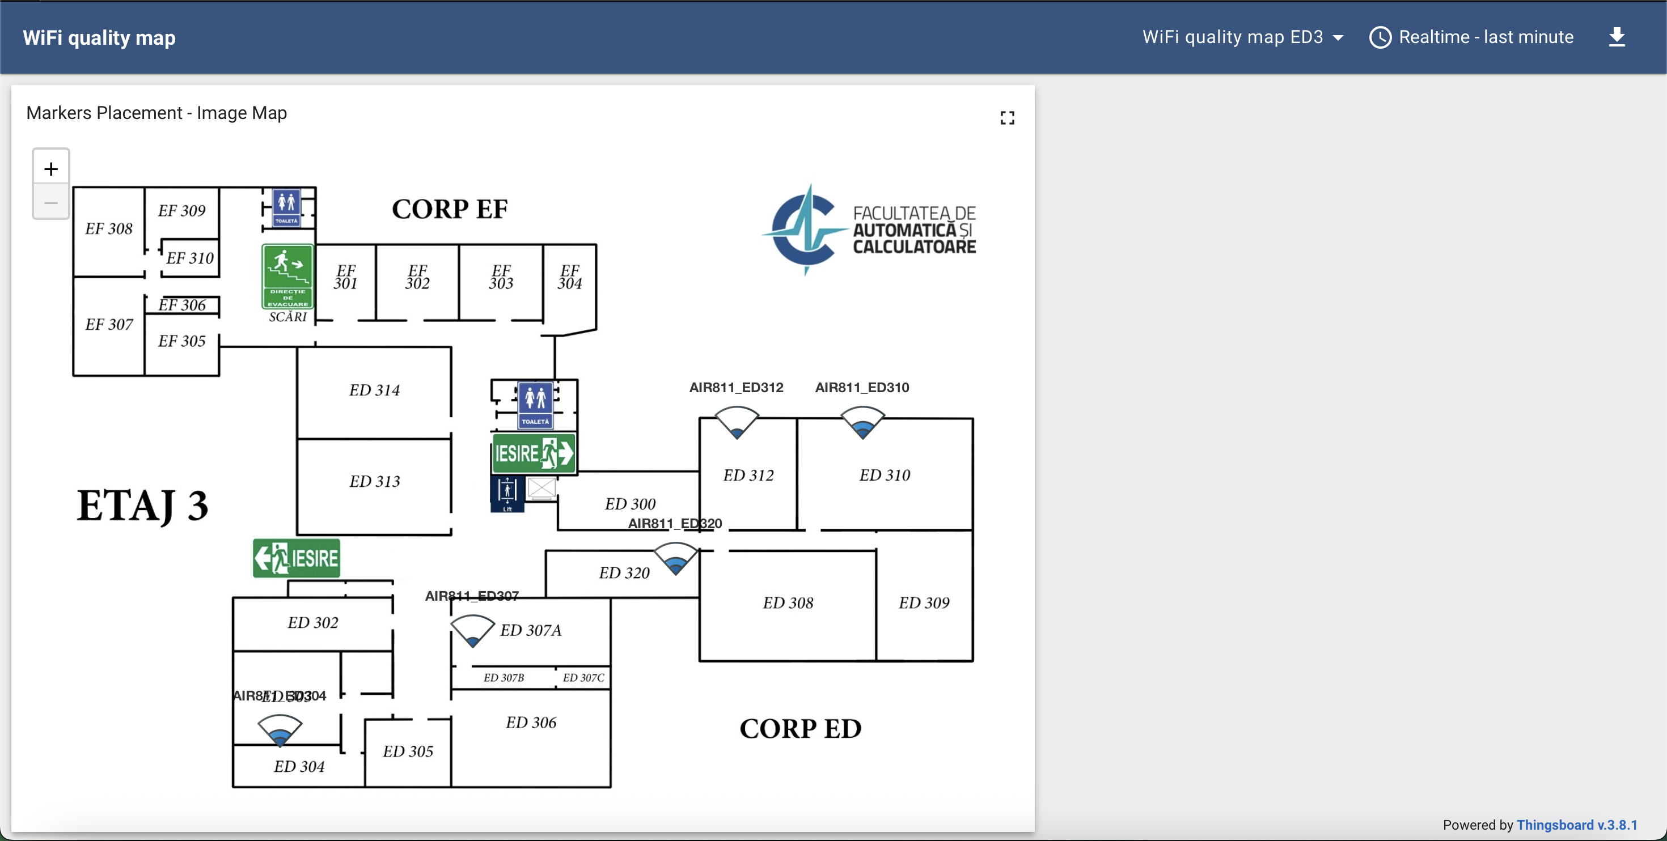
Objectives
Leverage IoT nodes for network performance sensing
Continuous monitoring without extra infrastructure
Visualize data in real time via ThingsBoard dashboards
Fig. 1 Thingsboard Dashboard
Notes:
“Our objectives were threefold. First, to leverage IoT nodes for opportunistic network sensing. Second, to achieve continuous monitoring of Wi-Fi without deploying new devices. And third, to provide real-time visualization of performance through ThingsBoard dashboards. The idea is to reuse what we already have and make the system lightweight but effective.”

Slide 5

System Architecture
Three layers: Data Acquisition → Communication → Visualization
ESP8266 nodes collect metrics
MQTT protocol for data transport
ThingsBoard for visualization
Visualization
Communication
Data Acquisition
Notes:
“The proposed system architecture is modular, with three layers.
The Data Acquisition Layer uses IoT nodes to collect Wi-Fi metrics.
The Communication Layer sends this data efficiently via MQTT.
Finally, the Visualization Layer aggregates and displays results on ThingsBoard dashboards.
This structure makes the solution scalable, reusable, and easy to integrate with existing IoT deployments.”

Slide 6

Data Acquisition
ESP8266-based IoT nodes (low-cost, <$5)
Metrics: RSSI, SSID, channel congestion, latency, encryption
Quality Score: weighted mean based on the metrics above
Notes:
“At the heart of our system are ESP8266-based IoT nodes. These are low-cost devices, less than 5 dollars each, yet powerful enough for Wi-Fi scanning and data collection.
The metrics we track include RSSI, SSID, latency, channel congestion, and encryption type. Every 10 seconds, each node performs a scan, computes a Quality Score using a weighted mean of these metrics, and prepares the data for transmission.”

Slide 7
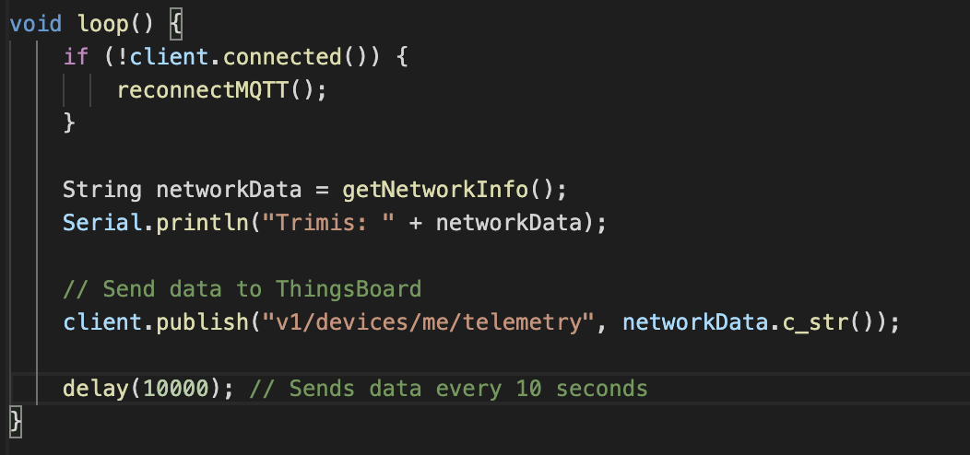

Communication Layer
MQTT lightweight publish/subscribe protocol
Each node sends JSON packets every 10s
Unique client IDs for identification
Notes:
“To transmit the collected data, we use the MQTT protocol. This is a lightweight publish–subscribe model, designed for resource-constrained environments like IoT.
Each node is identified by a unique client ID and sends its results as JSON packets every 10 seconds. This ensures reliable delivery and proper data separation on the server side.”

Slide 8
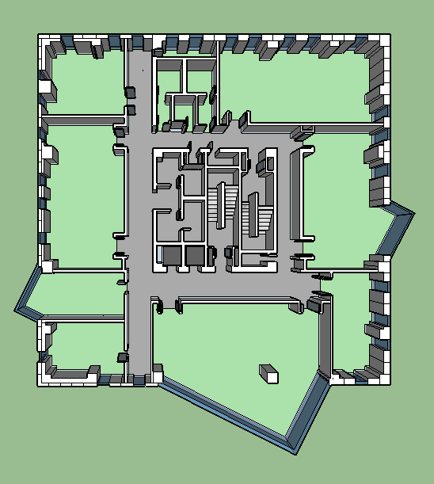
Visualization & Analytics
ThingsBoard IoT platform
Real-time dashboards
Floor plan map (Image Marker Placement Map)
Time-series charts of Wi-Fi metrics
Notes:
“On the server, we deployed ThingsBoard, which is an open-source IoT platform. It allows us to ingest telemetry data, process it, and display it in real time.
We implemented dashboards with two main views:
First, a floor plan map, where nodes are positioned and color-coded by Quality Score.
Second, time-series charts, showing how metrics evolve over time.
This dual representation helps us quickly identify connectivity blind spots and temporal variations.”

Slide 9
Performance Metrics
RSSI: -30 dBm (strong) to -100 dBm (weak)
Ping Latency: <30ms low, 30–100ms acceptable, >100ms high
Channel congestion: number of SSIDs per channel
Security type: WPA2, WPA3, open
Quality Score: weighted (RSSI 30%, Ping 30%, Congestion 25%, Security 15%)
Notes:
“To make the monitoring meaningful, we defined several Key Performance Indicators.
RSSI: signal strength, ranging from -30 dBm for strong to -100 dBm for weak.
Ping latency: low below 30 ms, acceptable up to 100 ms, and high above that.
Channel congestion: number of SSIDs operating on the same channel.
Security type: WPA2, WPA3, or open networks.
We combined these into a Quality Score, where RSSI and ping each contribute 30%, channel congestion 25%, and security 15%. This gave us a single, intuitive metric for performance.”

Slide 10
Deployment Scenarios
Building 1: Single-node → local network + internet performance
Building 2: Multi-node floor deployment → internet performance
Notes:
“We tested the system in two scenarios.
In Building 1, we deployed a single node that monitored both local network performance and internet connectivity.
In Building 2, we distributed multiple nodes across one floor. These focused on internet performance only, giving us a spatial view of Wi-Fi quality across the area.”

Slide 11
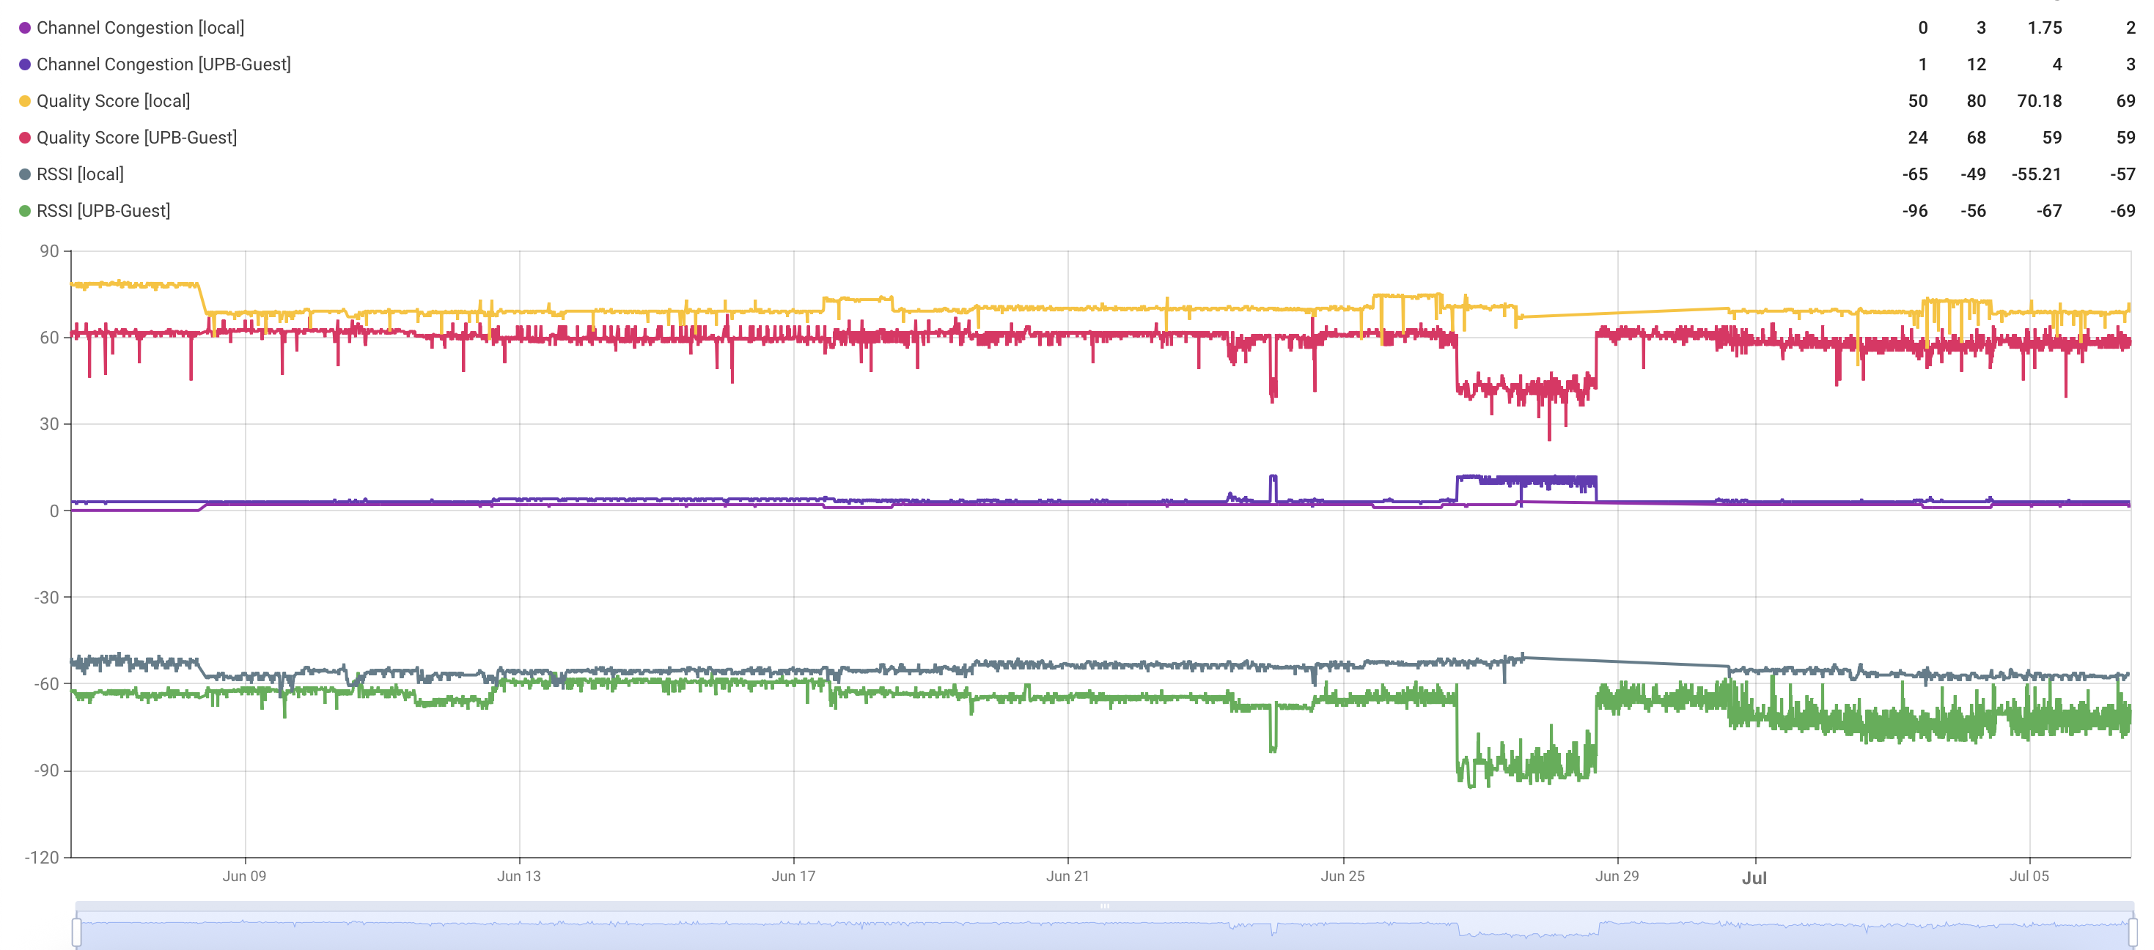
Results
Building 1: Local network stable, internet more variable
Building 2: Halls (center) better quality, extremities weaker
Channel congestion strongly impacts performance
Notes:
“The results were very revealing.
In Building 1, we found that the local network connection was stable, while internet connectivity showed more variability, especially in RSSI and latency.
In Building 2, nodes in central halls reported higher quality scores, while those at the extremities had weaker performance. We also observed that channel congestion had a significant negative effect, with Building B being more congested than Building A.”

Slide 12
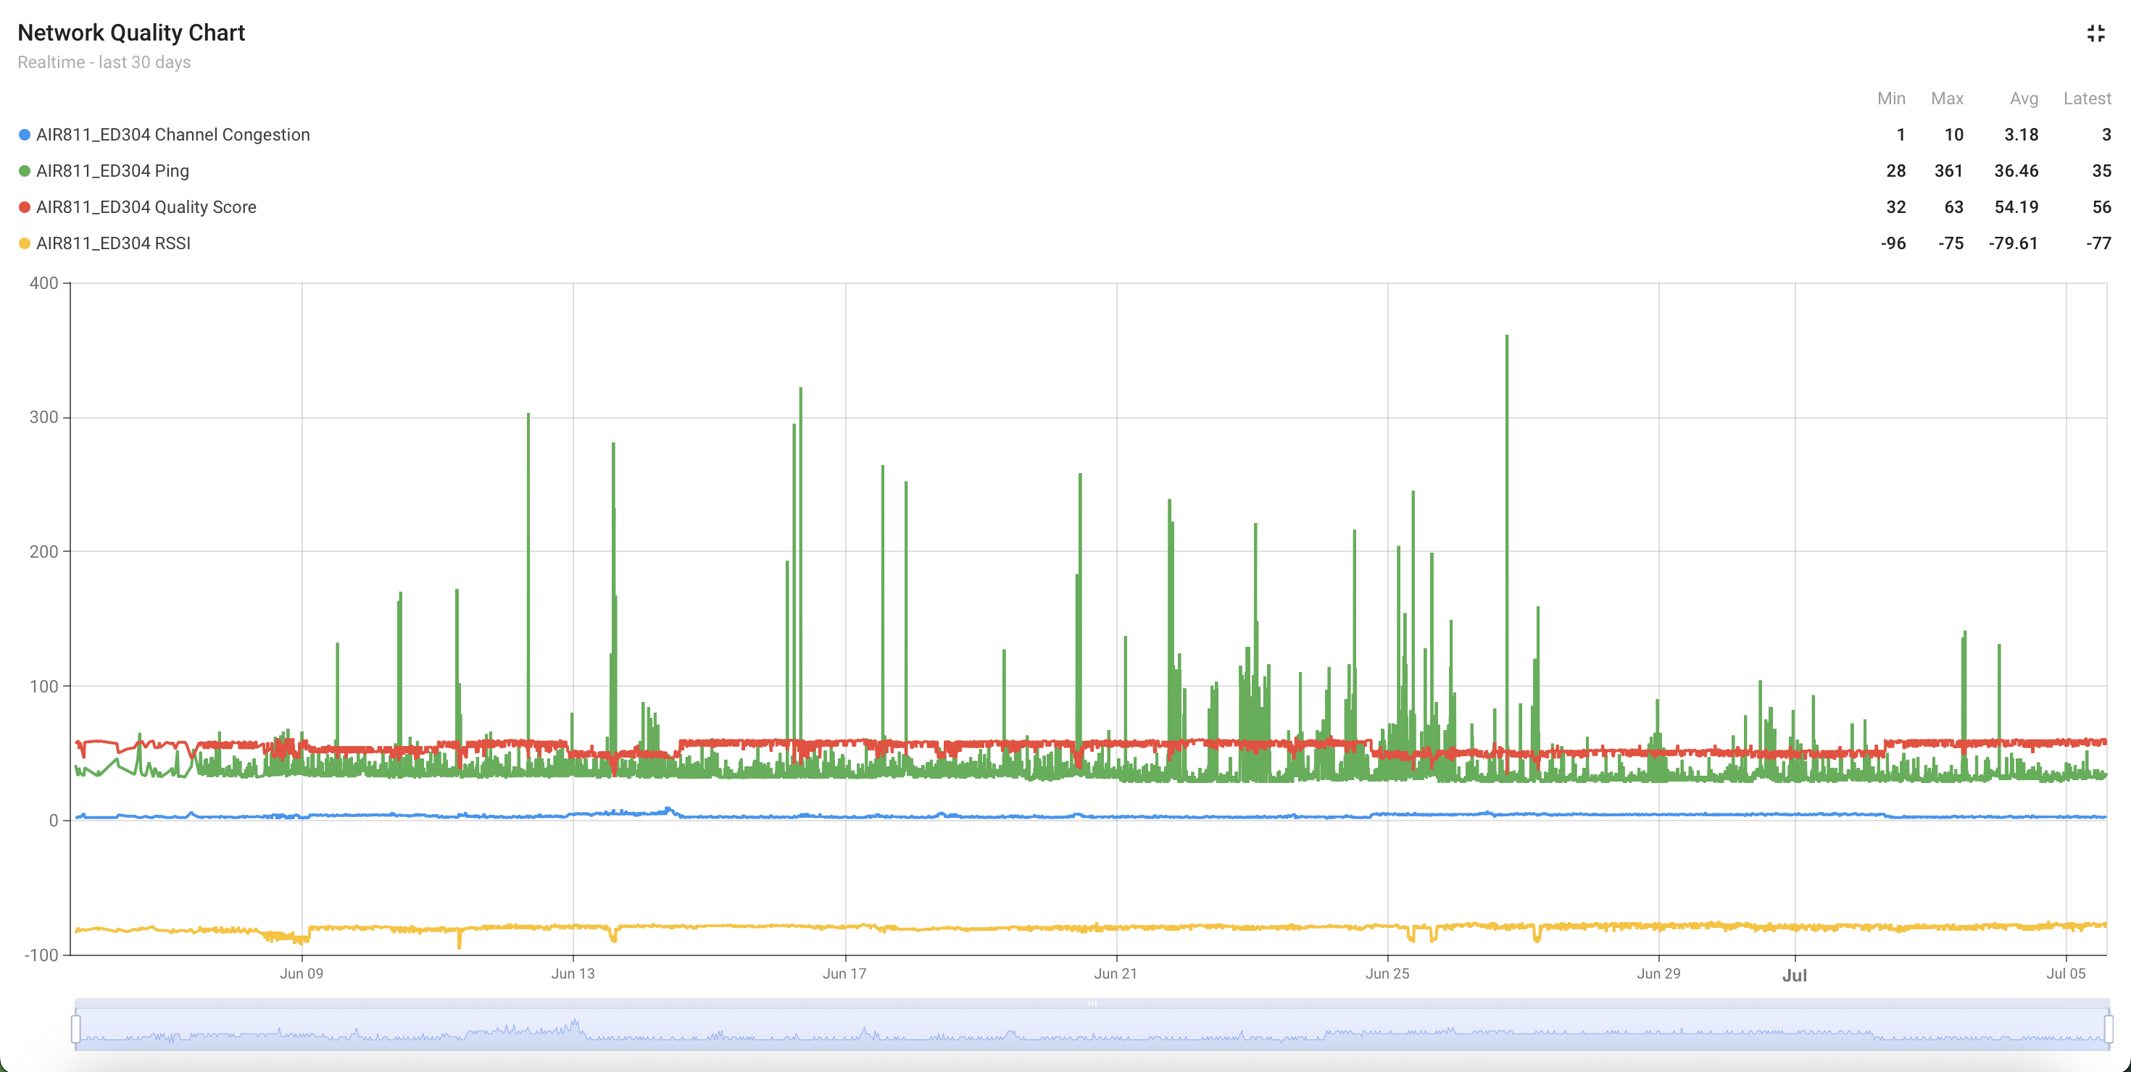
Comparative Analysis
Building 1: One point, local + internet, max RSSI drop -21 dBm, congestion up to 6
Building 2: Whole floor, internet only, max RSSI drop -29 dBm, congestion up to 19
Notes:
“This table summarizes the two deployment scenarios.
Building 1 used a single point and measured both local and internet performance. It experienced a maximum RSSI drop of 21 dBm and channel congestion of up to 6.
Building 2 monitored an entire floor but only internet performance. Here, RSSI drops reached 29 dBm and congestion went as high as 19.
This highlights the difference between controlled single-node monitoring and distributed, real-world conditions.”

Slide 13
Conclusions & Future Work
Feasibility of low-cost IoT Wi-Fi monitoring
Lightweight, scalable, real-time solution
Future: jitter, throughput, anomaly detection with ML
Integration into smart building management systems
Notes:
“To conclude, we demonstrated that IoT-based network performance monitoring is not only feasible but also effective using low-cost devices like the ESP8266.
The system is lightweight, scalable, and provides real-time insights into Wi-Fi quality.
Looking ahead, we plan to integrate additional metrics such as jitter and throughput, and to apply machine learning for anomaly detection and automated alerts. Ultimately, this system could become a part of smart building management, combining environmental and connectivity monitoring into one platform.”

Slide 14

Thank you for your attention Q&A
Notes:
“Thank you for your attention. I will now be happy to take your questions.”

