Slide 1

Reflections on trusting trust after 40 years
Alexandru-Cristian Bardaș

Slide 2
Introduction and motivations
Ken Thompson’s iconic 1984 paper titled “Reflections on trusting trust” represents a foundational idea in software security which became known today as supply-chain attacks.
41 years later, those concepts shine brighter than ever before in the current cybersecurity ecosystem.
The trust aspect evolved in unforeseen ways, developing itself into a wide attack surface, exploiting established trust relationships in attacks such as watering-hole or insider threats.
This research aims to present the last 40 years regarding the concept of “trusting trust”, showcasing just how far security has evolved since, and how attackers have evolved this idea into a unified framework of trust exploitation.

Slide 3

Supply-chain attacks

Slide 4
notpetya
Amidst the world-wide recovery from the WannaCry ransomware in May 2017, a new attack would stir up the cyber space towards the end of June.
Prior to closing hours on June 27, 2017, the day before the celebration of the Ukrainian Constitution, disaster struck when a destructive ransomware attack was launched through the malicious update of an official tax return software named MEDoc.
Initially, security researchers thought this was another Petya campaign. Upon further analysis, this ransomware displayed further enhancements from Petya, particularly aimed towards complete system destruction and credentials harvesting. Due to the similarities in some code but completely new functions added, this malware has been dubbed NotPetya.

Slide 5
notpetya
MEDoc’s extensive usage across a significant number of Ukrainian organizations and neighboring regions created an ideal attack surface for this large-scale attack, given the existent trust relation established by the legitimacy of the software system.
The actual compromise involved the insertion of backdoor code into a Dynamic Link-Library (DLL) component within MEDoc. This method utilizes the legitimacy of the software and its preexistent update mechanism to deliver the payload without triggering defensive controls. Security firm Cisco Talos confirmed that the compromise did occur from MEDoc’s internal servers, validating the supply-chain attack vector.
The malicious DLL enabled the threat actor to gather system data, perform credentials harvesting and download and execute arbitrary code, all distributed through the software’s legitimate update channels. It is believed that the Russian group inside the GRU called Sandworm was behind this attack.

Slide 6

Notpetya
Today, estimates mark the impact of NotPetya as having infected over 2300 organizations in over 100 countries, totaling the monetary losses between 10 and 11 billion dollars, with many calling it the biggest cyber-attack in history.
Critical infrastructure disruptions included Ukrainian banks, airports, and energy distribution networks, while international impacts affected major companies such as American medical company Merck, Hungarian OTP Bank and Russian Rosnyeft.
The biggest company that was shut down was the Danish shipping company Maersk, with an estimated 76 ports and 49000 computers shut down for a couple of days, demonstrating just how extensive the cascading results of supply-chain attacks can be.

Slide 7
Solarwinds and the 15-month campaign
On December 8, 2020, in the midst of the COVID-19 pandemic, security firm FireEye disclosed a security breach, which resulted in theft of data and several proprietary tools. This report triggered a cascading effect, as within days of it, multiple United States (US) government agencies and major enterprises also reported being targeted by cyber-attacks.
Five days later, while investigating the breach, FireEye discovered a backdoor in the SolarWinds Orion software. This discovery prompted global investigations, as the Orion IT network management system served over 300000 companies, including the US government, military, 425 out of the US Fortune 500 companies as well as numerous universities, colleges and companies worldwide, rendering it a perfect avenue for targeting high-valued entities.

Slide 8
Solarwinds and the 15-month campaign
Forensic analysis uncovered attacker-related traffic dating as far back as September 2019, with the compromised update being delivered between March and June 2020. In October 2019, a month after gaining access, the threat actors conducted preliminary tests to ensure the code injection process could bypass the internal checks.
The backdoor, named SUNBURST, focused on exfiltrating sensitive data, being delivered to as many as 18000 companies globally. It incorporated advanced evasion techniques, including mimicking Orion’s legitimate network traffic patterns, checking for anti-virus and forensic tools, using delays in operations and avoiding certain organizations. Most people blame a Russian group inside the SVR known as CozyBear for this attack.
While not as impactful money-wise as NotPetya, the attack still managed to infer around 90 million US dollars (USD) in losses. Not designed for destruction, its primary focus was instead data exfiltration. The full extent of the compromised data is still unknown today, due to the sheer volume of all the stolen data and the number of infiltrated organizations. Because of this, the attack is considered to be the biggest cyber-espionage campaign there has ever been.

Slide 9

3cx and the double supply-chain attack
On March 29, 2023, cybersecurity firm CrowdStrike detected malicious activity associated with 3CX, a widely known and legitimate voice and video calling application. At the time, 3CX counted more than 12 million users across 600000 different enterprises.
The disclosure quickly prompted 3CX to release their own statement, confirming that they have been breached and initiated incident response efforts together with cybersecurity firm Mandiant.
The investigation revealed that the initial compromise occurred due to a preceding supply-chain compromise of a software package related to cryptocurrencies, named X_TRADER, which was installed on the laptop of a 3CX employee. Obtaining access to the network of 3CX, the threat actors moved laterally through it and managed to acquire access to the Windows and macOS build environments. The threat actors behind this attack are believed to be part of the North-Korean Lazarus group.
This was the first instance of a cascading supply-chain attack, demonstrating the compounding risks inherent to supply-chains and the challenges associated with such an attack.

Slide 10
The “xz-utils” incident
On the 29th of March 2023, a software developer by the name of Andres Freund disclosed a critical backdoor in the open-source liblzma library to Openwall’s security mailing list. The vulnerability was assigned a Common Vulnerabilities and Exposures (CVE) number with the highest Common Vulnerability Scoring System (CVSS) score possible, 10.
This report prompted an immediate response within the community, with everyone pitching into what might be the biggest cyber-attack of all times. The repository was quickly frozen, releases halted, and the community coordinated efforts to revert to clean versions of the library.

Slide 11
The “xz-utils” incident
In his report, Freund described the possibility that the committer was having malicious intent with these updates but didn’t elaborate further. Subsequent investigations did however, dive deeper into the committer’s history, and found out that the social engineering component was remarkably straightforward.
Operating under the name “Jia Tan”, the threat actor’s approach relied on basic psychological principles: manufactured urgency through fake feature requests, exploitation of maintainer burnout and gradual trust building through legitimate contributions, establishing himself as a helpful solution. This manufactured workload pressure facilitated the threat actor’s rise to co-maintainer status, thereby allowing him to perform privileged actions within the project.
Eventually, somewhere in 2023, he decided to push out a complex backdoor, very well hidden in the project, and only in the source code of the tarball release, such that dependent projects would be compromised.

Slide 12
The “xz-utils” incident
In stark contrast, the backdoor itself demonstrated remarkable technical complexity. It employed a multi-stage attack chain and sophisticated obfuscation techniques, all culminating in allowing an attacker with a specific private key to execute system commands when connecting to a machine via SSH. During the loading of liblzma within the SSH binary, it would hijack the symbol resolver function, such that the RSA_public_decrypt function would resolve to custom code, allowing execution of commands via the system function.
Despite the backdoor’s presence in various Linux distributions for almost a month, there are no confirmed exploitations. Had this come to fruition, the extent to which it would have caused harm is immense, way beyond what was seen before. This asymmetry reveals why supply-chain attacks are becoming the preferred vector for sophisticated threat actors. The attack reinforces that the weakest link in the software supply chain may not be the build infrastructure or review processes, but the fundamental assumption that community members act in good faith.

Slide 13
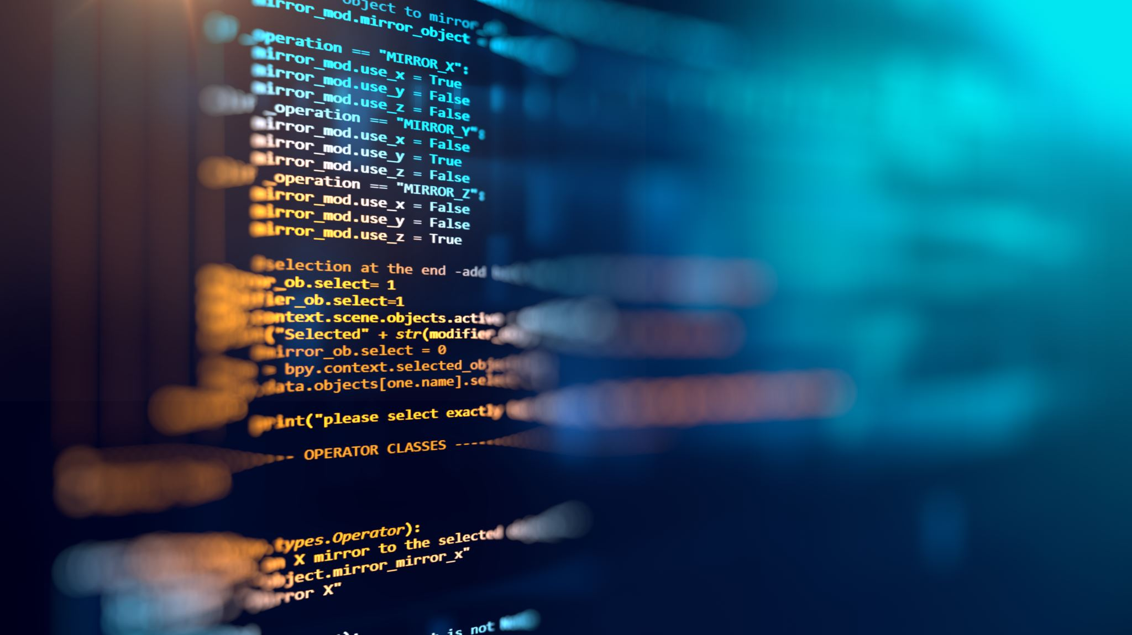
watering-hole attacks

Slide 14

When an update is clearly fake
Fake update notifications have been documented in the literature since 2018, primarily perpetrated by a threat actor designated as TA569, with occasional reports of successful exploitations. This attack variant consists of displaying fictitious yet legitimate looking update prompts to users, thus deceiving them into downloading and running malicious software.
In August 2023, cybersecurity researcher Randy McEoin published his analysis of emerging attacks exploiting this technique, designating the campaign as ClearFake.
These attacks compromised legitimate websites, modifying them to incorporate fake browser update notifications that closely mimicked authentic prompts. The pre-existing trust relationship between the user and the website renders this update prompt credible even to more security-conscious people, demonstrating the psychological tactics this type of lure employs.

Slide 15
When an update is clearly fake
This initial campaign acted as a catalyst for derivative campaigns, due to its colossal deception success rates, as it is a basic truth of the human condition that familiarity leads to lower defenses, highlighting the great risks associated with these types of attacks.

Slide 16

Fake captchas and where to find them
The Completely Automated Public Turing test to tell Computers and Humans Apart (CAPTCHA) is the most prevalent method for authenticating human users in web environments. It can consist of various heuristics checks based on your browsing history or matching various images to specific objects. As anyone would know, the latter is more predisposed to errors, as sometimes an image contains the slightest bits of the required object, therefore making the process take longer.
Attackers have caught on to the user’s cognitive predisposition towards rapidly completing CAPTCHA tests and began exploiting it, by streamlining the process, offering fast and easy to follow steps. However, these steps eventually lead to the user running malicious code, thereby infecting themselves, generally with information stealing malware.

Slide 17
Fake captchas and where to find them
This type of lure has become the most prevalent one in recent times, and it further emphasizes the circumvention of traditional security awareness measures, as they avoid all the general landmarks of phishing, such as temporal urgency, promises of rewards or requirements of immediate action.

Slide 18
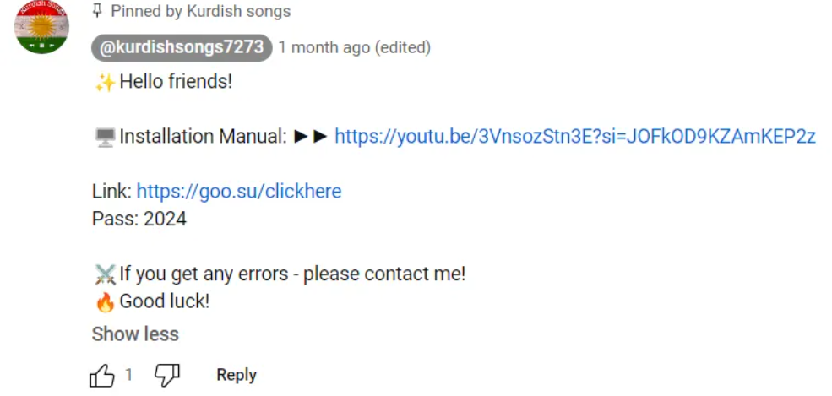
When fixing an error doesn’t actually fix it
Another technique on the rise is called ClickFix. It consists of fictitious error messages, where the compromised website would ask the user to perform a simple action to remediate it. As in the previous case, the provided quick fix involves running a simple command, which will lead to self-infection.
Another variation on this technique is called FakeTutorials, where threat actors compromise websites offering solutions for some of the common errors a user might search for, such as various Windows error codes. The fix, as in the previous cases, includes running malicious code that leads to self-infection.

Slide 19

Insider threats

Slide 20
When a job isn’t actually a job
In the enterprise ecosystem, insider threats have always posed a significant security risk. In contemporary times, these threats have demonstrated a higher prevalence, especially in the Information Technology (IT) sector, mostly due to implications from nation-state threat actors and the possibility of remote work that was made available by the COVID pandemic.
The first of the two campaigns is named ContagiousInterview. Threat actors will post fictitious job listings in the IT sector, offering compromised projects that pose as interview questions. This campaign, together with the following one are perpetrated by state actors of North-Korean origin.
A user would download the code for the project, and upon running it, infect himself with information stealing malware. The malicious code within the project is well hidden, making it hard to detect for an unsuspecting job hunter.

Slide 21
When a job isn’t actually a job
While not directly associated with insider threats, this campaign may pose indirect risk if the person seeking employment is still within an enterprise environment. Additionally, after a successful infection, threat actors may occasionally use the identity of the victim to conduct another operation, one with potentially more risks.

Slide 22
When an employee isn’t actually an employee
The second campaign perpetrated by DPRK’s hackers is named WageMole. This time, threat actors create fake personas or modify existing personas, such that they reflect a different identity, in order to successfully pose as legitimate employment seekers.
In doing so, it is thought that they use this campaign to funnel wages to their weapons’ programs. Notwithstanding the previous claim, this type of attack poses other risks, which were observed when a cybersecurity awareness firm, KnowBe4, was breached as a result of this campaign.
Luckily, no harm was done, as the firm did catch the hacking attempts in time, but this highlights just how great the potential risks are, and that it may happen to anyone.
While this attack was caught on time, subsequent attacks may not and could potentially lead to great damage, from data theft to various supply-chain attacks lead from within, seeing as how the targeted sector is the software industry. Given the rapid evolution of AI, these types of attacks will only increase in numbers.

Slide 23

Bonus attacks

Slide 24
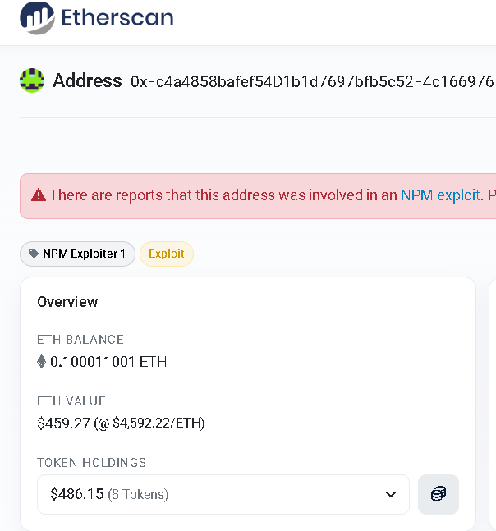
The biggest supply-chain (that would maybe get you a 1 month’s rent in a medium apartment)
On September 8, 2025, a developer publishing packages on the Node Package Manager (npm) was phished, action which led to his npm account being hijacked. The attacker then managed to compromise 18 very popular packages (2+ billion downloads collectively) with crypto-stealing malware.
Fortunately, the developer realized his mistake soon thereafter and came out publicly. The community was understanding and began helping with the remediation, every package being revert to a clean version and all npm accounts being frozen within 6 hours of the initial compromise.
Unfortunately for the attacker, the quick actions of the responsible developer meant that the packages didn’t fully manage to propagate through npm-managed projects, hence the total gains for this attack don’t exceed $500.

Slide 25

Npm and the dune fanboys
On September 15, 2025, the npm was breached (again), by virtue of another targeted phishing campaign against npm maintainers. This time, the attackers didn’t hold back on the type of malware used and have gone with a self-replicating worm dubbed “Shai-Hulud” (after the sandworms from the Dune series), together with credentials harvesting, with a specific focus on cloud environments (AWS, GCP, Azure and others).
This attack began on August 26, when a vulnerable GitHub Action in the Nx repository led to the leaking of a npm publishing token. Since then, the post-install script of the compromised Nx package began slowly extracting credentials from various developers and replicating itself in npm packages. Today, the list of compromised packages contains over 180 entries, with attacks still happening.

Slide 26
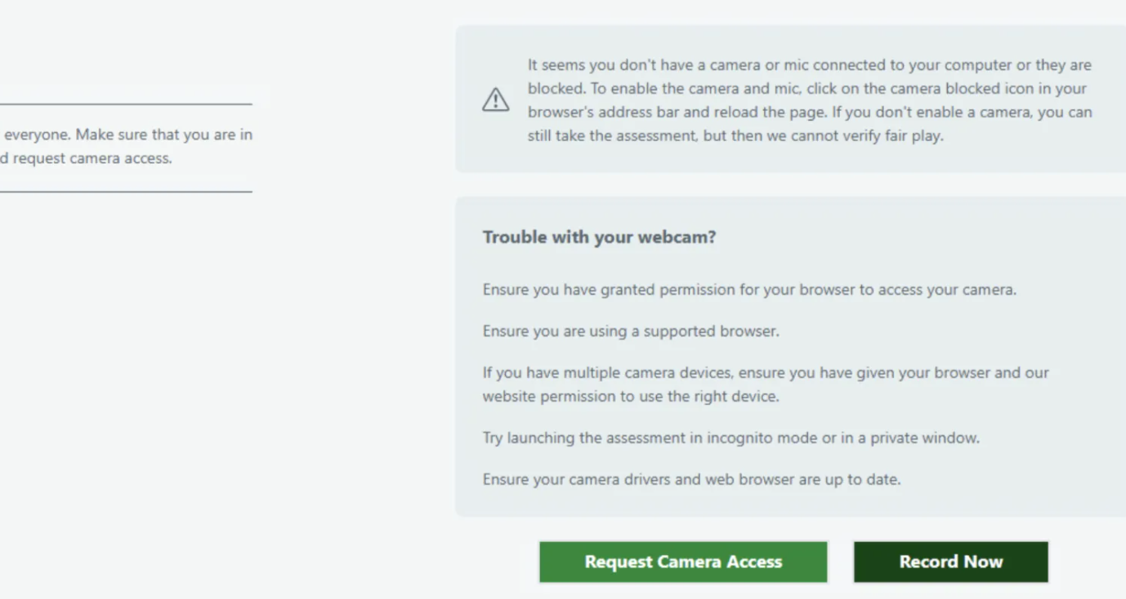
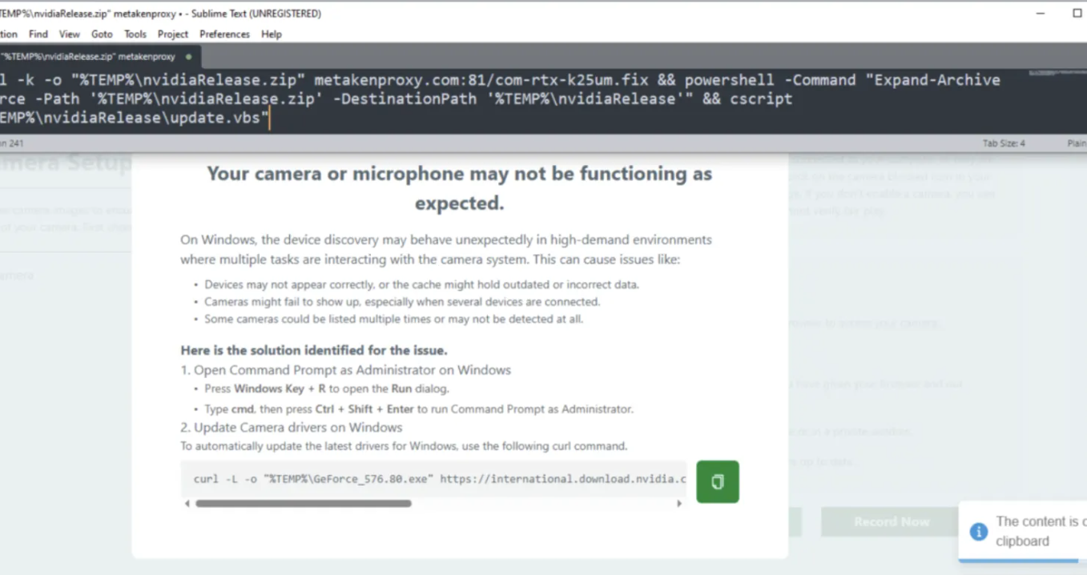
When fake jobs meets fake fixes and they fall in love
In recent times, the North Korean group Lazarus elevated their tactics in the ContagiousInterview campaign and began combining it with ClickFix. Users are invited to an “interview assessment”, where after answering some simple questions, they are asked for camera access for a video. Unfortunately, in all cases the camera does not seem to work, so the attackers provide a “simple” command for fixing it.

Slide 27

Conclusion
As in Thompson’s research, the moral of this paper is that you cannot fully trust code that you did not write. In 1984, that might’ve been feasible, as code bases were generally not that big, but in contemporary times that is just an unreasonable ask.
This research demonstrates how Thompson’s foundational concept of “trusting trust” has directly evolved into a unified framework of trust exploitation, expressing itself across four primary attack vectors: supply-chain attacks, watering-hole attacks, insider threats and phishing, though the latter was not discussed due to it not necessarily being tied to trust exploitation.
Common defensive measures that may aid in the aforementioned attacks include, but are not limited to: zero-trust architectures, continuous external verification and behavioral monitoring of trusted components and adaptive security systems. As AI tools become more widespread in areas such as vulnerability assessment and attack sophistication, organizations must recognize that defending against “trusting trust” requires a more complex approach that addresses the underlying trust assumptions rather than just the technical manifestations of it.

Slide 28

Thank you! Q&a

