Slide 1
Metadata-based Network Traffic Analysis Using Zeek
RoEduNet 2025
Ștefan-Dorin Jumărea
Darius Mihai
Maria-Elena Mihăilescu
Andreia-Irina Ocănoaia
Mihai Carabaș
Lukas Vytautas Dagilis
Andreea Grama
stefan.jumarea@upb.ro
darius.mihai@upb.ro
maria.mihailescu@upb.ro
andreia.ocanoaia@upb.ro
mihai.carabas@upb.ro
ld@nrdcs.lt
agrama@revelsi.com
National University of Science and Technology POLITEHNICA Bucharest

Slide 2

Acknowledgments
Co-funded by the European Union. The project funded under Grant Agreement No. 101145843 is supported by the European Cybersecurity Competence Centre. Views and opinions expressed are however those of the author(s) only and do not necessarily reflect those of the European Union or the European Cybersecurity Competence Centre. Neither the European Union nor the European Cybersecurity Competence Centre can be held responsible for them.​

Slide 3
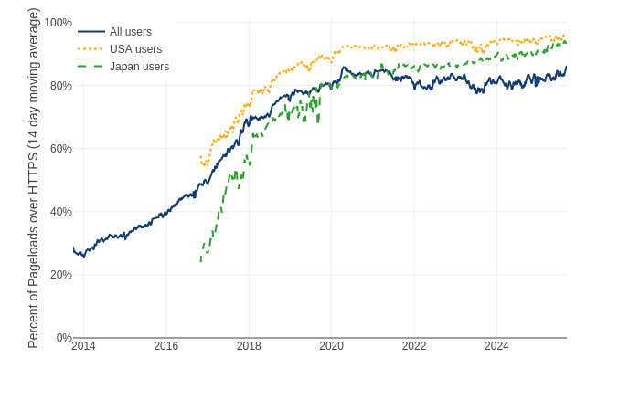
Encrypted Internet Traffic Adoption
> 80% of web pages loaded using HTTPS
Encrypted traffic is good, but difficult to monitor
Attackers will hide behind the encryption
Classic IDS will not work
Felt, A. P., Barnes, R., King, A., Palmer, C., Bentzel, C., & Tabriz, P. (2017). Measuring {HTTPS} adoption on the web. In 26th USENIX security symposium (USENIX security 17) (pp. 1323-1338).

Slide 4
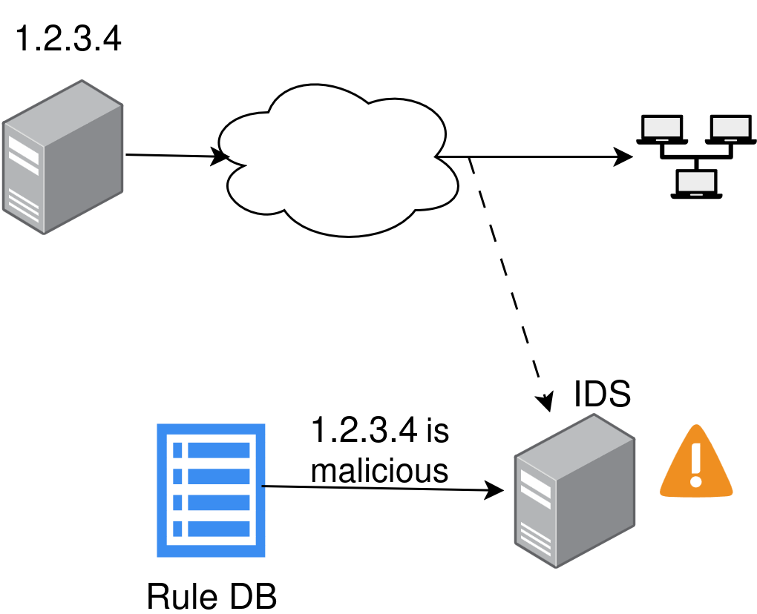
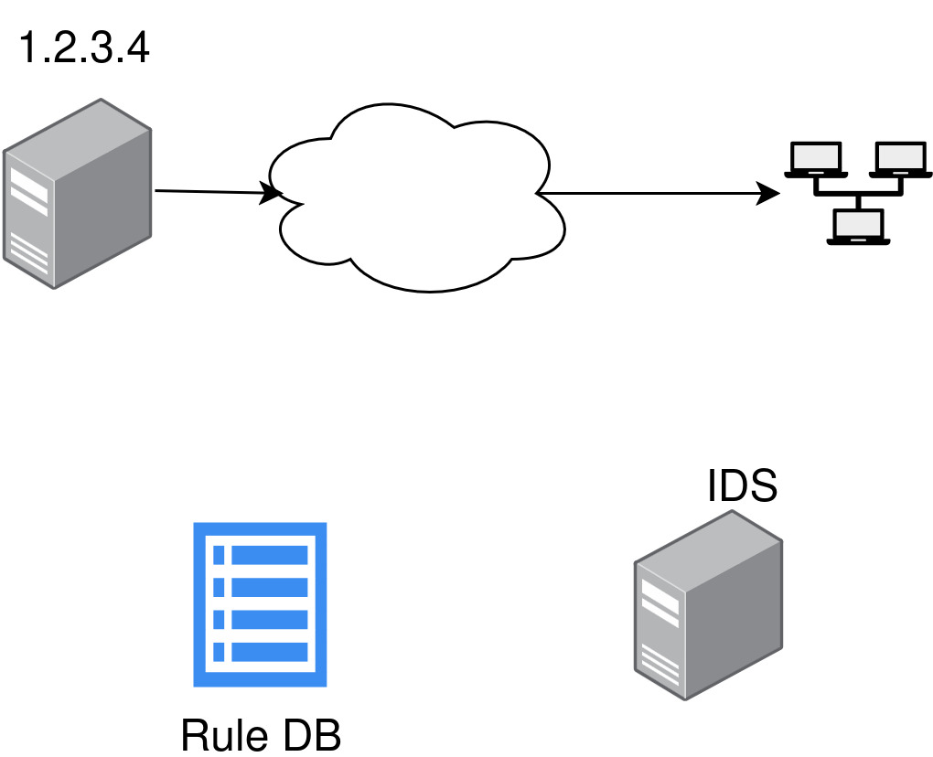
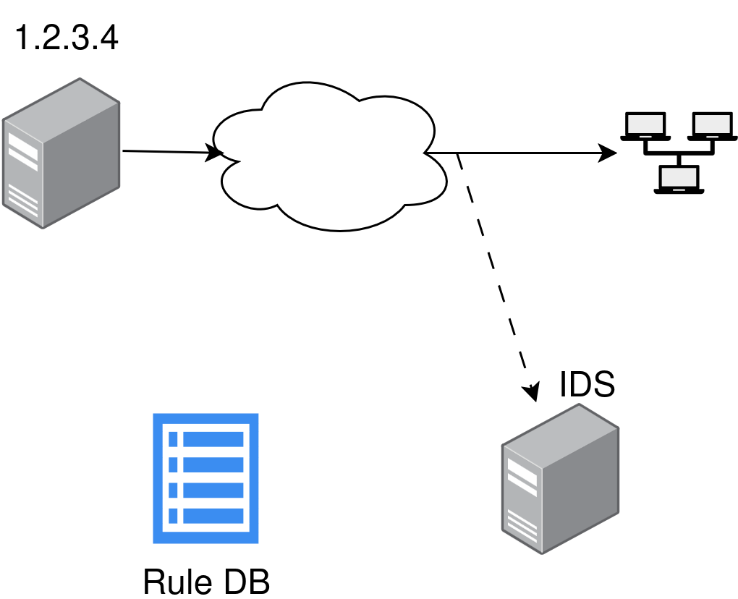
Network Intrusion Detection
Rule-based

Slide 5
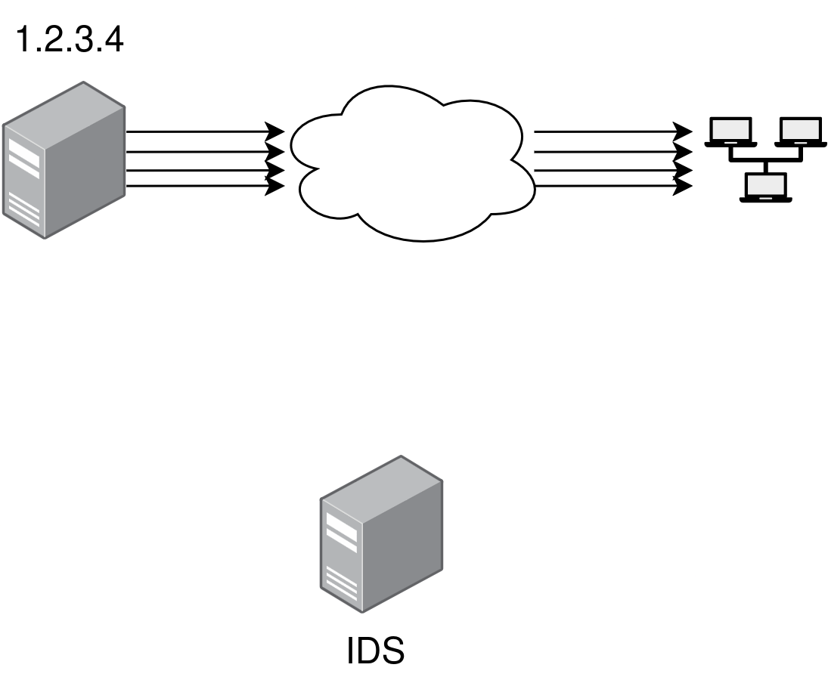
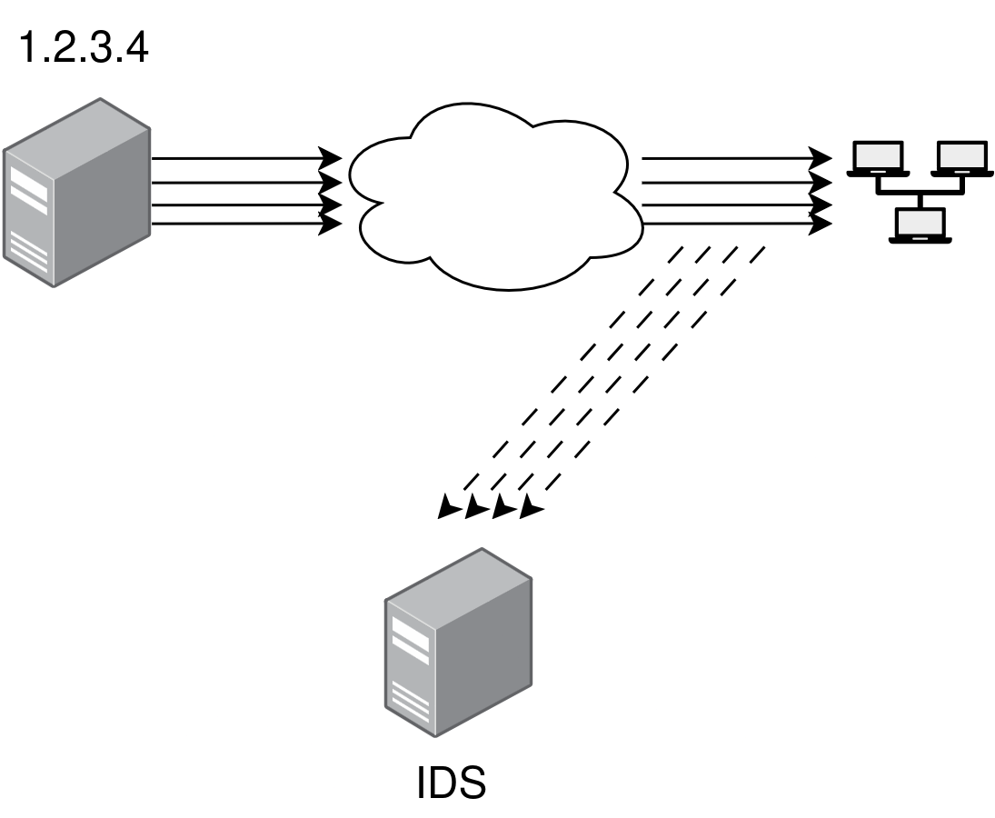
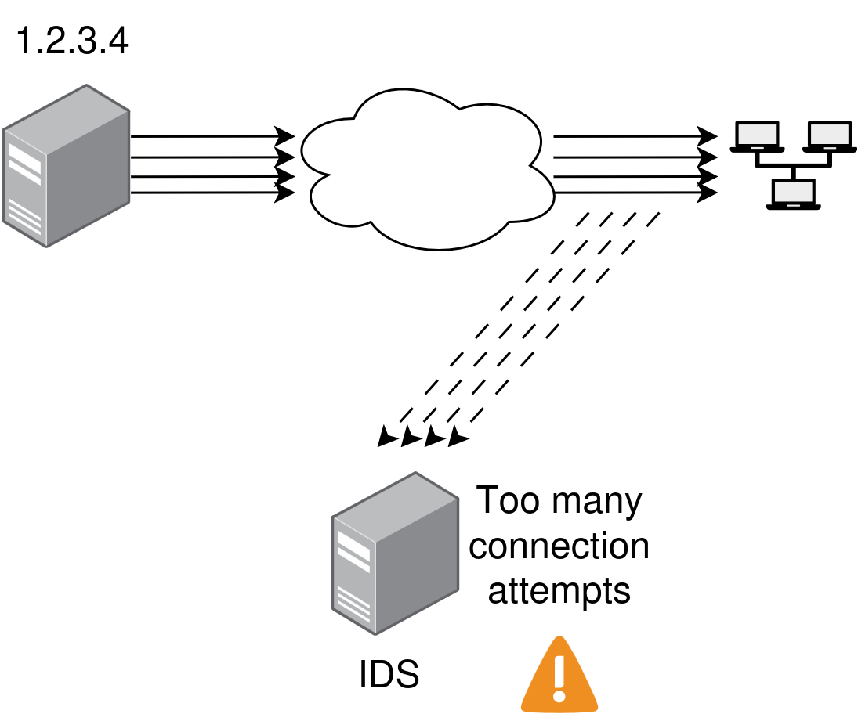
Network Intrusion Detection
Anomaly-based

Slide 6




IDS Solutions

Slide 7
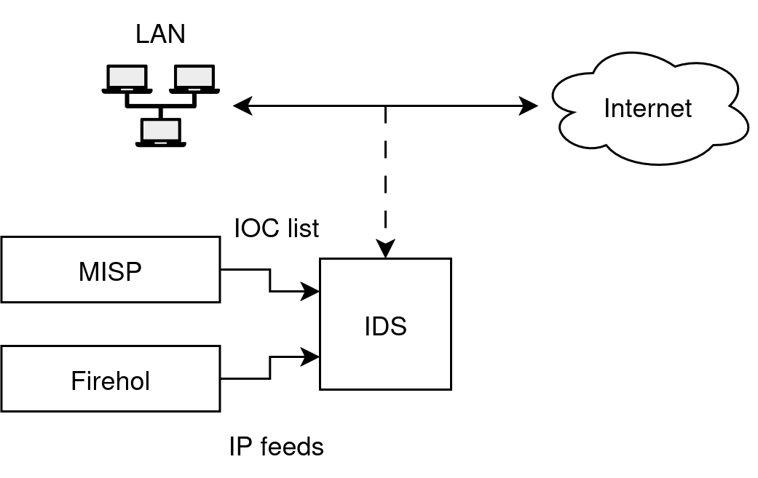
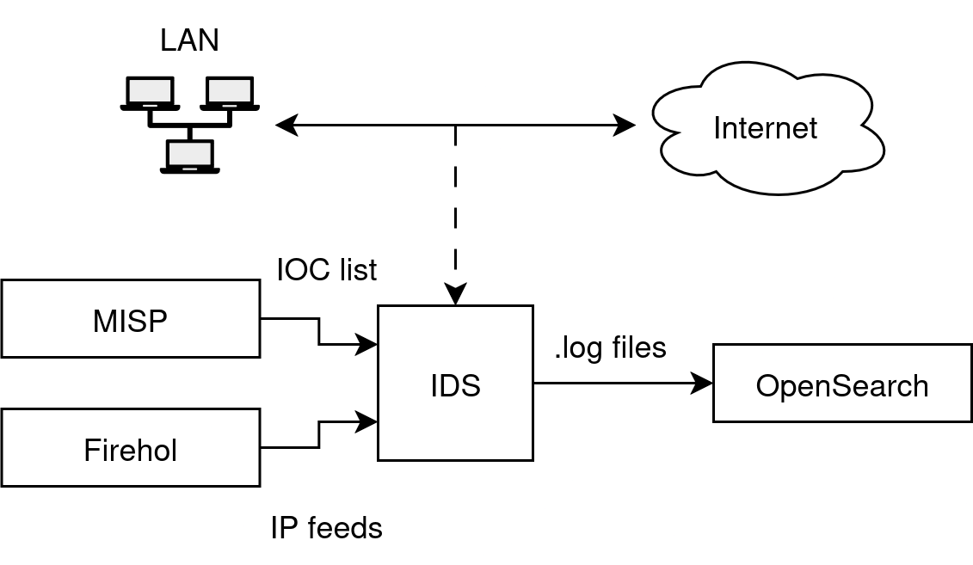
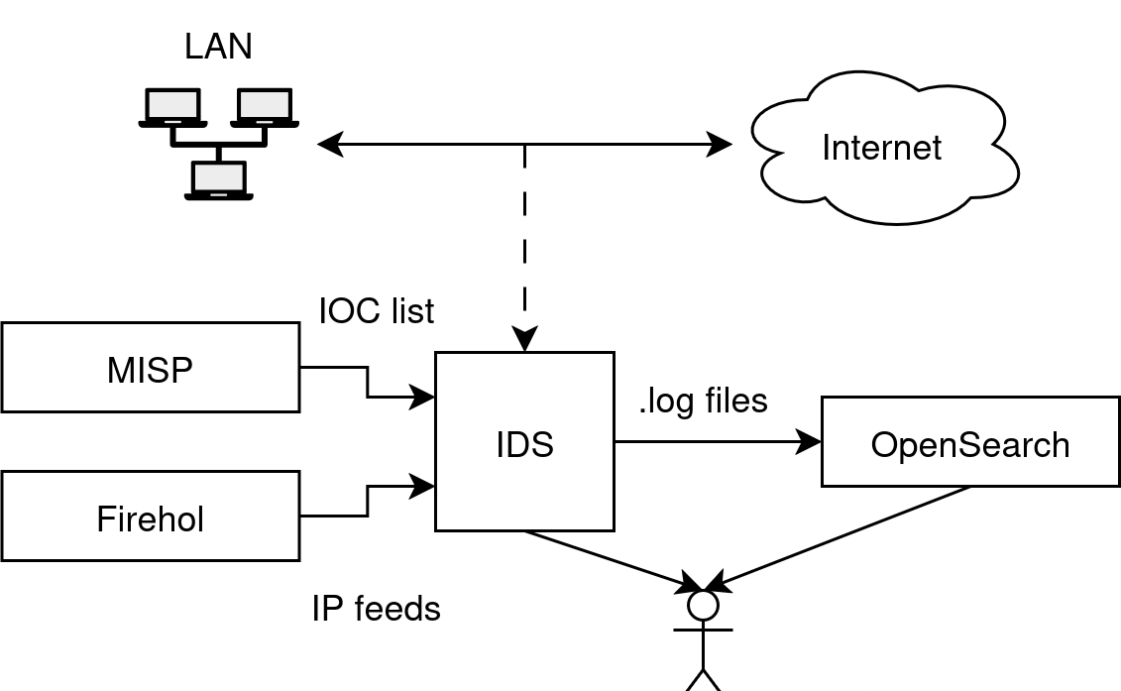
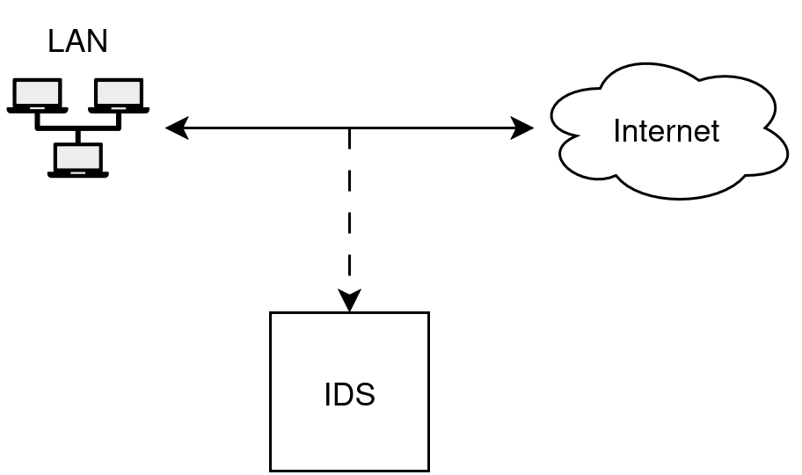
Proposed Architecture

Slide 8
Zeek (Bro)
Passive, open-source, network traffic analyzer
Provides a domain-specific scripting language
Easy to add new rules
Easy to customize and extend existing rules

Slide 9
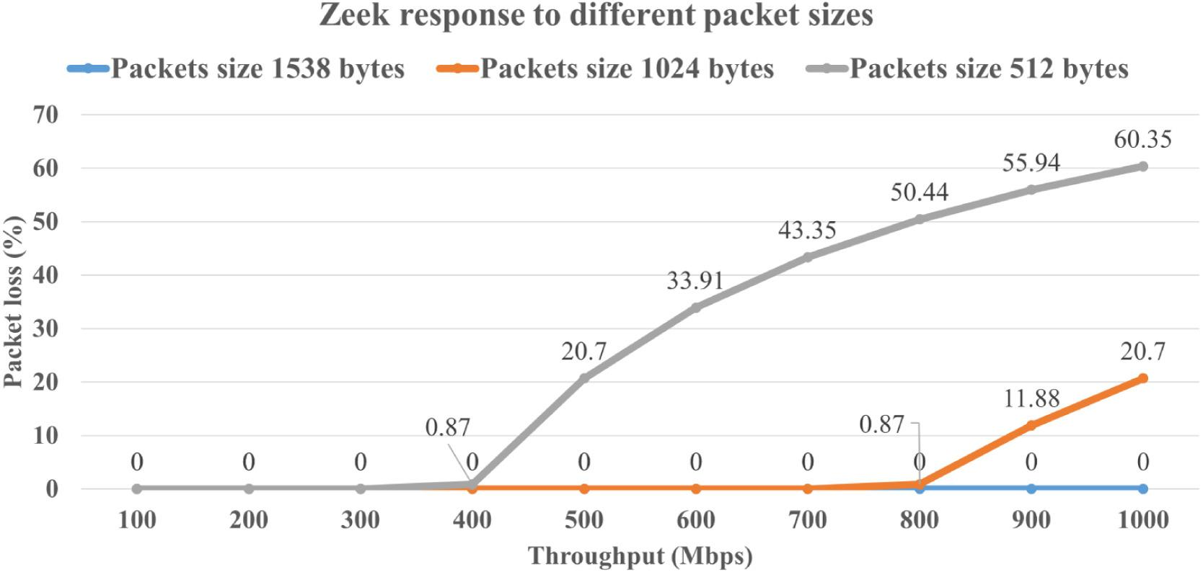
Zeek (Bro) - Performance
4 Cores, 16GB RAM
https://www.sciencedirect.com/science/article/pii/S1389128622002420

Slide 10
Zeek (Bro) - Intrusion Detection
Rule-based
Anomaly-based
Using Zeek’s Intelligence Framework
Rules and signatures from external sources (MISP, Firehol)
Updated every day
Custom scripts
Port scanning, SSH attempts, geolocation anomalies, outgoing traffic from certain servers, etc.

Slide 11
Zeek (Bro) - Intrusion Detection
SSH Bruteforce Detection
Traffic is encrypted, so we have no way of knowing if the attempt is successful or not
Just count all initiated SSH connections, regardless of the result
Is a threshold is reached, issue an alert

Slide 12
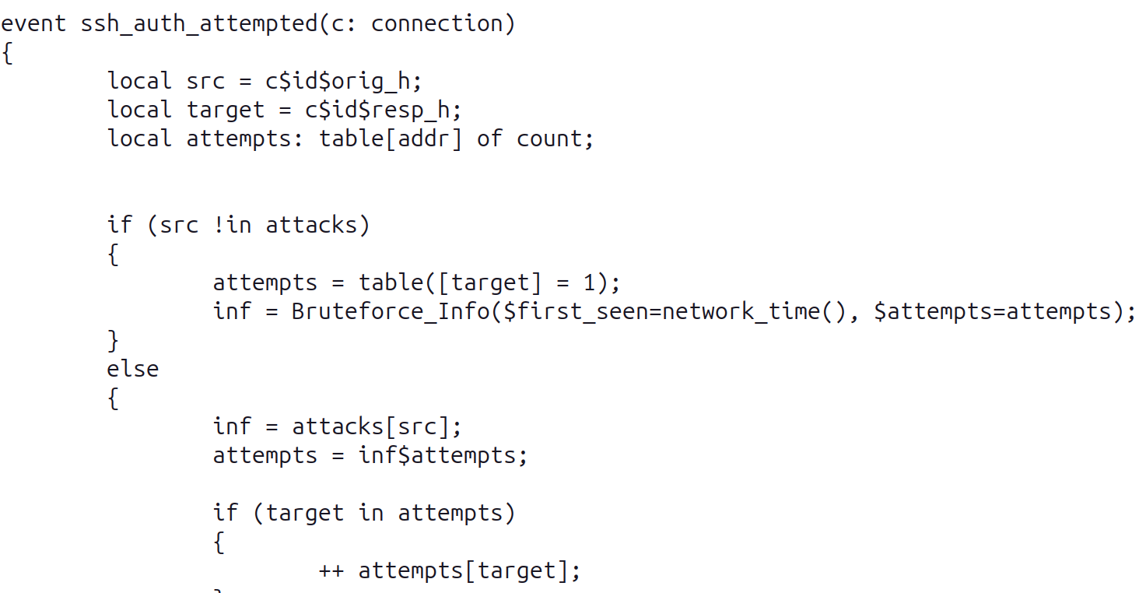
Zeek (Bro) - Intrusion Detection

Slide 13
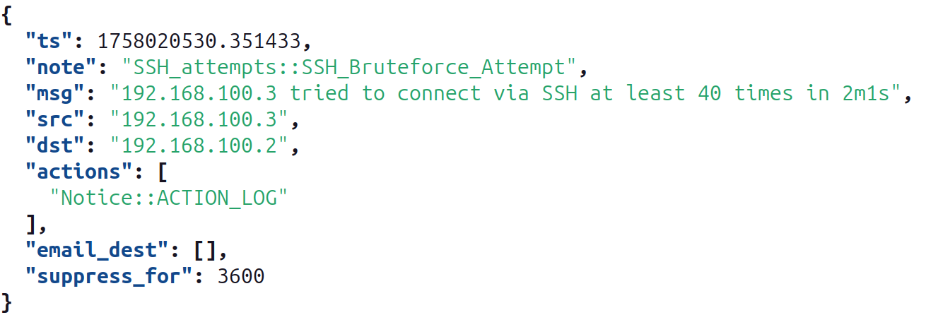
Zeek (Bro) - Intrusion Detection

Slide 14
Zeek (Bro) - Intrusion Detection
Scan Detection
Monitor the number of connections initiated from every host
If the number of unique IP:PORT destinations exceeds a threshold, issue an alert
Threshold and the time until a connection is forgotten are configurable in the main “local.zeek” file.

Slide 15
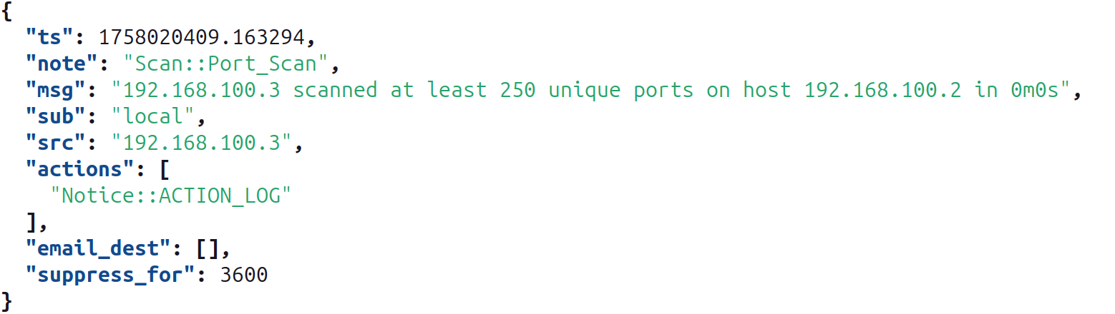
Zeek (Bro) - Intrusion Detection

Slide 16
Zeek (Bro) - Intrusion Detection
Geolocation Anomalies
Set different thresholds for any number of countries/locations
If the number of connections initiated from that location exceeds the limit, issue an alert
Get the location by using the GeoLite2-City database

Slide 17
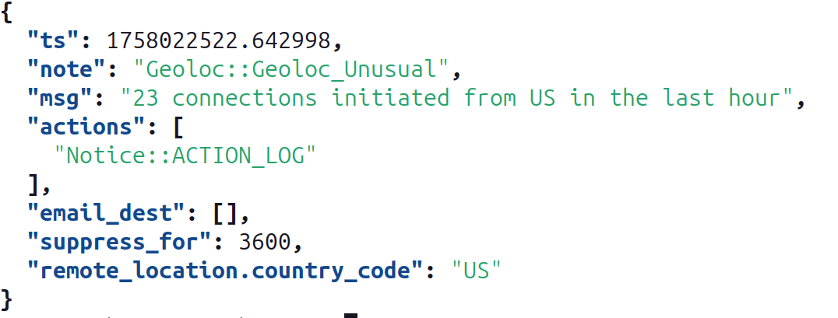
Zeek (Bro) - Intrusion Detection

Slide 18
Zeek (Bro) - Intrusion Detection
Other
Issue an alert when connections are initiated by hosts that should only receive connections
Issue an alert when there are a lot of connections coming from cloud providers networks
Check source IPs on Virustotal (does not scale because of the rate limit)

Slide 19
Zeek (Bro) - Logging
Zeek exports many logs by default
conn.log -> logs every connection
notice.log -> situations detected by the scripts, worth investigating
We send logs to OpenSearch for visualization and aggregation.
Alerts can be sent from both Zeek and OpenSearch

Slide 20
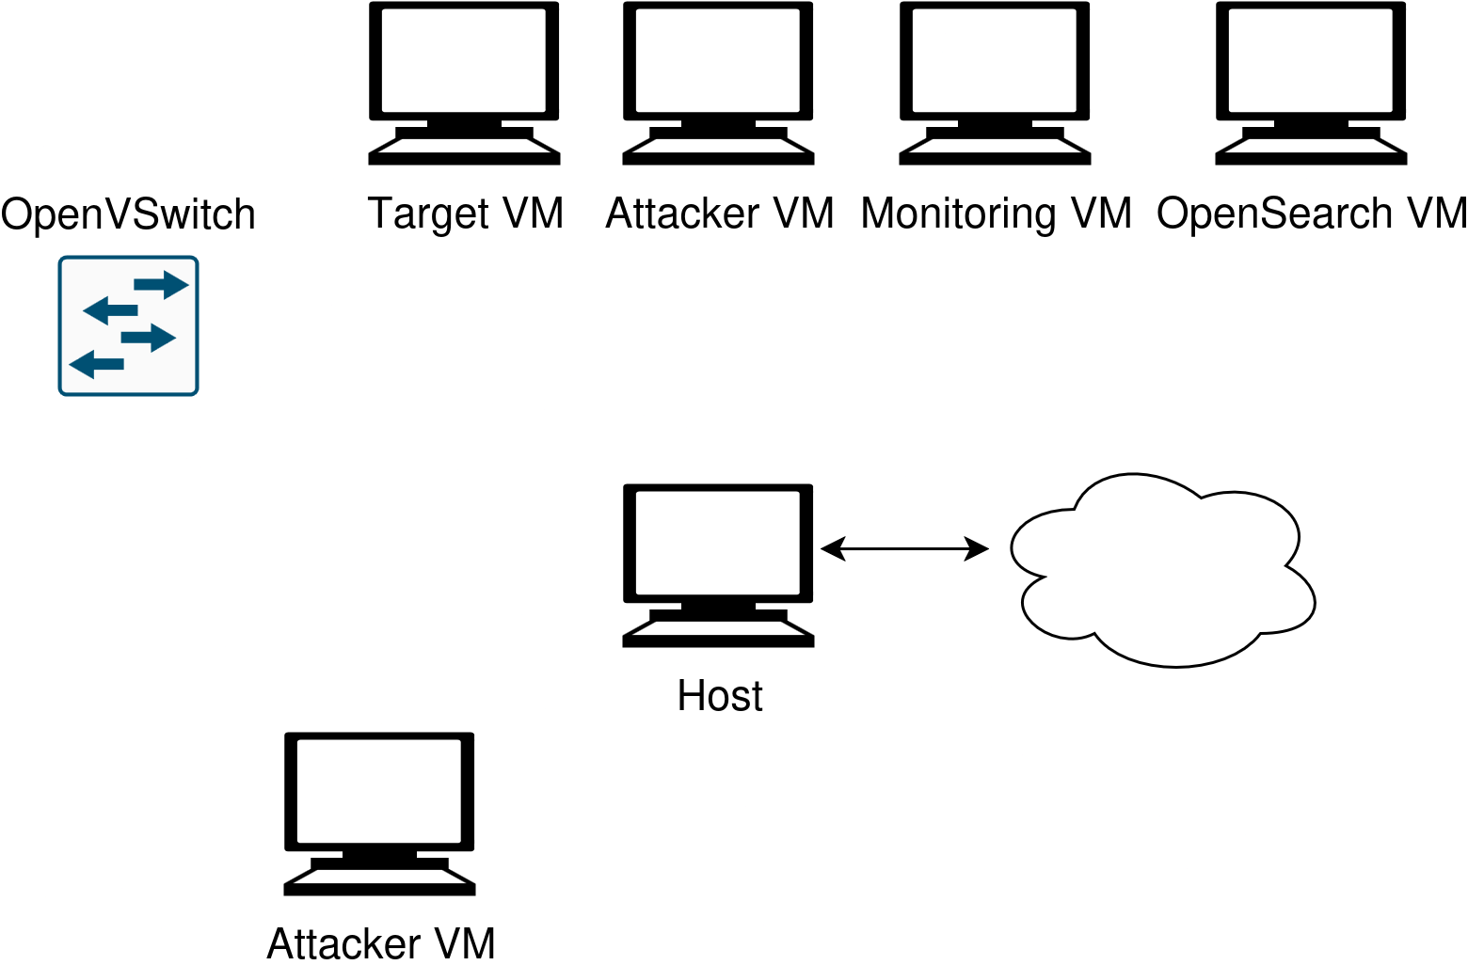
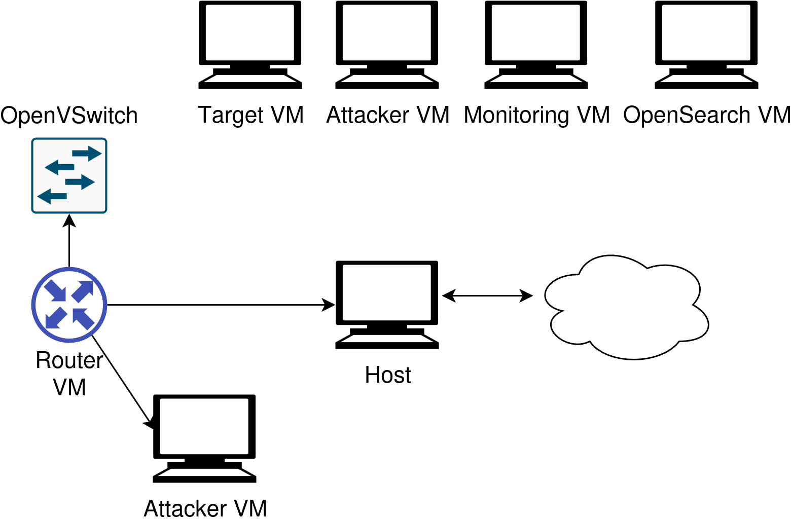
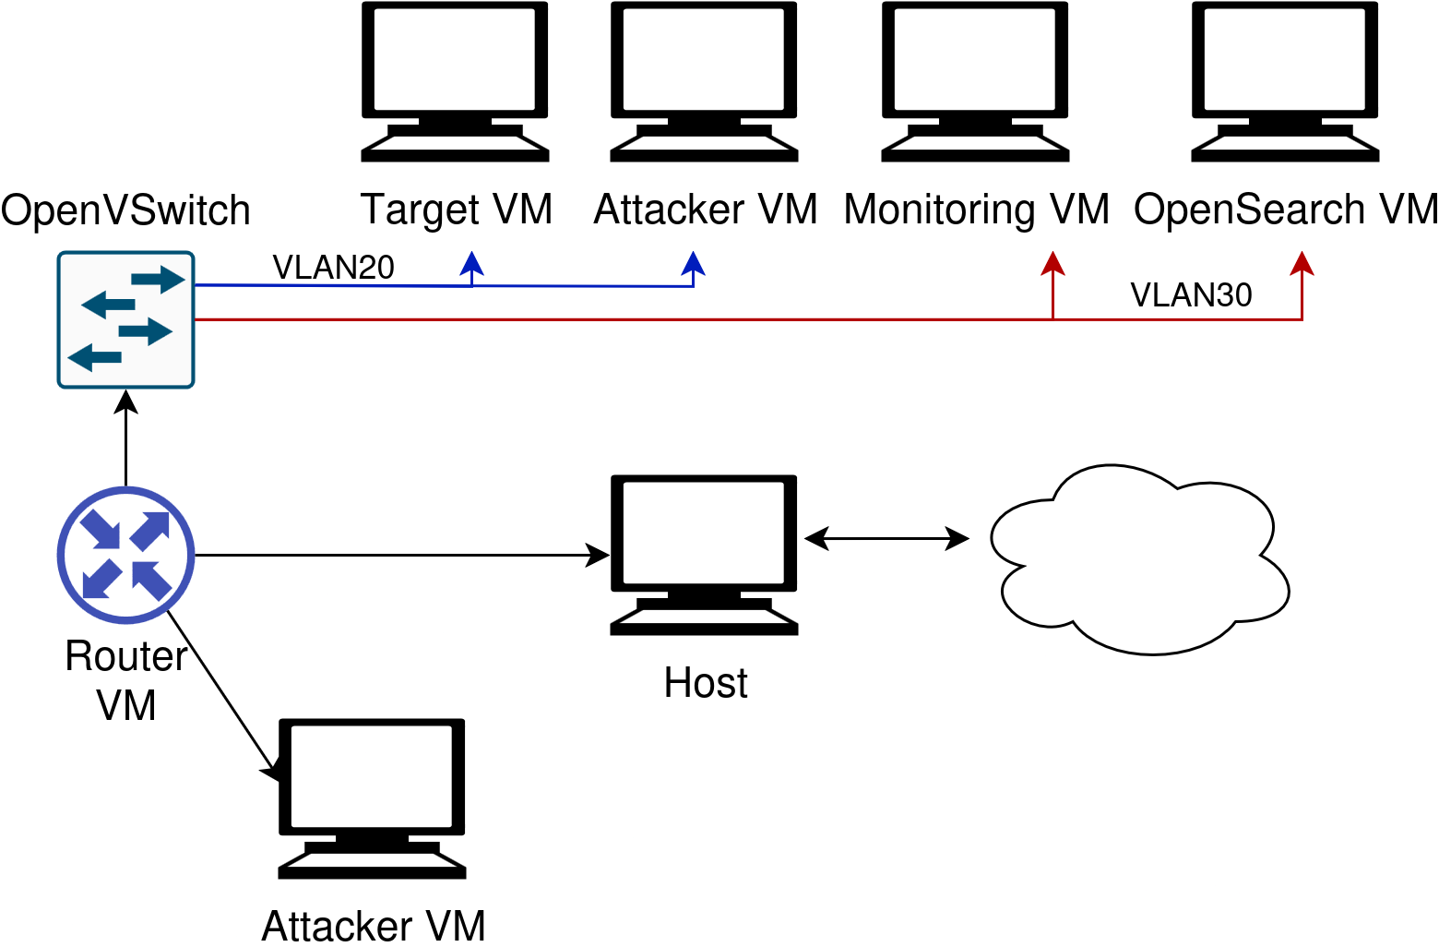
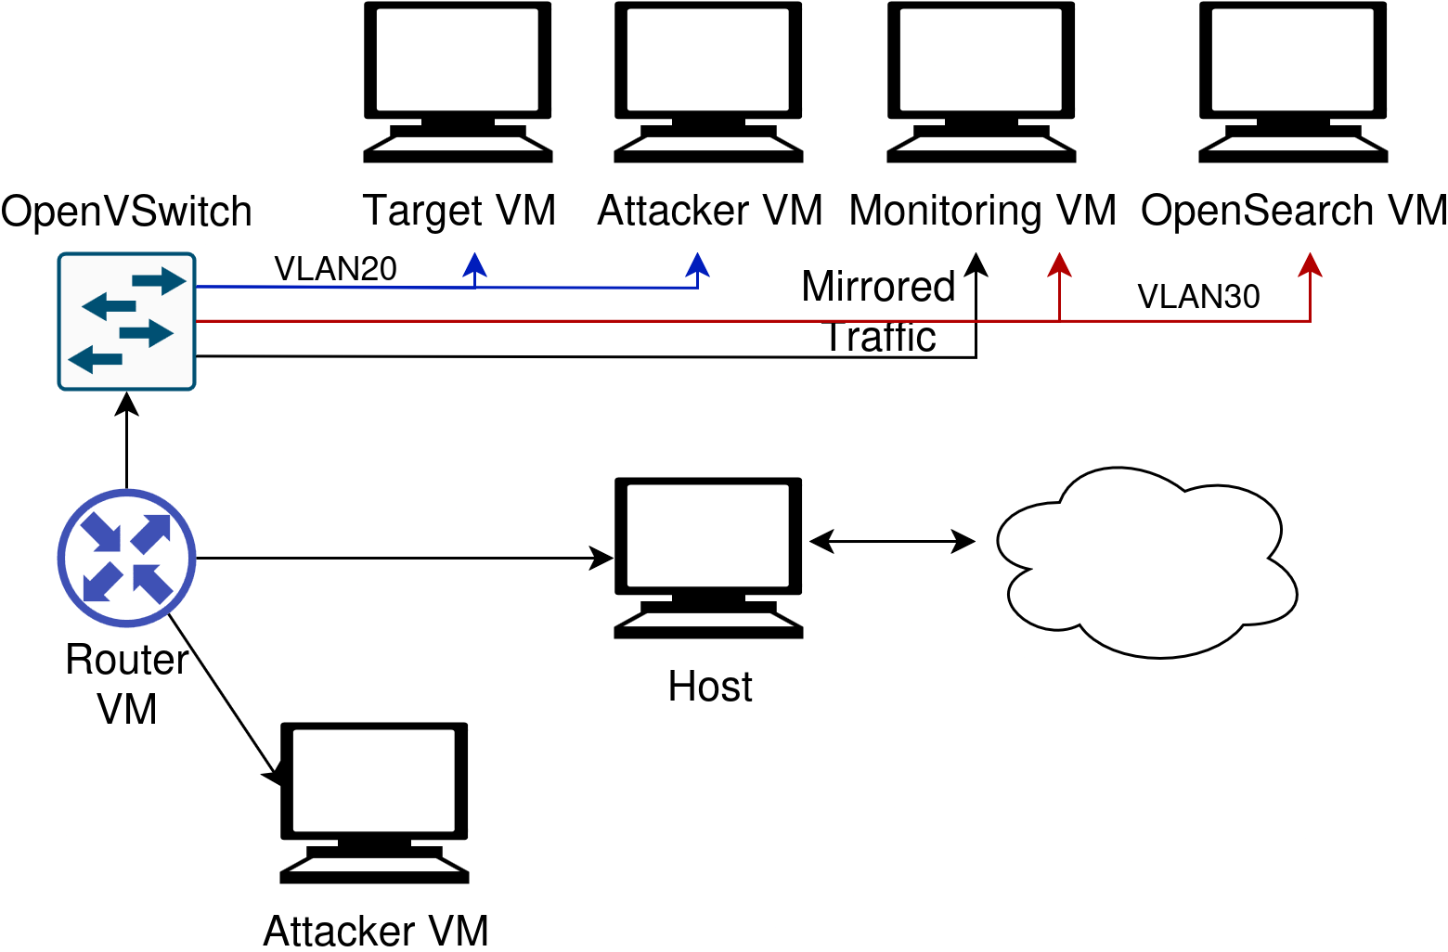
Zeek (Bro) - Testing Architecture

Slide 21
Conclusions
Zeek can use both signature and anomaly based detection
The setup integrates several signature sources (MISP, Firehol) and OpenSearch for log aggregation
Alerts can be generated by Zeek and OpenSearch
More resource intensive than Snort and Suricata, but more flexible
Testing in production still to be done

