Slide 1



Anti‑Plagiarism System for Exam Monitoring
Valentin Pletea-Marinescu
Ștefan-Dan Ciocîrlan
Ge Su
Ștefan-Alexandru Mocanu

Slide 2
Introduction - The Problem
Academic dishonesty through exam cheating has risen
Post-2019 Covid pandemic: rise in exam frauds
Current systems: costly, proprietary, require hardware/privacy compromise
Small institutions can't afford them
Need: open-source, accessible hardware solution

Slide 3
Our Solution
Suspicious gaze detection
Smart cheating devices detection (smartphones, smartwatches)
CPU-only, no GPU
Real-time with optional full recording
Reports with violation timestamps and types

Slide 4
Gaze Detection Method
MediaPipe Face Mesh: 468 landmarks
Horizontal/vertical ratios compute gaze
Kalman filter smooths trajectory
Dynamic thresholds classify gaze directions
Head pose compensation based on yaw and pitch angles

Slide 5
Object Detection
YOLOv8n models fine-tuned for smartphones and smartwatches
Real-time processing on CPUs
Accuracy: 88.6% (smartphones) 92.5% (smartwatches)
Latency < 200ms

Slide 6
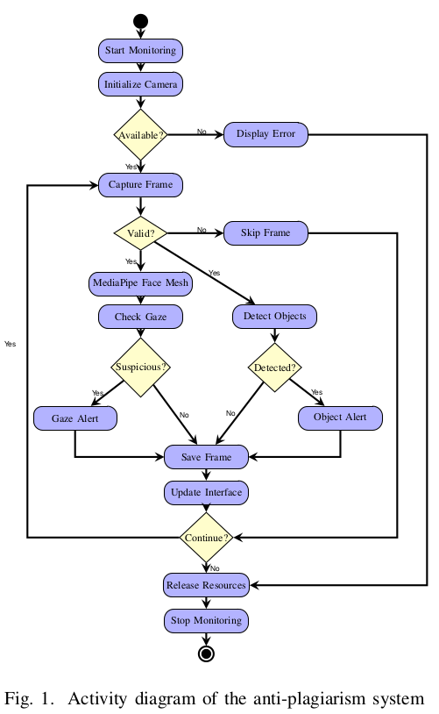
System Architecture
Facial detection 468 landmarks
Gaze analysis abnormal behavior
Object detection dual YOLOv8 models
Violation monitoring fuses gaze + object data
Report generation logs & reports

Slide 7
Implementation Details
Python, OpenCV, MediaPipe, PyQt5, PyTorch
Tested on Ubuntu 22.04/24.04 & Windows 11
Processing rates: Every 3 frames: HR/VR Every 25 frames: dynamic thresholds Every 20 frames: object detection

Slide 8
Evaluation Results
Intel i5-7300HQ 2.5GHz 7.6 GB of RAM
Real-time: 25.3 FPS
Latency: 44.9ms system latency
Memory: 819.6MB
CPU usage: 10% during monitoring
Dataset: 1,600 images, 16 participants
Combined accuracy: 92.4% gaze detection

Slide 9
Key Advantages
Privacy: offline, no cloud
Cost: no extra, runs on CPU
Accessibility: works in schools with limited resources
Performance: 3+ hours continuous use
Max CPU: 27% utilization on Intel i5

Slide 10
Future Work
Expand detection to more unauthorized devices
1
Detect collaborative cheating
2
Integrate audio NLP detection
3

Slide 11
Conclusion
Modular design: MediaPipe Face Mesh + YOLOv8
Real-time performance on standard hardware
Accessible, efficient monitoring for institutions
Supports academic integrity while preserving privacy
Repository: github.com/Pletea-Marinescu-Valentin/sistem-anti-plagiat

